Slide 1
To understand the value & purpose of engaging with a Careers Impact internal leadership review
To understand the process and commitment to engage in a Careers Impact internal leadership review
To gain insight into what to expect from a Careers Impact internal leadership review
To Understand the difference between CIS & QiC
Session Aims

Slide 2
14.00 Welcome
14.05 Intro to ILRs & the CIS.
14.10 Whats the difference - Quality in Careers Standard and Careers Impact System?
14.25 Practitioner’s Perspective
14.35 Next Steps
14.35 Q & A
14.45 Finish
Agenda

Slide 3
What does the Careers Impact System give us?
“A different way of talking about careers & careers leadership: in the realm of overall improvement”
“An opportunity to identify the actions that will create a more sustainable and embedded approach where leadership is distributed and careers is considered to be everyone’s responsibility”
“A strategic focus on the impact and outcomes of careers provision, when the temptation can be to focus on the operational inputs and activities”
Notes:
The system overall provides us with a different way of talking about careers and careers leadership, specifically through the lens of wider school, special school and college improvement
The reviews within the system allow us all to reflect on practice and to identify actions that will create a more sustainable and strategic approach to careers leadership
The reviews give you a safe space to focus on the strategic leadership of careers and to step back from the to-do list to re-calibrate
The structure starts with the maturity model itself so let’s look at this element of the system in more detail

Slide 4
Why?
Careers leadership as a driver for school, special school and college improvement
Impact evaluation with robust and regular monitoring (by SLT and governance) and celebration of success
Allocating relevant resource and distributed leadership of careers (inc SLT)
Strategic approach to planning of careers provision with clearly articulated vision and priorities (link to overall development planning)
Intentionally planned student career learning journeys that are responsive to need and that include clear measurable milestones
Clear vision from leaders with definition of intended impact and identification of relevant success criteria shared with SLT and governance
Notes:
An ambitious and comprehensive vision from leaders that is clearly articulated and measurable and widely shared and understood
A strategic approach to planning for careers with articulated priorities and clear and distributed lines of accountability/robust monitoring of progress by SLT/Govs
Definition of what impact they wanted to see for learners with intentional careers learning journeys that were responsive to need and underpinned by: LOs and progressive learning experiences and encounters
Finally, we also saw robust monitoring of success and impact of this towards school vision and intent for learners as leavers – this was strongest where there was a clear articulation of vision and specific priorities and related learning outcomes
There is a video to follow highlighting the 5 conditions for success

Slide 5
Notes:
In another nod to the quiz – here is a reminder of the 6 themes of the Maturity Model!
This makes the links to the BMs explicit – it is interesting to hover here and think about some of the language we use about BMs - I sometimes hear colleagues talking about ‘going beyond the BMs’ – the BMs are a world class standard that we are supporting all schools, special schools and colleges to meet – the Maturity Model supports us in that work to get underneath the BMs and to really focus on meaningful practice, impact led practice – to focus on the ‘so what’ and to embed practice that is sustainable and strategic and that is aligned to priorities of the schools, special schools and colleges and therefore that is in the improvement fabric of institutions but that is also aligned to measurable positive student outcomes
The maturity model allows us to position careers leadership and the Gatsby BMs in the language of school, special school and college improvement

Slide 6
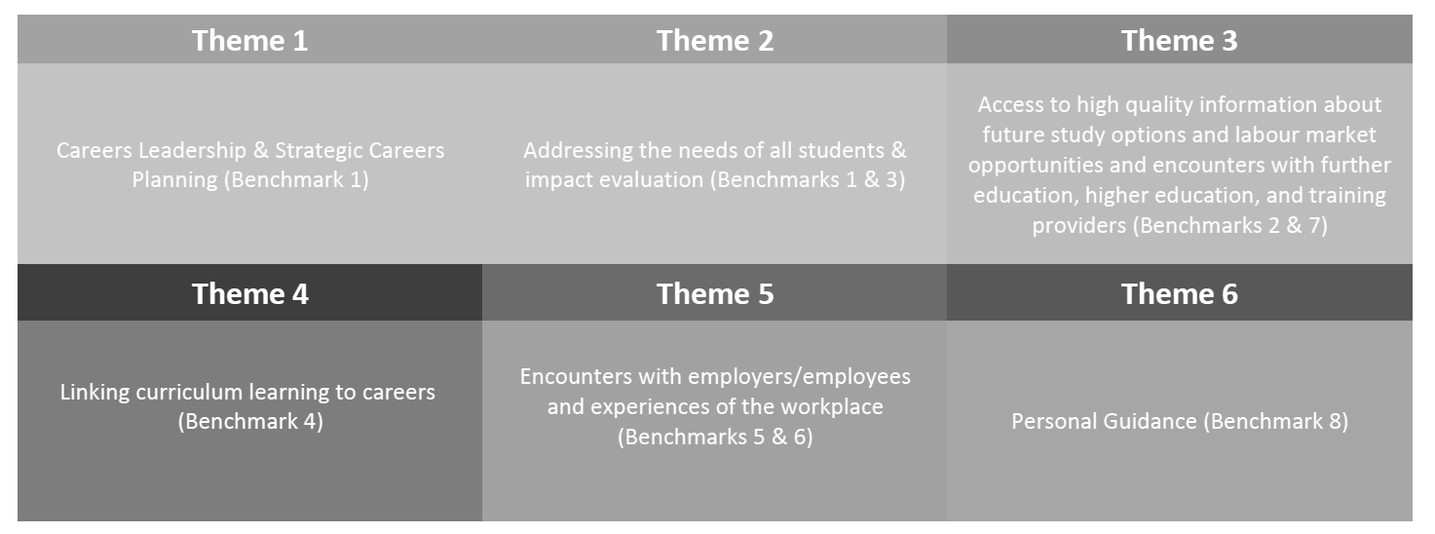
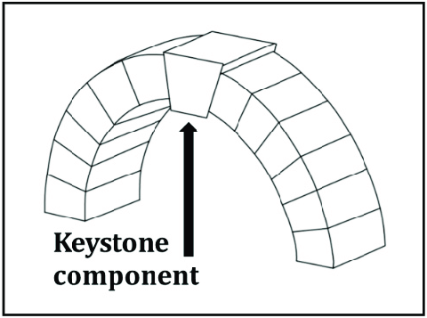
Themes 1 & 2 act as keystone themes
*keystone = the central part of a system, on which all else depends
Notes:
As I alluded to previously – the model is front loaded with the core elements, the conditions of success that embed strategic and sustainable careers leadership – these are focused in Theme 1&2 as keystone themses
You will notice a focus on these keystone themes in both the internal review process and tool and also within the methodology for peer-to-peer

Slide 7
1
2
Represents indicators of intentional provision with conscious decision making, moving towards a more strategic and progressive provision that has elements of continuous improvement
3
Starts to move into a whole school, special school or college approach that is more responsive to data and cohort needs… leading to stability and sustainability of provision
4
Is where careers is a golden thread to school, special school and college improvement...where careers is hardwired as part of the solution to the key strategic priorities of the institution
Generally represents indicators of a standalone provision with ad hoc activity that may of course bring value yet potentially more from happenstance than design
Language of the columns – what do we notice?
Notes:
We resisted calls to label the columns as the process is self-reflective for an institution and is non-judgemental - we however can notice what each column represents
We will focus more on the core elements of Theme 1 & 2 in a moment but the elevations to maturity emerge from core rows of the model that allow institutions to move through maturity from well-meaning but potentially ad hoc practice into more progressive and planned provision through to responsive and sustainable practice that ultimately is threaded through school, special school or college improvement

Slide 8
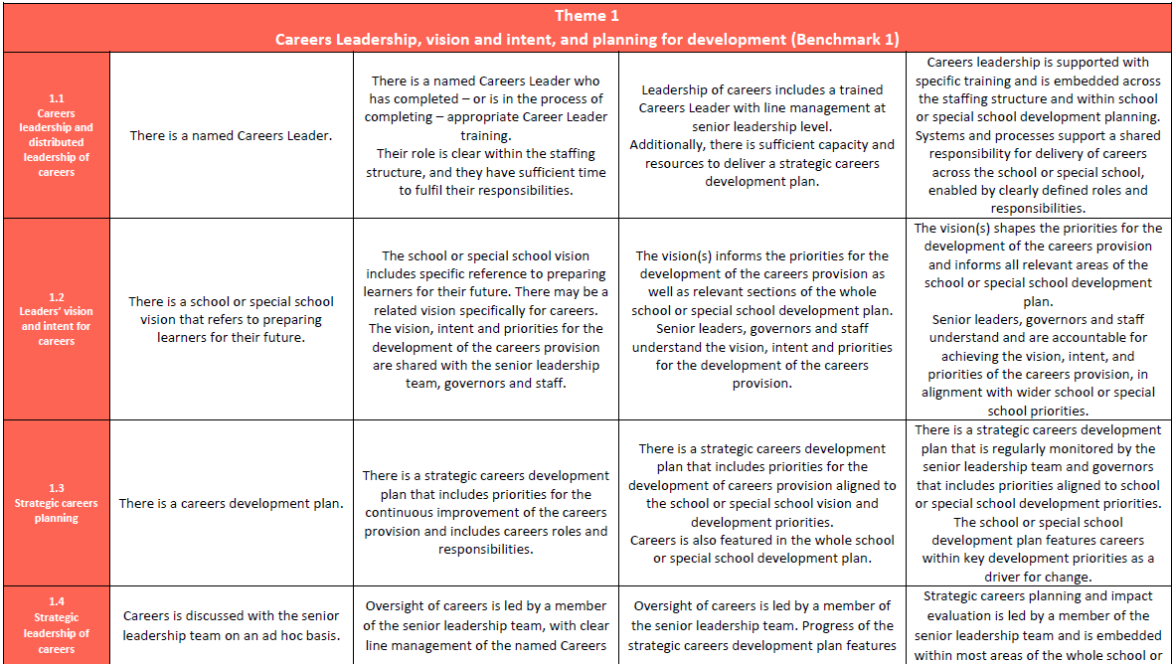
Careers Impact Maturity Model: Layout

Slide 9
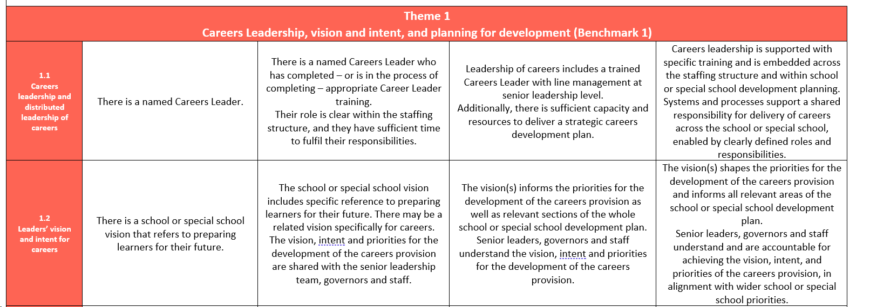
Notes:
This is an excerpt from the maturity model Theme 1 and reflects some of those factors and conditions for success
Straight away you can see the description of practice and articulation of what good looks like and straight away I bet you are already plotting some of your caseload on this…this is how the internal leadership review came into being ☺
This process of reflection has always been step 1 of a p2p review – within that process it was referred to as self-evaluation part B, which is not a very catchy title and is also a mis-representation about the process.
Before a p2p review schools, special schools and colleges were asked to RAG rate themselves on this document with key SLT colleagues and with sign off from the Head
We found that this stage of the process really started the process of continuous improvement and started to spark lightbulb moment before the review had even happened – this is what prompted u to look more closely at this first step of a P2P review and to test it as a review in its own right for that is exactly what it is!
When we started to reflect on how institutions had approach the internal leadership review we noticed that there was a real difference in the maturity of different approaches and that this was okay! I will move non to some of the detail from theguidance that accompanies the internal leadership reviews in a moment and you could almost plot them in the columns of the maturity model!

Slide 10
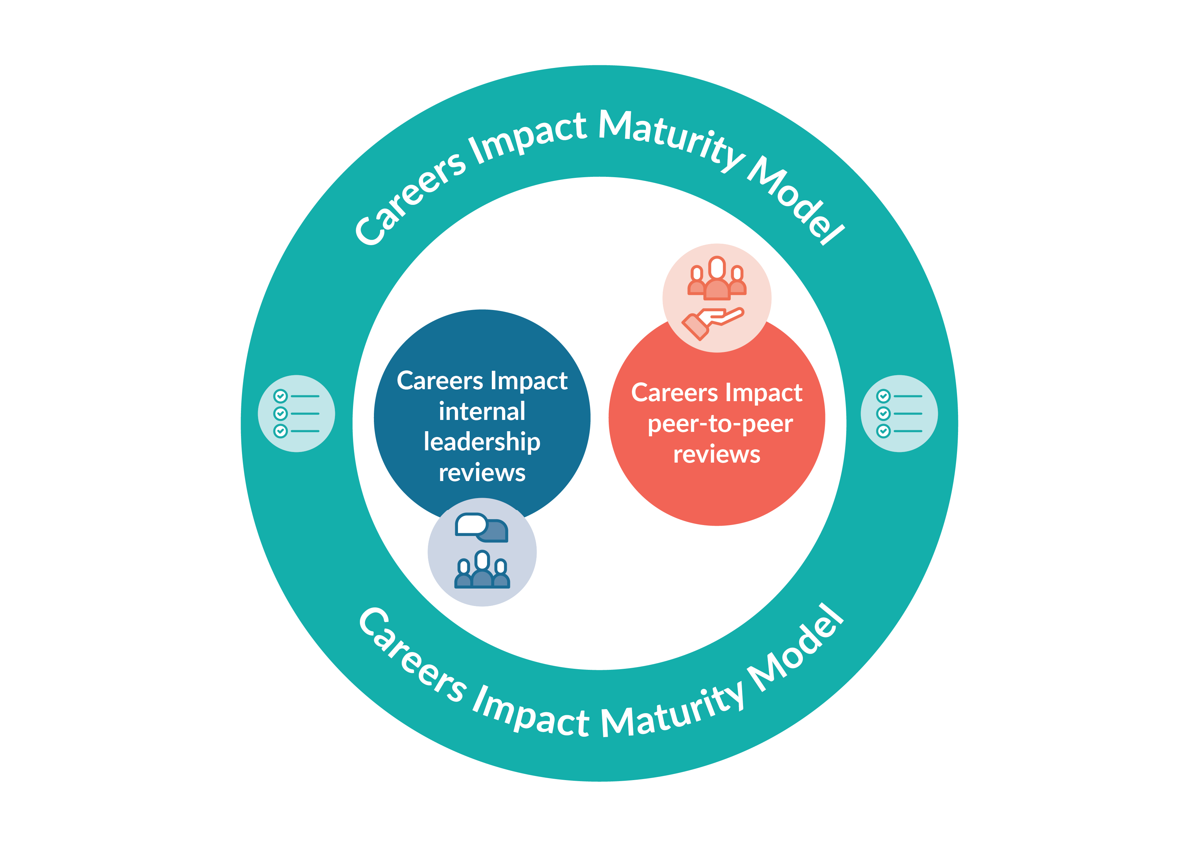
Internal leadership reviews
Convene
All those involved in the distributed leadership of careers should be involved in the review process
Agree
The review involves colleagues reflecting on which statements in the Maturity Model best describe the practice their institution
Record
The digital feature allows institutions to record the responses collaboratively agreed during an institution’s internal review. Colleagues will have access to a summary of institution's insights, showing a snapshot of indicated areas of strength and priority action areas
Act
Institution identification of highest leverage actions to drive school, special school or college improvement and to support improved student outcomes
Careers Impact
Self-evaluation tool
Notes:
They are deliberately named: these are internal to the institution AND they are to engage all those involved in distributed leadership of careers, including education leaders
Ambition that every school, special school and college undertakes a careers impact internal leadership review annually within their impact evaluation process
The key steps to a review are highlighted on this slide
All those involved in distributed leadership of careers within an institution should convene in the review process
Those convened then consider the maturity model and agree the best ft statements on each line that describes practice in their institutions
We then encourage colleagues to return to the digital tool to record their responses – crucial that this lands as an offline review/discussion process where responses are recorded online through compass/Compass+
The digital functionality allows institutions to see data visualisations of their strengths and areas for focus and recommendations for improvement
The data that institutions see will inform next steps and action planning
The engagement collateral folder will include an overview doc of internal leadership review value, purpose and process. There is also an animation in train that should be ready for September

Slide 11
Quality Assuring Careers
John Ambrose
Director, Complete-Careers LLP
john.ambrose@complete-careers.com

Slide 12
Session outline
Components to quality assure your careers programme
Comparing the Careers Impact System and the Quality in Careers Standard
Introducing the Quality in Careers Standard through the Career Mark approach

Slide 13
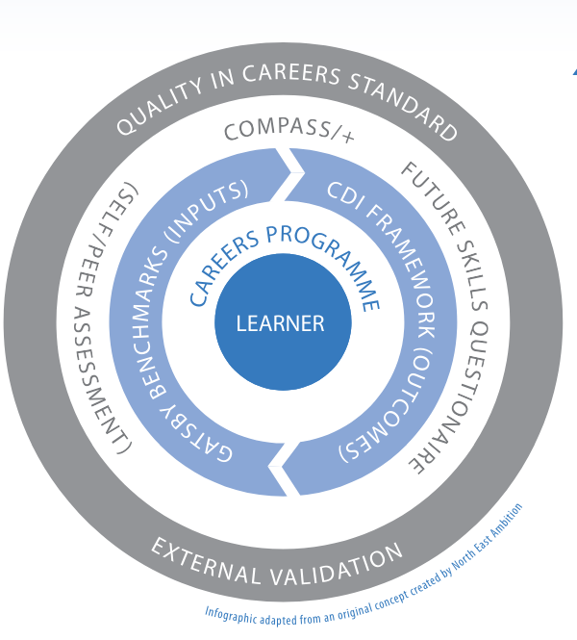
Careers Circle
Careers Guidance
Career Management Skills
Career Readiness

Slide 14
Careers Impact System and Quality in Careers Standard – What is the difference?

Slide 15
Quality in Careers and Careers Impact System
CIS provides the opportunity to benchmark your Internal Leadership Review with local and national averages
CIS provides the opportunity for peer-to-peer and trust to trust facilitated discussion
CIS is developmental, Quality in Careers is developmental and judgemental
Quality in Careers will require evidence to be submitted to scrutiny against the national criteria
Quality in Careers will involve a detailed individual report with recommendations/requirements to work on between assessments
Quality in Careers assessment will include focus group sessions with learners to triangulate feedback of impact
Successful assessment will result in a award with certification, plaque and national registration, as well as the opportunity to celebrate with shareholders.
Basically, it isn’t either or… it is clearly both!

Slide 16
CEC on Quality In Careers Standard
“Since the DfE 'strongly recommends all schools and colleges' to work towards achieving the Quality in Careers Standard, the Department hopes that engagement in any element of the Careers Impact System will encourage more schools, special schools and colleges to consider working towards the Standard by increasing their confidence to seek external assessment.”

Slide 17
What is the Quality in
Careers Standard?

Slide 18
Structure of Career Mark approach
There are two stages to assessment:
Stage 1
Portfolio assessment - the portfolio is assessed against the 4 delivery standards and the evidence supplied. This is a desk top exercise by one of our assessors. Successful completion leads on to stage 2.
Stage 2
Assessment day - The assessor will assess the learner’s knowledge based on the evidence in a school’s portfolio. This is usually done by seeing a selection of students from each year group

Slide 19
Structure of Career Mark approach
Four delivery measures
Management : measures the effectiveness of systems for planning, managing and integrating CEIAG
Advice and Guidance: measures the effectiveness of an integrated programme of advice, guidance and support
Information : measures the accessibility, relevance, importance and effectiveness of information, the acquisition of skills to research and evaluate to be able to make well informed and realistic career decisions
Career Learning: measures how effectively the curriculum supports the development of learners’ knowledge, skills, understanding and attitudes

Slide 20
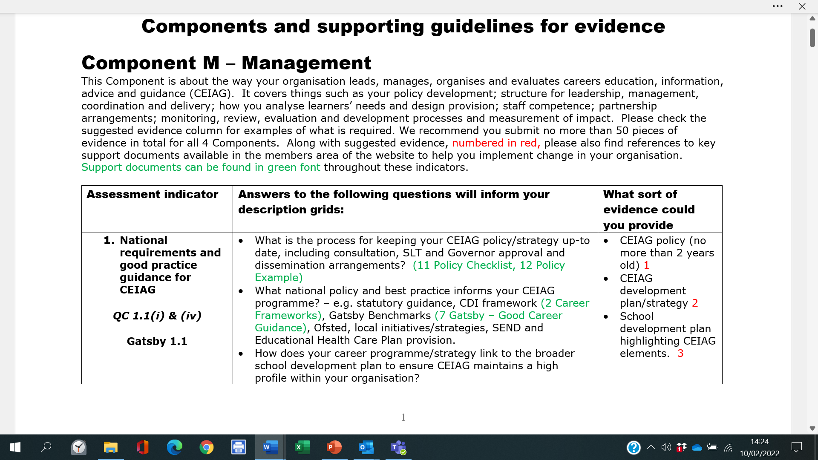

Slide 21
Thank you for listening
john.ambrose@complete-careers.com

Slide 22
A Practitioners Perspective
Jo Saward
Trust Lead for Careers & Employability Creative Education Trust
Notes:
This is the main page for internal leadership reviews via resource directory – there are also a plethora of guidance and help centre articles to support colleagues in the process
Your schools can get started on this today
Find out more: Careers Impact Internal Leadership Review | CEC Resource Directory (careersandenterprise.co.uk)
Following this session, you will receive a copy of these slides, a link to an animation, an engagement deckyou can deliver to your CLs and pdf of an overview briefing about the reviews that you can share vai email with Careers and Education Leaders

Slide 23
Visit our Resource Directory to get started with the Careers Impact internal leadership review
Notes:
This is the main page for internal leadership reviews via resource directory – there are also a plethora of guidance and help centre articles to support colleagues in the process
Your schools can get started on this today
Find out more: Careers Impact Internal Leadership Review | CEC Resource Directory (careersandenterprise.co.uk)
Following this session, you will receive a copy of these slides, a link to an animation, an engagement deckyou can deliver to your CLs and pdf of an overview briefing about the reviews that you can share vai email with Careers and Education Leaders

Slide 24
Questions

Slide 25
The review involves colleagues reflecting on which statements in the Maturity Model best describe the practice their institution. ​
They should consider the statements and the responses which indicate progressive maturity within each of the six themes. ​
Colleagues should do this ahead of coming together to discuss and agree a final response for each statement that represents their institution. ​
What does an internal leadership review involve?
Notes:
As I referenced earlier – the whole process is underpinned by the maturity model and includes colleagues reflecting on each row to decide their best fit
Consider for a moment how you imagine colleagues would convene to do to agree the best fit responses?

Slide 26
Approaches to completing an internal leadership review
1. HT Confirmation of CL View
3. Governor Collaboration
“As the Careers Leader, I completed the process and then met with the Headteacher to discuss this.
Where there was a difference of opinion, I was able to explain my judgement and we discussed and were then able to agree on the ‘best-fit’ response.”
“A core group of us met together (Careers Leader, Trust Central Strategic Careers Leader, Careers Link Governor) and we agreed the ‘best-fit’ statements through discussion and debate, with elements requiring us to refer to evidence to justify our decisions with each other. These were then signed off by the headteacher.”
2. SLT Collaboration
4. Collaboration and SLT Confirmation
“We initially completed the self-evaluation process as a team of two (CL and SLT CL).
We then discussed with the wider Senior Leadership team which has helped to raise the profile of careers and gain further buy-in from the Headteacher and SLT.”
“We took a 3-stage approach to complete and QA the process”
Review by Careers Team (CL and SLT CL)
Feedback on our responses from wider SLT, including SENCo
Final agreement by Headteacher and SLT Careers Leader of best-fit responses
Notes:
How do these match with the ideas that you had in your head?
What do you notice and what reflections do you have?
You will notice that this activity is offline ☺

Slide 27
The digital feature allows colleagues to record the responses collaboratively agreed during the institution's internal leadership review. ​
There is will instant access to a summary of the institution's insights, including a graphic showing a snapshot of the institution’s indicated areas of strengths and priority action areas​
These can be shared
The digital feature also signposts to support and resources for each theme area to drive continuous improvement​
Recording your responses
Notes:
This makes the digital feature unique amongst our suite of tools as the main action is conducted online
Colleagues go online to access the guidance and download the maturity model and then convene with colleagues to agree their best fit
The usp of returning to record responses are the data visualisations and the signposting – which is primarily to the CL and wider workforce CPD offer

Slide 28
How to record your internal leadership review
In evaluations, go to internal leadership review, click
You will require @30 minutes to record your responses
You will be prompted to record who took part in your internal leadership review
Notes:
The RECORD stage is facilitated by a new feature in Compass and Compass+ available to all from September 24.
You should have already convened as a group and agreed the responses. You have most likely downloaded the digital version from Compass+ to complete by hand. However, having a digital version means you can see progress year on year. Within the tool are also recommendations for action, highlighting areas to focus upon.
In addition, the Help Centre articles support users through every step of the process, including providing examples of how pilot institutions effectively carried out the CONVENE/AGREE stage, and how to get the most out of the new digital functionality.

Slide 29
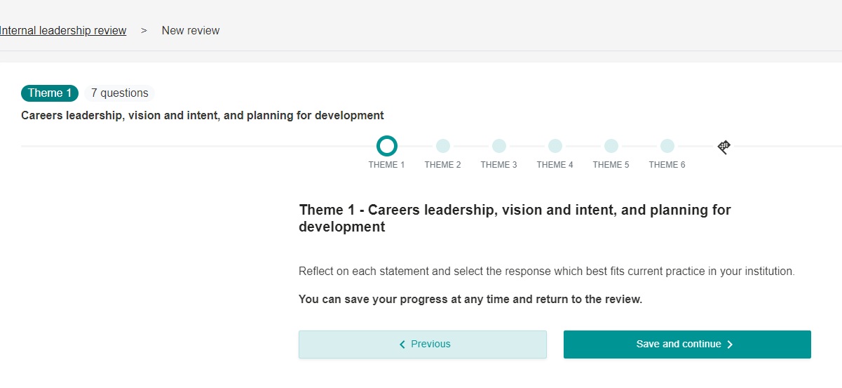
How to record your internal leadership review
Each theme will take you through a series of questions and you can track progress.
You can save and continue, or close and return to the document later.
Copy the results from your paper version
Any in progress or completed reviews will appear on your leadership review dashboard
Notes:
The RECORD stage is facilitated by a new feature in Compass and Compass+ available to all from September 24.
You should have already convened as a group and agreed the responses. You have most likely downloaded the digital version form Compass+ to complete by hand. However, having a digital version means you can see progress year on year. Within the tool are also recommendations for action, highlighting areas to focus upon.
In addition, the Help Centre articles support users through every step of the process, including providing examples of how pilot institutions effectively carried out the CONVENE/AGREE stage, and how to get the most out of the new digital functionality.

Slide 30
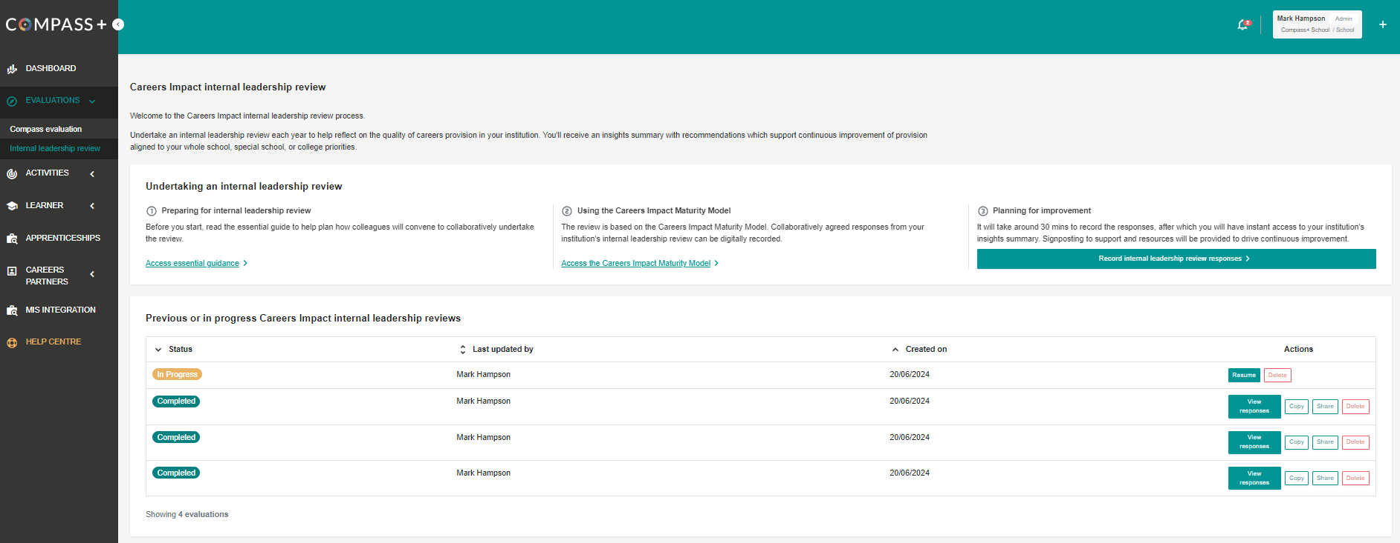
How to record your internal leadership review
Notes:
You can see a screenshot here of what your leadership review dashboard will look like once a few reviews are completed. This will take Careers leaders a couple of years to get to this stage of multiple reviews.
There is the option in tool to compare progress from one to the next which I’ll show you

Slide 31
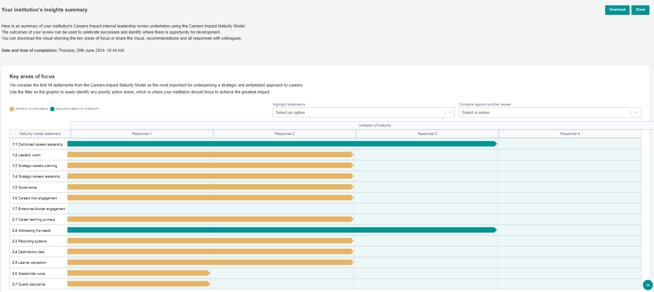
How to record your internal leadership review
Notes:
Once completed you can view your responses to themes 1 and 2.
You can download them into a single pdf or share via email with key stakeholders.

Slide 32
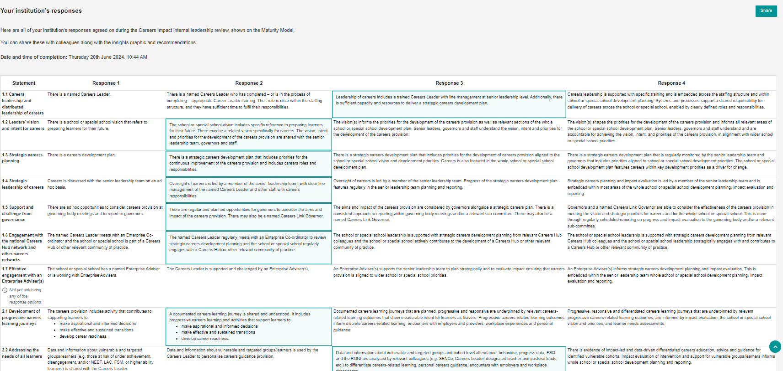
How to record your internal leadership review
Notes:
You can view all responses and share this as you wish

Slide 33
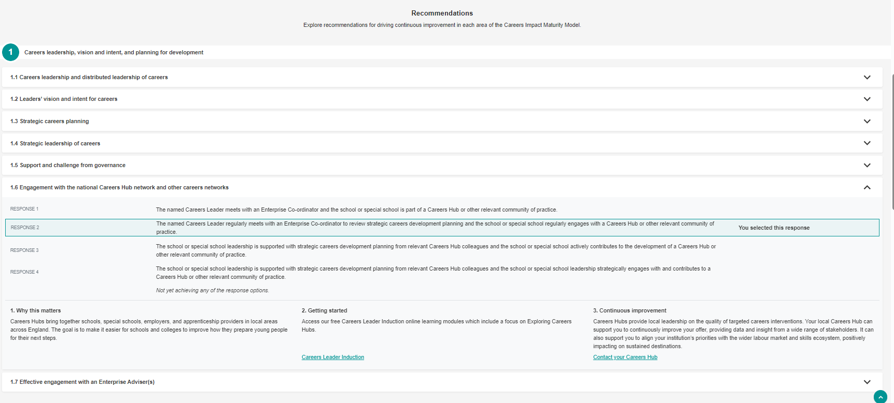
How to record your internal leadership review
Notes:
You can view recommendations too be selecting any statement

Slide 34
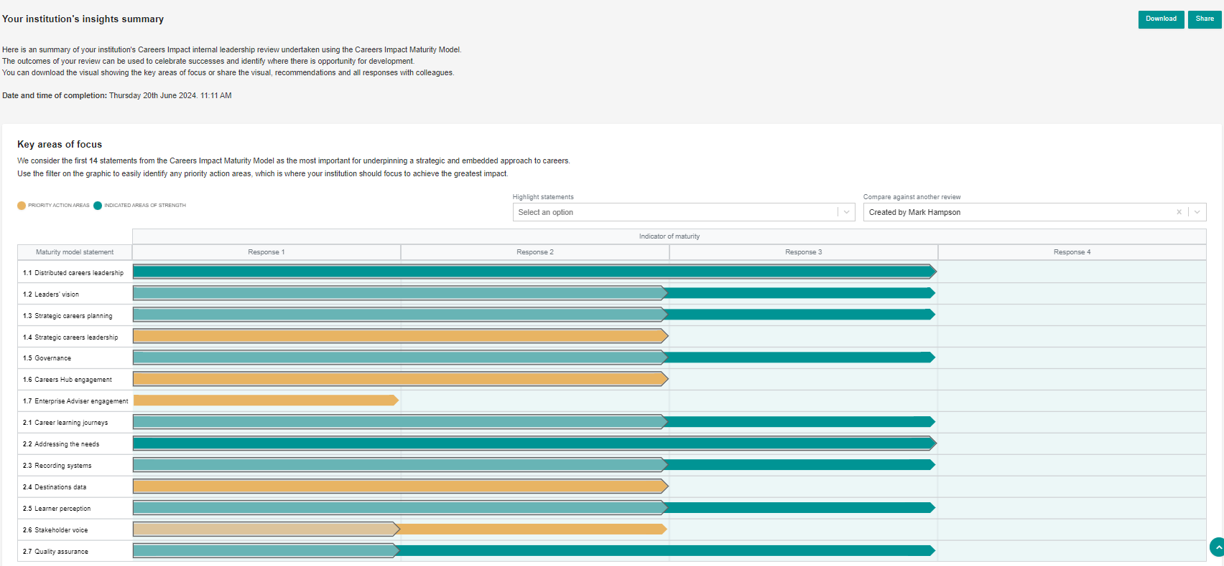
How to record your internal leadership review
Notes:
Once you have completed two or more internal leadership reviews (usually only completed at least annually) you can compare progress made. This is helpful to share with SLT/Governors and use to report success.

Slide 35
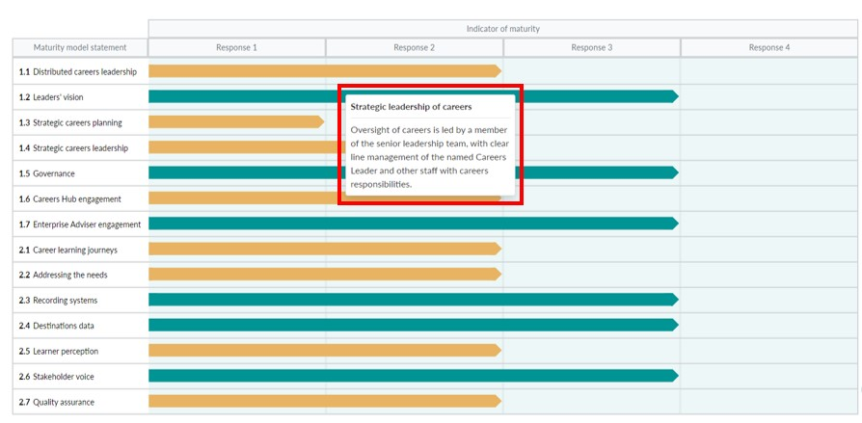
Internal leadership reviews:
Recording responses and gaining insight via Compass & Compass+ (from Sept 24)
Support from Help Centre articles on how to prepare for an internal leadership review, how to complete the process using the digital feature and how to find your institution’s responses and recommended actions.
Compass+ Help Centre
Compass Help Centre (by institution type)
Notes:
The RECORD stage is facilitated by a new feature in Compass and Compass+ available to all from September 24.
Digital version of the maturity model so once an institution has CONVENED and AGREED, a representative is ready to use the feature to record their responses so they have central record and can see progress year on year. It also sets them up for the final stage, ACT, by providing them with recommended actions, highlighting areas to focus on. Key recommended actions include CLT training, and other modules on the Digital Hub for educators, plus content such as My Learning, My Future and Talking Futures.
The Help Centre articles support users through every step of the process, including providing examples of how pilot institutions effectively carried out the CONVENE/AGREE stage, and how to get the most out of the new digital functionality.

Slide 36
Visit our Resource Directory to get started with the Careers Impact internal leadership review
For support & further guidance contact your Careers Consultant
Notes:
This is the main page for internal leadership reviews via resource directory – there are also a plethora of guidance and help centre articles to support colleagues in the process
Your schools can get started on this today
Find out more: Careers Impact Internal Leadership Review | CEC Resource Directory (careersandenterprise.co.uk)
Following this session, you will receive a copy of these slides, a link to an animation, an engagement deckyou can deliver to your CLs and pdf of an overview briefing about the reviews that you can share vai email with Careers and Education Leaders

