Slide 1
To understand the value & purpose of engaging with Parents & Carers
To understand the tools, resources and CPD that can support you with this
To gain insight into examples of local good practice engaging with Parents & Carers
Please add name, school/college and rate how much you know out of 5 for each of the objectives in the chat (we will do this again at the end)
25/02/25
Parental Engagement
Session Aims

Slide 2
14.00 Welcome
14.05 Parental engagement and Link to Gatsby 10
14.15 SMCH - funded parent & carer survey
14.20 CPD, Tools and resources
14.30 Examples of good practice
Wootton Park School
Vandyke
BA
14.40 Q & A
14.45 Finish
Agenda

Slide 3
Five prominent themes emerged from the evidence used during the review of the benchmarks:
Careers at the heart of education and leadership
Inclusion and impact for each and every young person
Meaningful and varied encounters and experiences
Focusing on the use of information and data
Engagement of parents and carers

Slide 4
ENGAGEMENT OF PARENTS AND CARERS
Parents and carers continue to play a significant role in the decision-making of their children, but they often struggle to feel confident or knowledgeable enough to fully embrace this role. Many rely on their own personal experiences or the knowledge of their social networks. It is crucial that young people receive consistent guidance about their future choices from both their educational institution and their home.
To address this, the benchmarks have been updated to strengthen the relationship between careers programs and parents and carers. Engagement with parents and carers is now included in Benchmark 1 as part of the strategic planning of careers programs.
Throughout the framework, there is an emphasis on not only sharing information about education and career options with parents and carers but also supporting them in accessing and utilizing this information in conversations with their children.

Slide 5
BM1
Added the need to use feedback from careers advisers and other staff who support young people as well as from young people, parents and carers, and employers.
Added a new criterion that careers programmes should set out how parents and carers will be engaged throughout
Retained the requirement for online publication of the careers programme but clarify that it should also be communicated in ways that enable young people, parents and carers, staff and employers to access and understand it.
BM2
Added that parents and carers should be encouraged and supported to access and use information about careers, pathways and the labour market to inform their support to their children.
Benchmark 2 now specifies that young people with SEND and their parents and carers may require different or additional information.
BM8
Benchmark 8 has been updated to state that information about personal guidance support and how to access it should be communicated to young people and parents and carers, including through the institution’s website.

Slide 6
Parent & Carers Survey
Hub funded parental survey
In partnership with Amazing Apprenticeships
Impactful questions to help you plan for implementation of Gatsby 10
Data collection link prepared for you to distribute to parents
Questions to help prep for implementation of Gatsby 10
Also questions to support understanding of pot-16 routes & help schools plan PE events/content in response

Slide 7
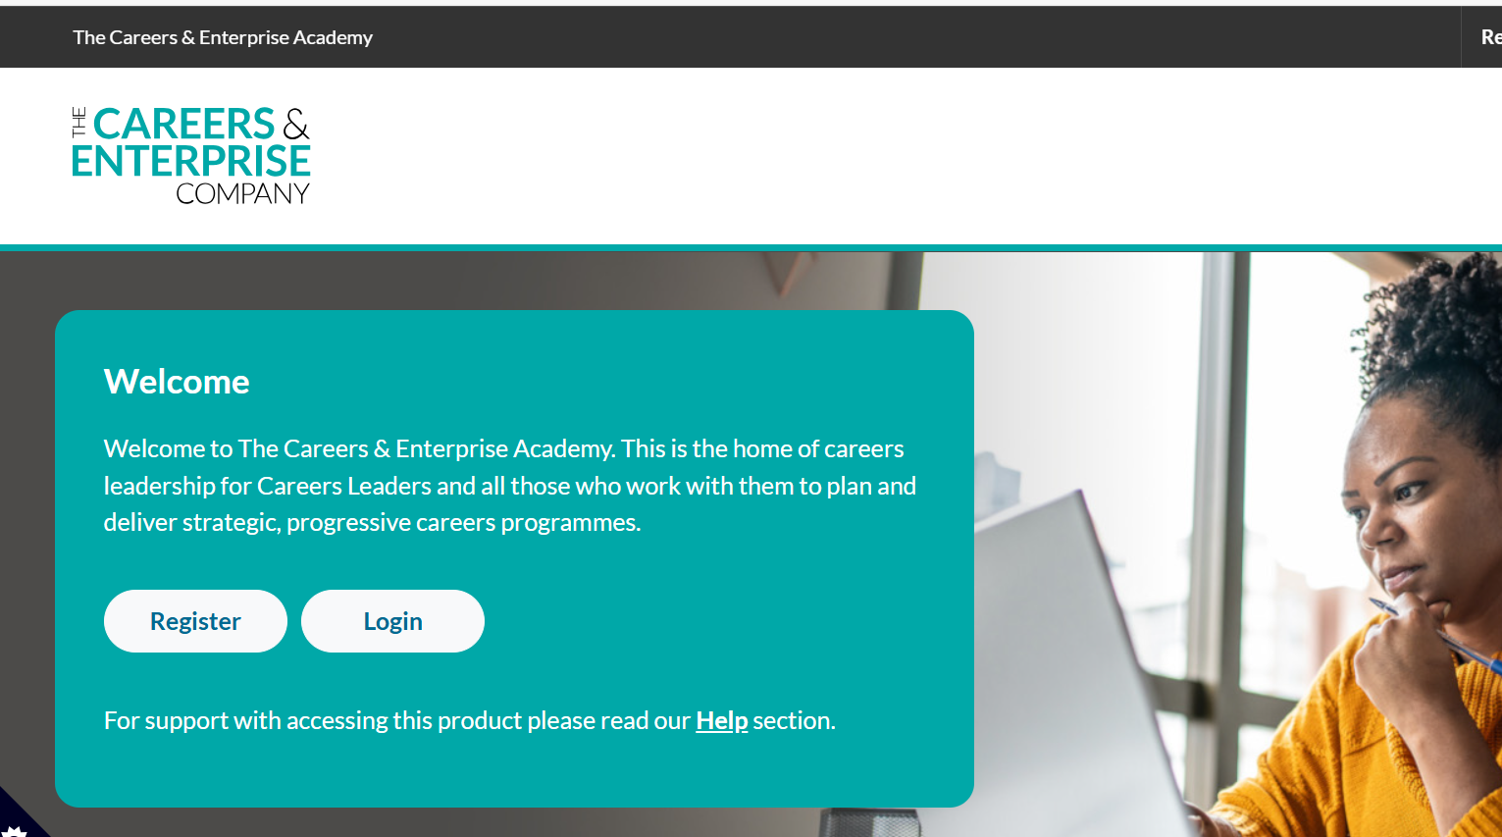
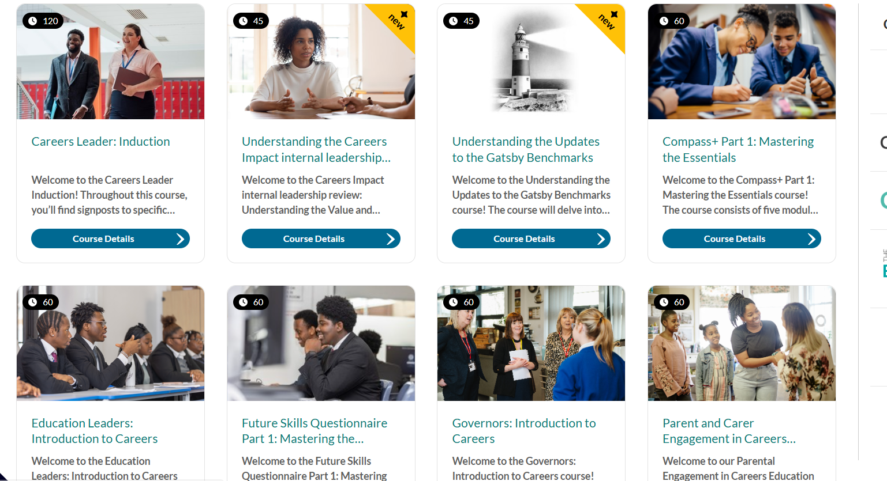
Careers & Enterprise Academy
Notes:
This is the main page for internal leadership reviews via resource directory – there are also a plethora of guidance and help centre articles to support colleagues in the process
Your schools can get started on this today
Find out more: Careers Impact Internal Leadership Review | CEC Resource Directory (careersandenterprise.co.uk)
Following this session, you will receive a copy of these slides, a link to an animation, an engagement deckyou can deliver to your CLs and pdf of an overview briefing about the reviews that you can share vai email with Careers and Education Leaders

Slide 8
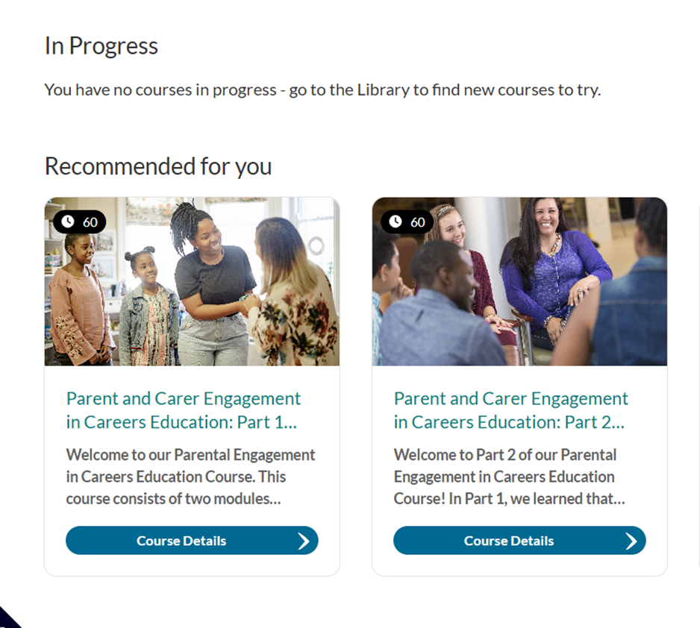
Notes:
This is the main page for internal leadership reviews via resource directory – there are also a plethora of guidance and help centre articles to support colleagues in the process
Your schools can get started on this today
Find out more: Careers Impact Internal Leadership Review | CEC Resource Directory (careersandenterprise.co.uk)
Following this session, you will receive a copy of these slides, a link to an animation, an engagement deckyou can deliver to your CLs and pdf of an overview briefing about the reviews that you can share vai email with Careers and Education Leaders

Slide 9
Talking Futures Resources – for your school
Info in an easy-to-understand format on P16 & P18 pathways, careers conversations, qualifications, how to talk to your teen & more
Add to the careers area of your school website
Include in parent comms
Share with key staff e.g., PP lead, attainment lead, academic leads, attendance lead, SENDco etc.
Notes:
An ambitious and comprehensive vision from leaders that is clearly articulated and measurable and widely shared and understood
A strategic approach to planning for careers with articulated priorities and clear and distributed lines of accountability/robust monitoring of progress by SLT/Govs
Definition of what impact they wanted to see for learners with intentional careers learning journeys that were responsive to need and underpinned by: LOs and progressive learning experiences and encounters
Finally, we also saw robust monitoring of success and impact of this towards school vision and intent for learners as leavers – this was strongest where there was a clear articulation of vision and specific priorities and related learning outcomes
There is a video to follow highlighting the 5 conditions for success

Slide 10
Talking Futures Toolkit – parent facing site
This toolkit is designed to help schools and colleges to:
Maximise the effectiveness of parental engagement
around careers
Support parents in education decision making
Increase participation from parents
Notes:
An ambitious and comprehensive vision from leaders that is clearly articulated and measurable and widely shared and understood
A strategic approach to planning for careers with articulated priorities and clear and distributed lines of accountability/robust monitoring of progress by SLT/Govs
Definition of what impact they wanted to see for learners with intentional careers learning journeys that were responsive to need and underpinned by: LOs and progressive learning experiences and encounters
Finally, we also saw robust monitoring of success and impact of this towards school vision and intent for learners as leavers – this was strongest where there was a clear articulation of vision and specific priorities and related learning outcomes
There is a video to follow highlighting the 5 conditions for success

Slide 11
Sarah MacDougall
Wootton Park School
Notes:
This is the main page for internal leadership reviews via resource directory – there are also a plethora of guidance and help centre articles to support colleagues in the process
Your schools can get started on this today
Find out more: Careers Impact Internal Leadership Review | CEC Resource Directory (careersandenterprise.co.uk)
Following this session, you will receive a copy of these slides, a link to an animation, an engagement deckyou can deliver to your CLs and pdf of an overview briefing about the reviews that you can share vai email with Careers and Education Leaders

Slide 12
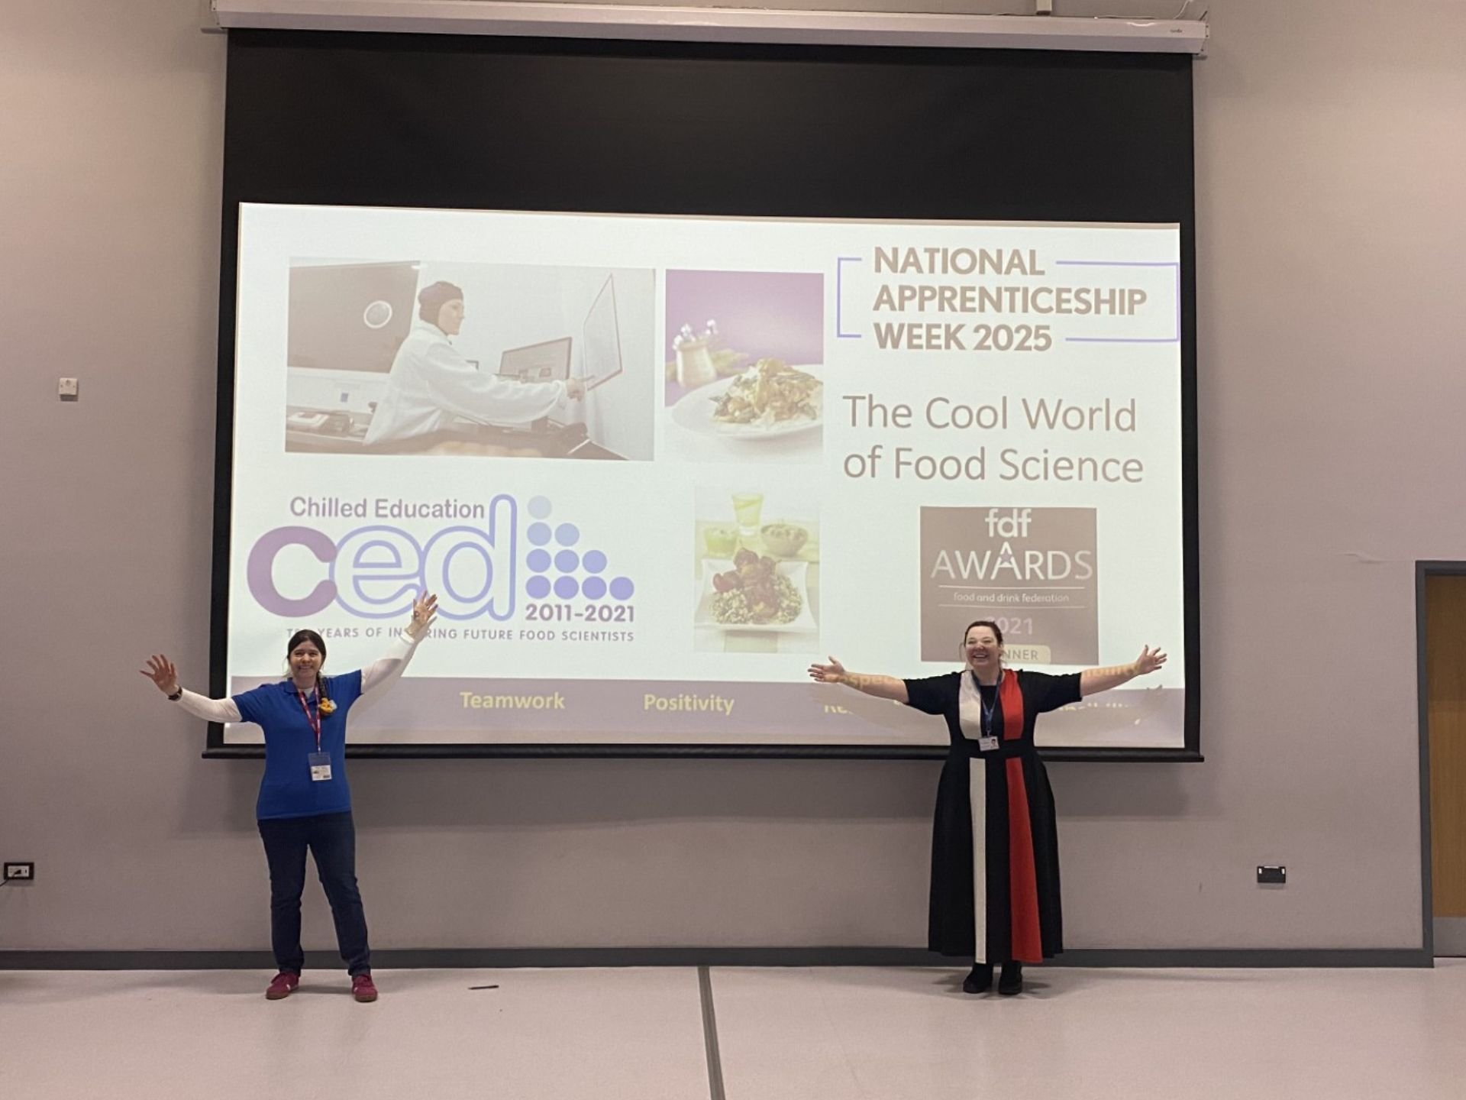
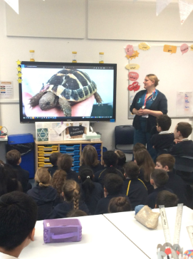
Termly Newsletter to highlight activities and events from primary through to Sixth Form
Careers Team at attendance at parents evening from Y7-Y13
Y9 Options Evening & Sixth Form Information Evenings (including visitors such as UON and Dale from My Great First Job)
Welcoming parents to career events / talks as employers
Forms questionnaires to gather feedback, track destinations and offer additional support to learners who left in Y13.
Emailing parents/carers local CEIAG events and opportunities

Slide 13
Dawn Lord has shared how she adopted and expanded an innovate idea from pupil premium lead Sarah Davis
Tea & Cake
Personal invitation
Early access to parent facing school events
Parent Send event
‘text talk’
Hand delivered letters
Parents felt welcome
Changed the dynamic
Notes:
An ambitious and comprehensive vision from leaders that is clearly articulated and measurable and widely shared and understood
A strategic approach to planning for careers with articulated priorities and clear and distributed lines of accountability/robust monitoring of progress by SLT/Govs
Definition of what impact they wanted to see for learners with intentional careers learning journeys that were responsive to need and underpinned by: LOs and progressive learning experiences and encounters
Finally, we also saw robust monitoring of success and impact of this towards school vision and intent for learners as leavers – this was strongest where there was a clear articulation of vision and specific priorities and related learning outcomes
There is a video to follow highlighting the 5 conditions for success

Slide 14
Vandyke details shared by CL Dawn Lord
This was the brainchild of our Pupil Premium Lead Sarah Davies.
We have a team of staff who work with these students to find out more about them and their backgrounds.
The incentive started with inviting them and their parents in to subject consultation events early for tea and cakes, this increased dramatically the attendance at these events and implemented by phone call invitation.
This seems to have helped by removing the barriers these families face engaging with schools and has increased the conversations between parent child and the school about many things including post 16 options.
Our school’s motto is a triangle one side the school, one side the pupil and one side the family if we do not all stand together it falls down. A simple concept but a valuable one.
In a new incentive this year we worked with the SEND department and invited all SEND parents into a coffee morning, one in the morning and one in the afternoon. To this event, I invited from our local college providers the more pathway' departments. This enabled parents to sit down face to face with these people and helped remove the barriers they face in a normal college open day event. By enabling, those to engage in this manner without the students’ parents were able to have frank open conversations about what may be the right pathway for their student. As many of these students are also pupil premium, young carers, LAC or school refusers and medical NEET it was a wonderful opportunity for them to find out about next steps. More importantly they now have a name and point of contact at the colleges they can talk to.
Notes:
An ambitious and comprehensive vision from leaders that is clearly articulated and measurable and widely shared and understood
A strategic approach to planning for careers with articulated priorities and clear and distributed lines of accountability/robust monitoring of progress by SLT/Govs
Definition of what impact they wanted to see for learners with intentional careers learning journeys that were responsive to need and underpinned by: LOs and progressive learning experiences and encounters
Finally, we also saw robust monitoring of success and impact of this towards school vision and intent for learners as leavers – this was strongest where there was a clear articulation of vision and specific priorities and related learning outcomes
There is a video to follow highlighting the 5 conditions for success

Slide 15
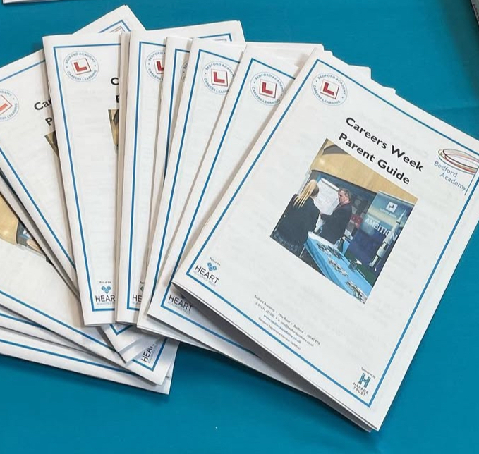
Examples from a previous & parallel life…
QiC - BM4 texts home
QiC - Job of the week group call
BA - Careers Charter
BA - parent booklet
BA - KS3, 4 & 5 parent events
BA - Parent College transition evening
BA - Careers as part of options evening & other parent facing events
BA - Personal guidance appointments parent comms
BA - Careers appointments at parent evenings
BA - Careers area in option booklet/prospectus
Careers Bears - instagram
Notes:
This is the main page for internal leadership reviews via resource directory – there are also a plethora of guidance and help centre articles to support colleagues in the process
Your schools can get started on this today
Find out more: Careers Impact Internal Leadership Review | CEC Resource Directory (careersandenterprise.co.uk)
Following this session, you will receive a copy of these slides, a link to an animation, an engagement deckyou can deliver to your CLs and pdf of an overview briefing about the reviews that you can share vai email with Careers and Education Leaders

Slide 16
Feedback Questions

