Slide 1
Modern work experience
Modern Work Experience | The Careers and Enterprise Company
Notes:
The following slide deck has been built to articulate how CEC are approaching the future of a “modern work experience” offer for all young people in secondary schools (of any type) in England. Our approach has been developed in direct response to the Government manifesto for “two weeks worth” of work experience. In the near future, CEC will start to release audience specific comms to further support the core messaging.

Slide 3
Notes:
At the recent launch of the updated Gatsby Benchmarks and report, The DfE outlined the Government’s vision for work experience. Currently this is articulated on this slide. These are the words of the Government, not CEC. We expect further detail to be shared regarding the broad direction of travel in the spring update of the Careers Statutory Guidance. The main purpose of this statutory guidance update will be the expected implementation of the updated Gatsby Benchmarks. Work experience detail is expected to be limited in Spring 2025, with a further and fuller update expected next year. This vision aligns very clearly to the ambitions outlined in the updates to the Gatsby Benchmarks, particularly Benchmark 6.

Slide 4
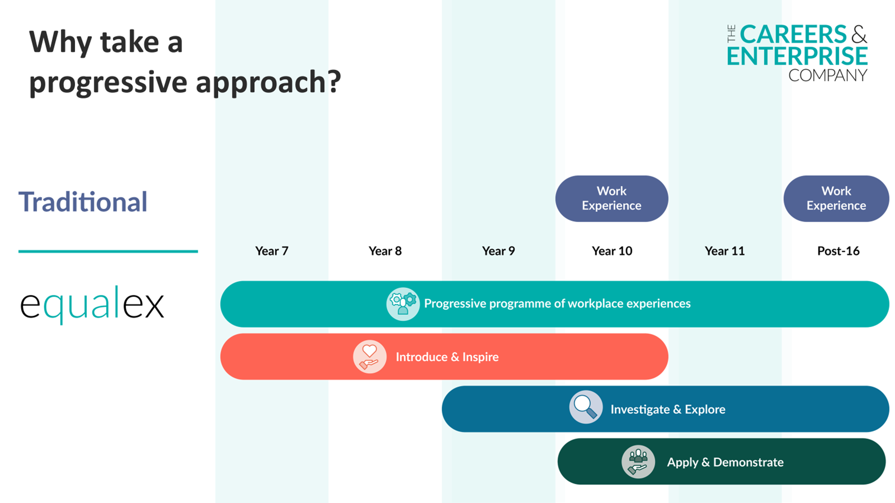
Notes:
CEC are keen to ensure reinvention of work experience and to challenge traditional norms and conventions as we know that whilst some traditional practice is impactful, some is low quality and many learners miss out completely. We have therefore started to define a “modern work experience” offer and the following slides articulate the principles of this approach. We aim to articulate what, why and how to approach the subject.
As described here – modern work experience is made up of a series of multiple workplace experiences – it is appropriate to use both phrases in this context.

Slide 5
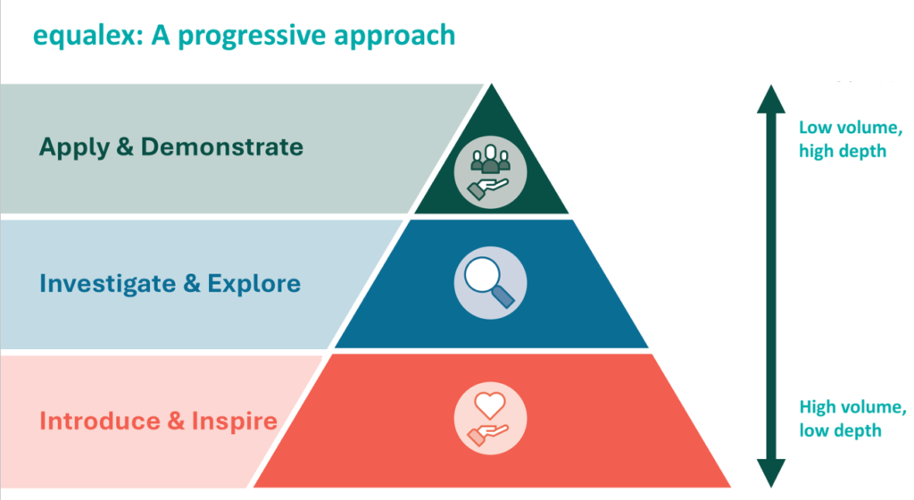
equalex

Slide 6
Policy delivery models & through the eyes of a learner

Slide 7
equalex model 3:
 | Year 7 | Year 8 | Year 9 | Year 10 | Year 11 | Post 16
No of days |  |  | 5 | 5 |  | Qual defined
Example experiences |  |  | One week OR 5 rotational days across a themed week | One week – in depth exploration of a role and applied experience |  | Focussed, destination specific WEs to inform post 16 pathways choices with linked project
 |  |  | All learning outcomes delivered over blocks where appropriate
Equalex outcome tier |  |  | 1&2 | 3
Focus |  |  | Introduce & Inspire, Investigate & Explore | Apply skills & knowledge in workplace | Transition readiness | Skill Development

Slide 8
equalex model 2:
 | Year 7 | Year 8 | Year 9 | Year 10 | Year 11 | Post 16
No of days |  | 2 | 3 | 5 |  | Qual defined
Example experiences |  | 2 x WE 1 x virtual workplace experience 2 x half day workplace visits | 3 x WE One day per term, 3 different workplace experiences in small groups | 1 block week Or 1-week with variety of experiences | Review and evaluate | Focussed, destination specific WEs to inform post 16 pathways choices with linked project
 |  | Opportunity to develop progressive blended programmes of meaningful face to face and virtual WEs
Equalex outcome tier |  | 1 | 1 & 2 | 3
Focus |  | Inspiration & self/ opportunity awareness | Explore roles & responsibilities, growth sectors, career readiness | Apply skills & knowledge in workplace | Transition readiness | Skill Development

Slide 9
equalex model 1:
 | Year 7 | Year 8 | Year 9 | Year 10 | Year 11 | Post 16
No of days | 1 | 2 | 3 | 3 | 1 | Qual defined
Example experiences | One workplace visit/trip with defined intent In school WE | 2 x WE Employer led preparation | 2 x WE Focussed presentation curriculum link English Language | 2 sets of 2 days different WE | Targeted WE visit supporting with project activity | Focussed, destination specific WEs to inform post 16 pathways choices with linked project
 | Opportunity to develop progressive blended programmes of meaningful face to face and virtual WEs
Equalex outcome tier | 1 | 1 | 1 & 2 | 2 | 3
Learning Outcome Focus | Inspiration & awareness | Develop opportunity awareness | Explore roles & responsibilities | Developing career readiness | Apply skills & knowledge in workplace | Skill Development
WE = Workplace experience

Slide 10
equalex model 4: Specialist setting
Timeline to suit needs of individual settings and YP - Stage not age
No of days | 2 | 2 | 2 | 2 | 2
Example experiences | Setting based exploration of workplaces inc voluntary sector Employer led Enterprise challenges | Setting based employer encounters linked to learning Short multiple internal WE | Short group visits to workplaces Internal or Virtual WE/ external community projects | 2-3 short external WE placements Visits to pathway providers | Focussed WE linked to future pathway
Opportunity to develop self-awareness and staggered approach to WE
Equalex outcome tier | 1 | 1 | 2 | 2 | 3
Focus | Self-awareness/ Inspiration | Opportunity awareness | Exploring roles and local LMI | Career readiness | Applying skills and knowledge in workplace

Slide 11

End of Year 11 – Sam’s profile
Knowledge
Awareness of pathways into a career in the digital industry and the roles associated with those pathways
Has used the knowledge gained to help make informed decisions about their transition thinking through the range of options available to them at Post 16 and Post 18
Increased confidence around their own skill set and how this can best support them in the future workplace
Skills
Can self-advocate and articulate the sector skills they have developed to support future choices
Equipped with the skills to support them in making a successful transition
Developed skills and qualifications relevant to their chosen pathway through employer experiences and projects
Sees the relevance of skills from their curriculum learning and qualifications to their future options
Behaviours
Developed an understanding of workplace culture and how this differs across different sectors
Developed positive workplace behaviours through multiple experiences
Feels confident in making positive informed decisions regarding their future options
At the end of year 11, Sam;
Understands pathways and opportunities
Realises own potential
Sees the relevance of curriculum to workplace
Has agency in own skills development
Has improved careers readiness scores
Has a line of sight to the future

Slide 12
What could this look like for Sam?
Year 8
English trip to BBC (1 day) Plus
In school project for BBC Young Journalist Competition – Applied literacy & oracy skills
(1 day)
T1
Year 7
3 x virtual sector visits (1 day)
Plus
1 x community-based project day e.g. Army
(1 day )
T1
T3
T2
Year 10
3 days x workplace exploration, 2+ x employers (e.g. KPMG or Herts model)
T2
Year 9
3 x half day industry visits in groups of 8
(1.5 days)
Plus
Physics trip to Jodrell Bank (1 day)
T1
Year 11
2 days x 1 employer in targeted sector
T3
Learner 1
T3
Learner 1 experiences:
KS3 – 5.5 days, KS4 5 days = TOTALLING 10 DAYS
3+ sectors
9+ employers
Two+ week’s worth
Multiple, progressive
high-quality
Equalex tiers:
T1 – Introduce & Inspire
T2 – Investigate & Explore
T3 – Apply & Demonstrate

Slide 13
What could this look like for Yara? (MBacc student)
Year 8
GM Meet My Future events (1 x half day)
T1
Year 9
6 x half day digital gateway industry visits
in groups of 8 (2 days)
Plus
Art/Technology trip to Media City with curriculum linked project (1 x half day))
T1
Year 10
1 x digital curriculum -related visit with course related task/project (1 x half day)
5 days x creative media workplace exploration, 3+ x employers (e.g. KPMG or Herts model)
(5 days )
T3
T3
Year 11
2 days x 1 employer in digital technology gateway employers
(2 days )
T2
T3
Learner 2 experiences:
53 hours / 10.5 days
5+ Gateways (sectors)
12+ employers
Learner MBacc equalex guarantee
10 days/50 hours+ by end of year 11
Learner 2
Two+ week’s worth
Multiple, progressive
high-quality
Equalex tiers:
T1 – Introduce & Inspire
T2 – Investigate & Explore
T3 – Apply & Demonstrate

Slide 14
What could this look like for Salem? (Building on traditional)
Year 7
2 curriculum led sector focussed
trips (1 day)
T1
Year 8
3 x virtual sector visits (1.5 days)
T1
Year 9
1 x half day workplace safari in groups of 8
(0.5 days)
Plus
2 x whole year group activity (2 day)
Year 10
5 days x workplace exploration, through traditional placement OR 5 x short, purposeful visits
linked to interests and aspirations
T1
T2
T3
T3
Learner 3
Learner 3 experiences:
KS3 – 5 days, KS4 5 days = TOTALLING 10 DAYS
5 sectors
5+ employers
Equalex tiers:
T1 – Introduce & Inspire
T2 – Investigate & Explore
T3 – Apply & Demonstrate
Two+ week’s worth
Multiple, progressive
high-quality
T2

Slide 15
What could this look like for Charlie – SEND learner/specialist setting
Stage 1
Project based activity around specific sector – NHS and roles within (relevant to YP future plans) exposure to the sector through videos and virtual activity
( 1.5 days )
Stage 2
4 x employer encounters through in school exposure
(2 days)
T1
T1
Stage 4
5 x half day supported industry visits in small groups or 121
(2.5 days of Tier 2)
Stage 3
1 x community-based project day e.g. Care Home, community project linked to NHS roles and through prep for adulthood curriculum model
(1 day)
T2
Learner 4
Term 5
6 x half days supported visit x 1 employer in targeted sector
( 3 days )
T2
T3
Learner experiences:
10 days
1 sectors
5+ employers
Two+ week’s worth
Multiple, progressive
high-quality
Equalex tiers:
T1 – Introduce & Inspire
T2 – Investigate & Explore
T3 – Apply & Demonstrate
Notes:
SeND

Slide 16
Myths and misconceptions!
My school can’t do one week work experience anymore
A myth - The model of delivery and curriculum implementation plan is completely within your gift. Employer voice tells us they are keen to move away from traditional blocks to pump up a pipeline of more experiences. You could still timetable as a week but use models that enable learners to access more than one employer
Learners will be in and out of school all over the place, missing core learning
A myth – this is in the hands of your strategic curriculum planning and school calendar. Many relevant activities will already be present in your curriculum model , some will need creative thinking and development
There isn’t enough placements in the system
This will quickly become a myth if we respond to employer voice. We don’t need the same employers to offer more placements, we need more employers to offer experiences that are right for them and their scale, industry, scope and resources
This is much more complicated to organise
A myth – it’s more than the singular job of a Careers Leader and will take collective leadership responsibility. The role of the Careers Hub is to be your support system. They will help you develop high-quality implementation plans, manage the pipeline of experiences and reduce burden
Notes:
N to populate simple answers

Slide 17
Strategic next steps for schools
Read and reflect on updated Gatsby Benchmarks (& updated statutory guidance when it lands, stat guidance update expected spring 2025 for implementation Sept 2025)
Convene your team and undertake an Internal Leadership Review of your school/college careers provision (then engage in peer-to-peer reviews facilitated by your Careers Hub)
Consider how you will develop an implementation plan for “two week’s worth” of high-quality modernised work experience

