Slide 1
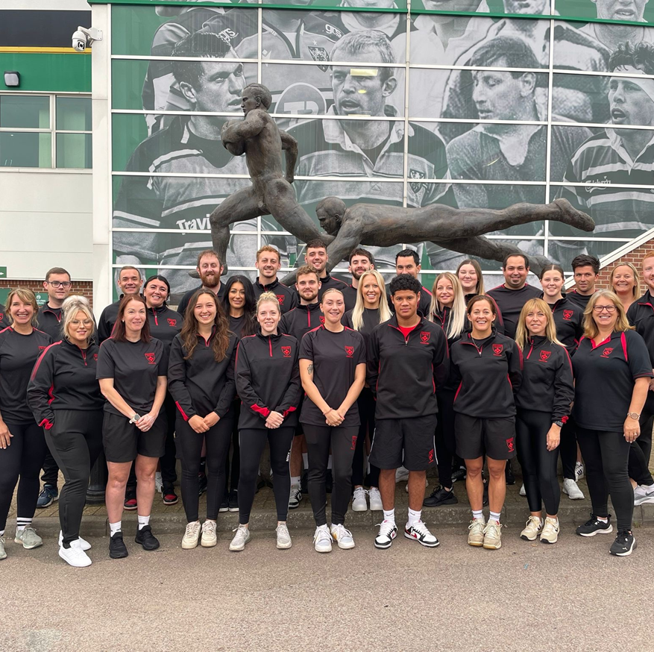
NORTHAMPTON SAINTS
FOUNDATION
Craig Phillips
Head of Employability & Skills

Slide 2

OUR VISION
We use the power of sport and the values of rugby to empower young minds and enrich lives across generations
INSPIRE, SUPPORT & EDUCATE
2
3
1
Use our heritage to INSPIRE our work, preserve our past and protect the future.
SUPPORT disengaged, disadvantaged people to find a better future.
Provide a range EDUCATION programmes .

Slide 3
OVERVIEW OF EMPLOYABILITY
1
2
3
MAINTAIN HIGH QUALITY DELIVERY AND LEARNER EVIDENCE
REDUCE THE RATE OF NEET IN THE COMMUNITY
REACH A MINIMUM OF 91% POSITIVE PROGRESSION
*
IDENITFY LOCAL SKILLS GAPS AND ENSURE A DIVERSE RANGE OF OPPORTUNITIES FOR ALL LEARNERS.

Slide 4
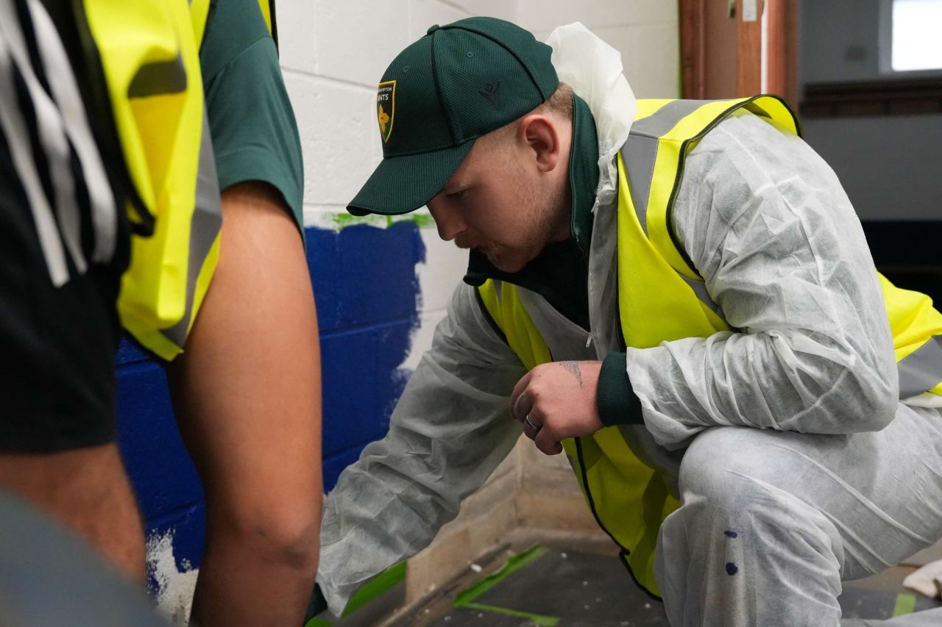
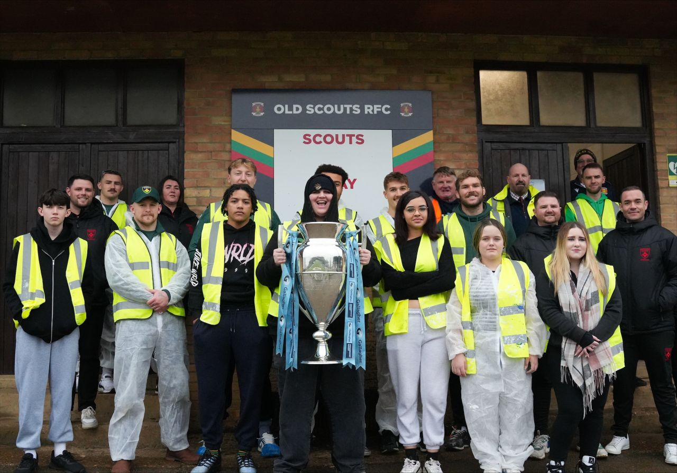
Wellbeing Programme
In partnership with West Northampton Council the programmes focuses on,
Non-accredited rolling programme
Core Employability skills
Development of Maths and English
Work experience placements
Enrichment calender supporting personal, social and mental development
Referrals
Direct to the Foundation
Young people aged 16 – 19 who are NEET
Organisations refer across the county
​
Notes:
personal, social and life skills to support young people.​

Slide 5
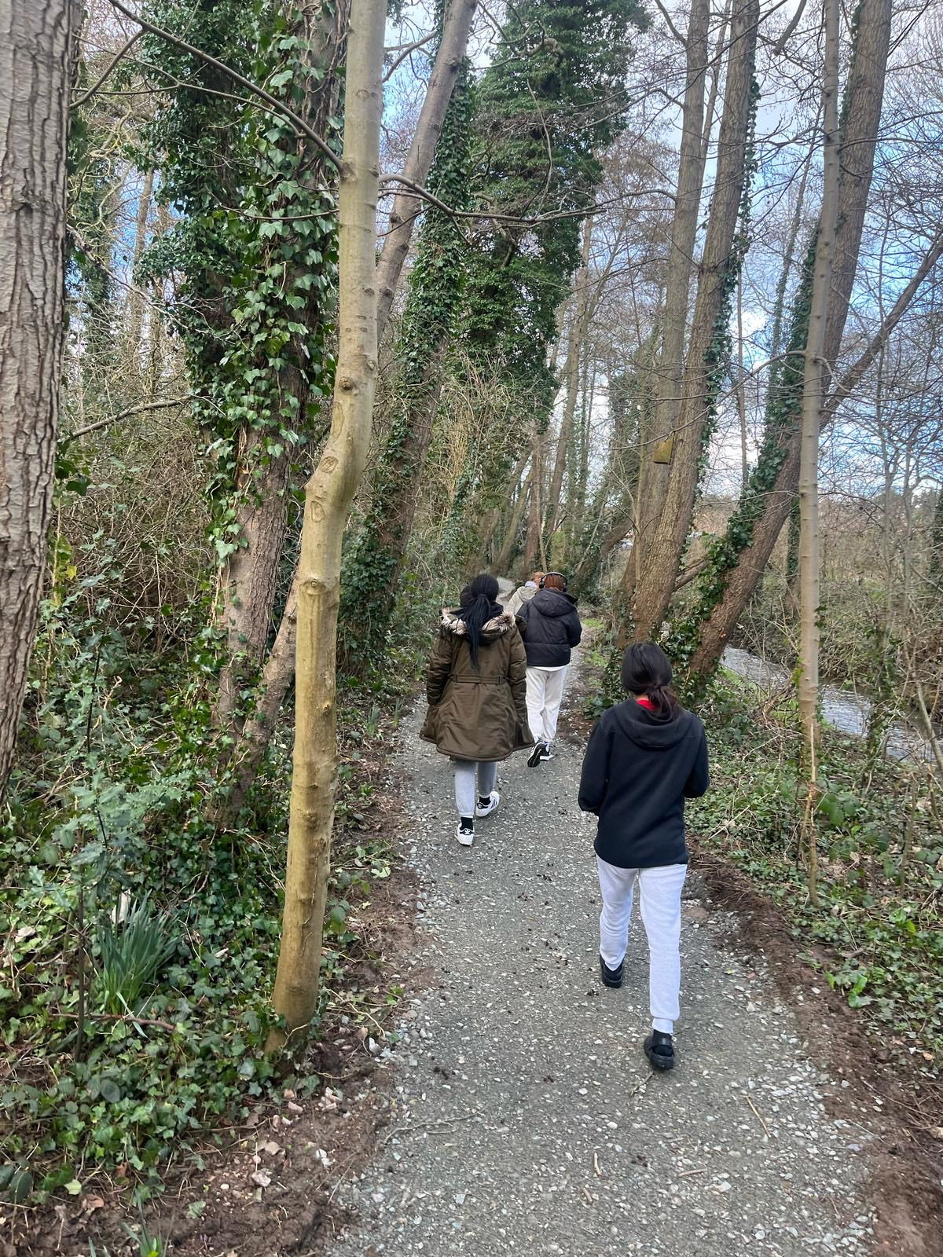
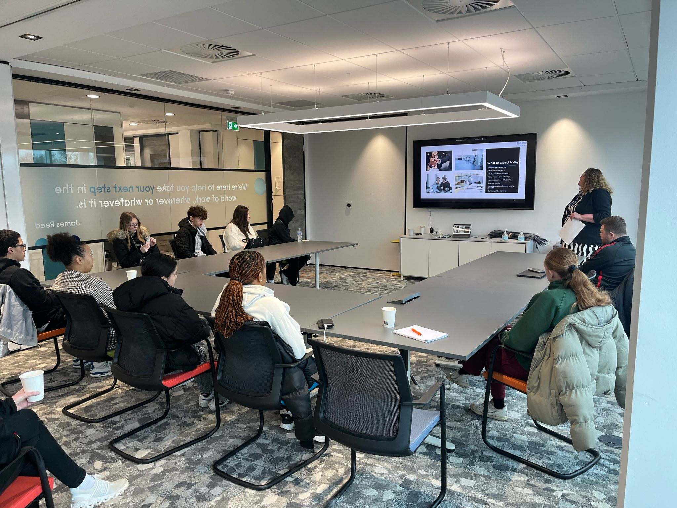

Northampton College Partnership
ASPIRE
Designed to support young individuals with the key skills and qualifications they need to create a positive pathway.
City & Guilds Level 1 and 2 Award in Employability Skills, whilst gaining their Maths and English GCSE's at Northampton College.
September start..
ENGAGE PLUS
Designed to support young individuals who require additional learning support or are at risk of not being in education, employment or training (NEET)
City & Guilds Level 1 in Employability Skills, whilst gaining their Maths and English GCSE's at Northampton College.
November start..
​
Notes:
personal, social and life skills to support young people.​

Slide 6
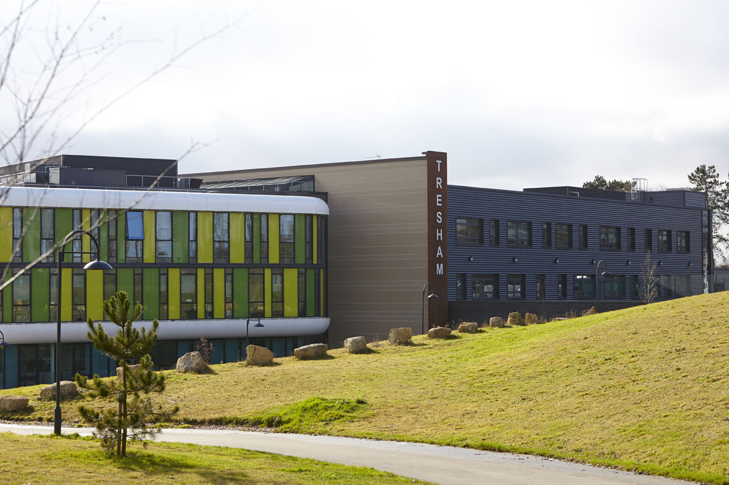

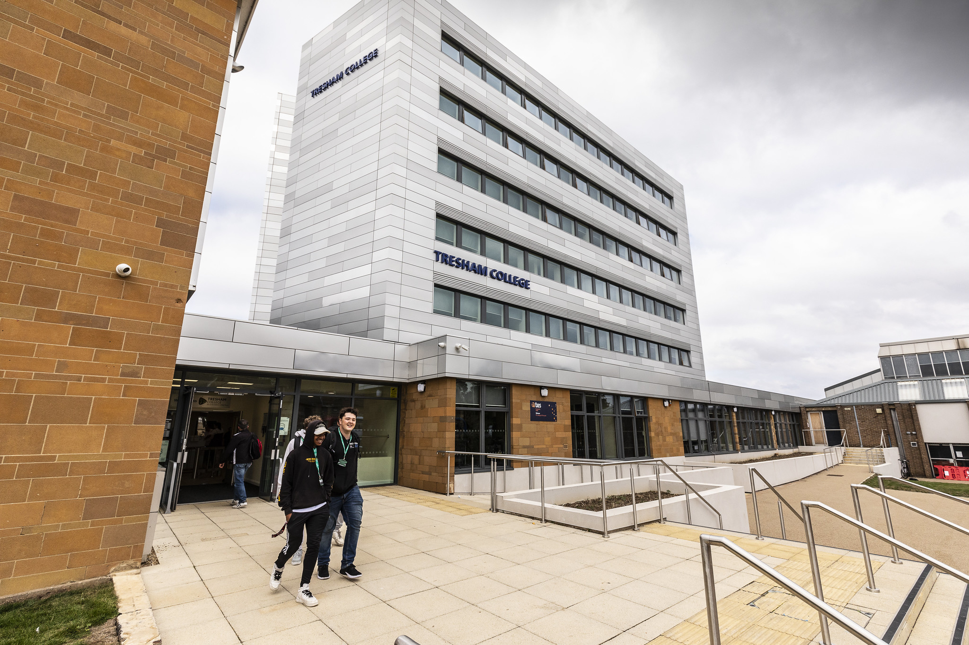
Tresham College Partnership
CORBY AND WELLINGBOROUGH
Reducing the risk of NEET and supporting the pathway back into education
November start…
Supporting 45 young people
Participants will work towards a City and Guilds Level 1 Certificate in Employability and gain key skills like CV writing, interview techniques, and personal finance management.
GCSE Maths and English
External referrals once internal referrals are complete
​
Notes:
personal, social and life skills to support young people.​

Slide 7
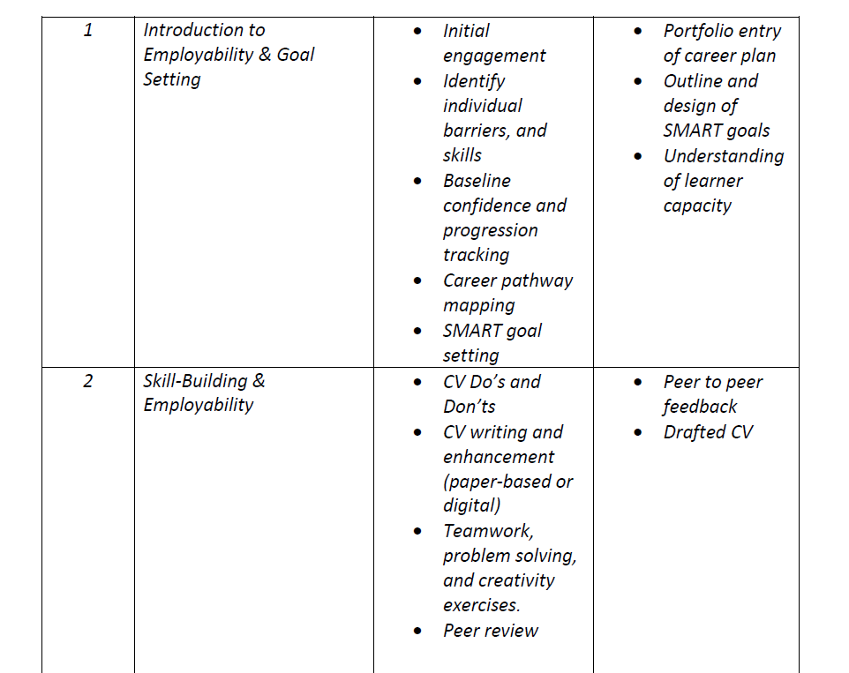

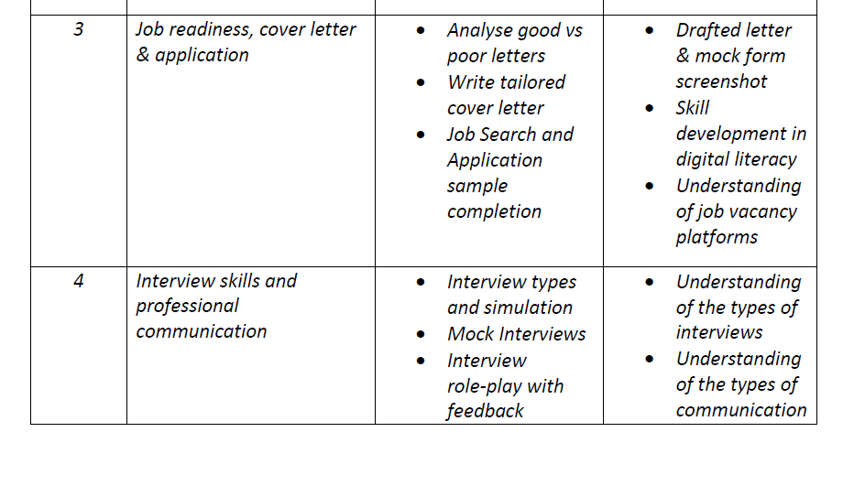
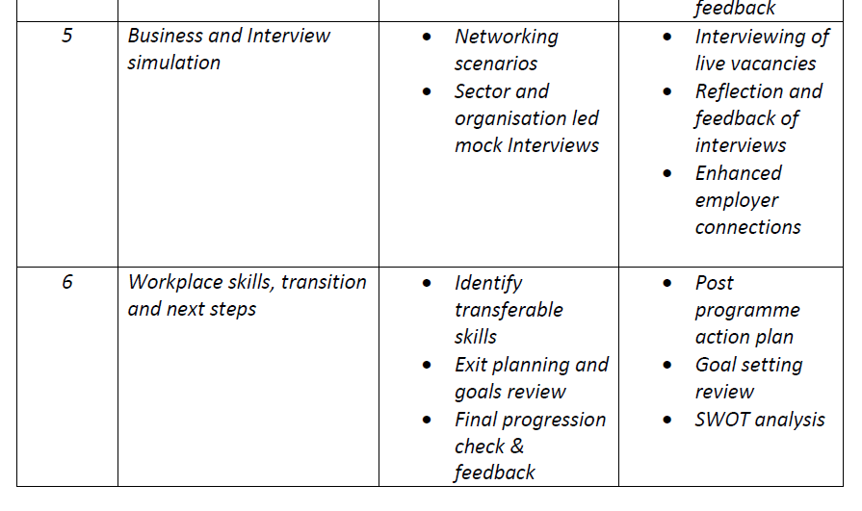

School Employability Programme
Support the prevention of NEET
Reduce skills gaps countywide and nationally
Falls inline with changes and youth guarantee
Increase job readiness, core employability skills and enhance PSD
6 - week programme
Pilot intervention supporting 90 young people
Year 10 and year 11
Journey to work theory of change

Slide 8
ANY QUESTIONS?
Notes:
Conclusion,
21/22 ( 2 cohorts) we had two programmes with the scope being for 25/26 proposed to be 9 cohorts with 7 programmes
Impact on NEET and unemployment adding social value contribution
Growing in numbers 147 completed in last three years adding another 67 this year with a total of 214
Academic year 25/26
Currently submitting plans for 4 cohorts in Corby and Welly with HITZ commencing.
Recruitment
Recruitment for new programmes and support roles, plan being developed with Anna
Business Needs
Working with the vice principle on building a business case and needs for all sites of Tresham College
Learning agreements
Currently yearly basis, in discussion to make this multiple year: Encourage partner collaboration, staff quality, NEET and unemployment rates

