Slide 1

EMPLOYER ENGAGEMENT
Building Trusted Partnerships
Career Leader CPD 09.03.26

Slide 2

Purpose of the Session
The importance of making positive employer connections.
Committing to connections by actively developing partnerships.
Introduction
5 minutes
Please introduce yourselves in the chat!
Case studies
20-25 minutes
Q&A and discussion
15-20 minutes
Add your thoughts to the chat

Slide 3

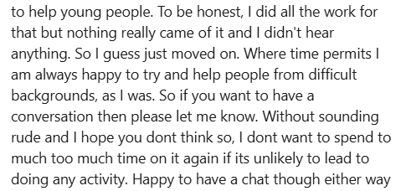


Slide 4
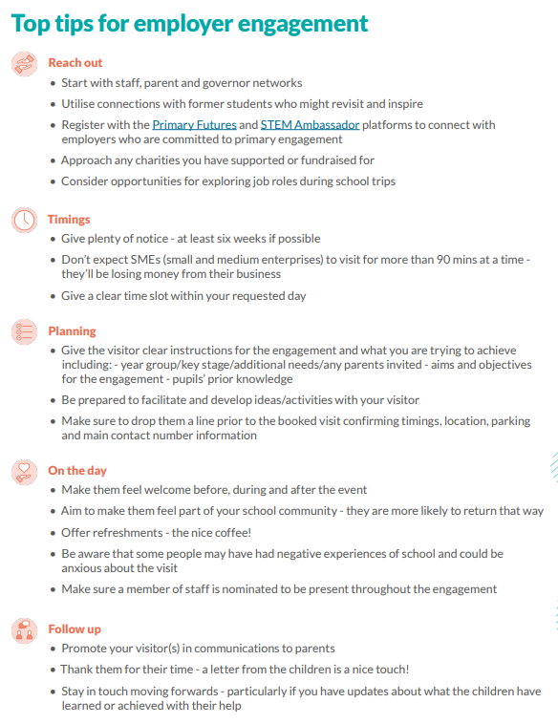
Operational Best Practices
Cornerstone Employers: Engage with local Cornerstone Employers to access high-quality, strategic partnerships.
Make it Simple: Provide clear, concise information and, for SMEs, keep requests to 90 minutes or less.
Create Meaningful Experiences: Opportunities for active engagement like workshops or mentoring.
Prepare Both Sides: Brief employers on the pupils, objectives, and the Gatsby Benchmarks, and ensure teachers participate in the interaction.
Evaluate Impact: Use the Future Skills Questionnaire in Compass+ to measure the impact on student confidence and career awareness.

Slide 5
Example - Latimer Arts College
Employer Engagement/Teacher CPD Inset day: Friday 5th December 2025
Head of Careers/Assistant Principal: Kerry Gallon
Careers Administrator: Vicky Stanyon
Industry Partner: Vikki Overson, Project Manager for Unilever
Careers Consultant: Claire Coles

Slide 6

Employer Engagement: Business Networking Event
March 2025
Initial planning & promoting
Dates fixed, NNBN Business Networking, resource sharing.
September 2025
Formal planning
Operations & logistics, registration set-up
October 2025
Employer outreach
More NNBN networking and targeted employer contact.
November 2025
Final prep
Staff briefing and final logistics confirmed.
5 December 2025
Successful event delivered!
~50 employers and 50+ staff
Dec 2025 - Present
Follow‑up
Post‑event actions and employer/student engagement.
June 2025
Planning began
Employer list creation, comms plan, and teacher‑prep planning.

Slide 7

Employer Engagement: Business Networking Event
🎯 Strategic Purpose | Refreshed & aligned employer engagement with the school’s strategic plan and Gatsby Benchmark 4
👥 Leadership Support | Fully endorsed by the Principal and SLT, embedding employer engagement into whole‑school practice
🔗 Employer–Teacher Links | Meaningful staff–employer connections created, with curriculum teams pursuing follow‑up collaborations
📈 Staff Development | CPD delivered on networking skills and embedding careers into the curriculum
🏢 Employer Awareness | Improved employer understanding of the Careers Programme and how they can contribute
🎓 Student Benefits | • A presentation from the Mayor to Year 12 Politics students • A workshop from an employer who runs a Fitness Company and provided a team building activity • A visit for Year 12 Design students to Satra (a footwear testing facility in Kettering)
Keeping the momentum | • Working group of employers (co‑develop curriculum resources and modern work‑experience opportunities). • Curriculum audit • Parental engagement plan • Internal Leadership review

Slide 8
Example – Southfield School for Girls
Employer Engagement/Job Application initiative
Careers Leader: Sophie Kursat
SLT Careers Lead: Adam Barratt
Industry Partner: Harrison Barlett, Emerging Talent Advisor (Nuclear & Energy, Environment), Kier
Careers Consultant: Claire Coles

Slide 9

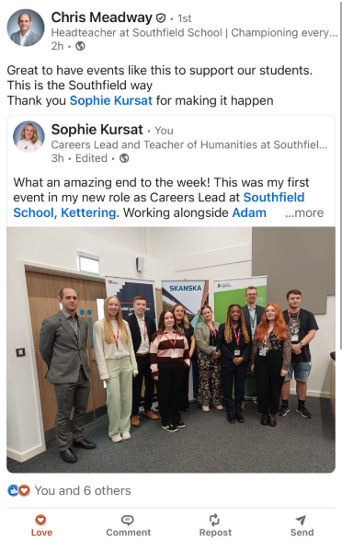
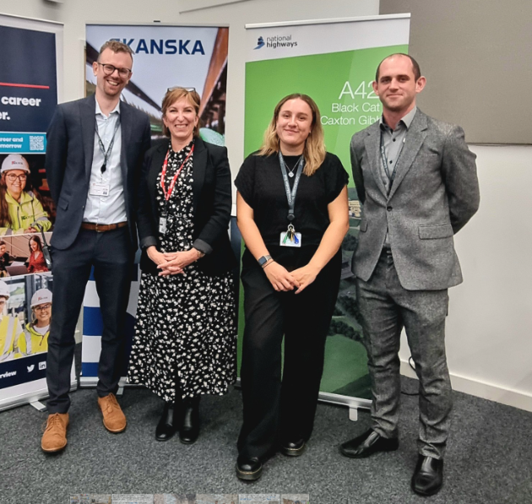
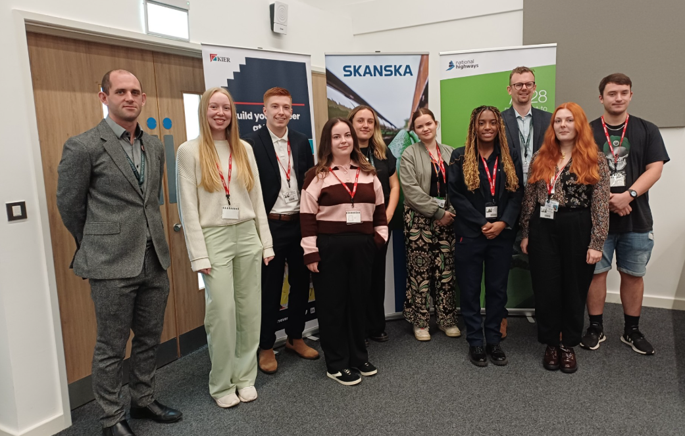
Young Inspirers Event
Networking:
Using social media to make connections
Alumni – inviting past students back into school to support current students.
Following up on Careers Hub Events and trialling various ways of making contact with ‘Young Inspirers’.
Making time to meet:
Arranging teams calls to ‘meet and greet’ virtually.
Preparing slides on their roles – support students to understand their roles better and who they are.
Ensuring SLT are there to greet visitors on the day.
Hospitality.
Alumni:
Continue to build the relationship with alumni, through coffee afternoons to get to know people better.

Slide 10
Working from data
Used the Future Skills Questionnaire to identify gaps in student knowledge:
  51% - Are you aware of some of the types of businesses or employers in your area of the country?
  63% - Do you know any trustworthy websites that can help you decide what to do in the future?
  63% - Have you contacted people who work in jobs that interest you?
  58% - Do you feel confident about your next steps after year 11?
  66% - Do you know about different types of recruitment and selection process, including interviews and assessment centres?
Explored the data with SLT, Claire and Harrison (Industry Partner)
Developing employer relationships
Being available to meet employers (timetable restrictions but can be done over teams too!)
Identifying their needs – Kier aim to increase the number of females coming into the industry.
Establishing the level of commitment – deciding on what each party's role will be in the partnership.
Notes:
Working from data:
Used future skills questionnaire where myself and Adam, Claire and Harrison met to go through the results of the data.
Identified gap in provision, to then bridge the gap in future year groups

Slide 11
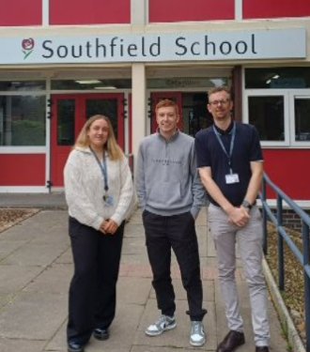
Exploring ideas of engagement
What is their motivation for working with the school?
Strategic or operational support?
Who is the employer keen to work with?
What level of commitment can they provide?
Information about their organisation? Skills, roles across the business, number of employees, how many would be willing to engage? Level of confidence or outreach experience, recruitment processes, etc.
Notes:
Exploring engagement ideas:
1. What is their motivation for working with the school?
Kier – looking to increase numbers of women/ young people into the construction industry, to a variety of roles.
2. Strategic or operational support?
Both – strategic support through exploring data, strategic planning from an employer's perspective, operational support through activity planning such as the Mock Interview Event.
3. Who is the employer keen to work with?
Students of all ages, began to branch out to others within the business and see how we can work on the ‘Kierriculum’ and deliver more sessions to others in the school.
4. What level of commitment can they provide?
Understand the level of commitment between yourself and the employer – I teach a 35 hour timetable (lucky me!) so I have time to spare but this can vary for teachers having a heavier load or careers leaders that do not have a teaching timetable – relevant to your institution.
5. Information about their organisation?
Skills, roles across the business, number of employees, how many would be willing to engage? Level of confidence or outreach experience, recruitment processes, etc.
We have been quite lucky that Kier is so willing to engage with us as a school and so many keen employees that are happy to take part in initiatives.
6. Would they welcome employee CPD to ready them for engagement?
???

Slide 12
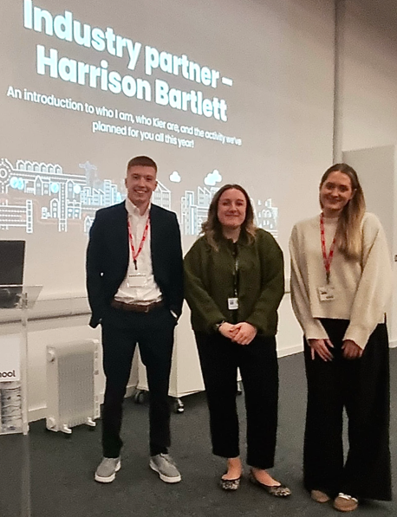
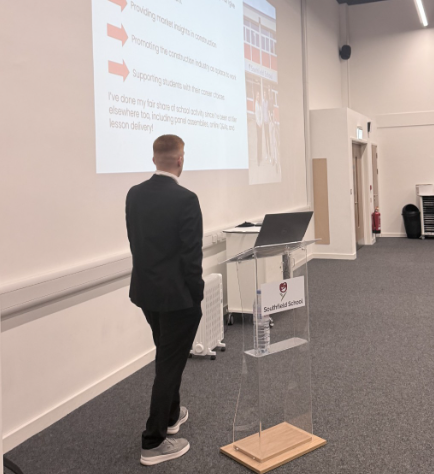
Year 10 Mock Interview Initiative
From the FSQ data, found gaps in our provision.
Mock interview initiative – two main days, with activity before and in between main days.
Monday 23rd March – series of workshops delivered by Kier staff. Interview skills, CV writing, researching a careers site and looking at LMI.
Thursday 2nd July – Mock interview day with 25+ Kier professionals. Students will interview for a job they have applied for through the Kier recruitment website and then receive feedback on their interview from the employer – ‘meaningful’.
Panel style assemblies in between students applying for a ‘mock’ job role through the employer website.

Slide 13
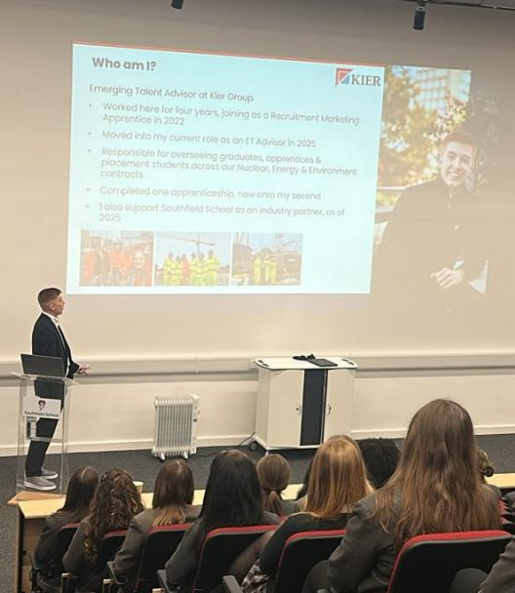
BM5 & BM6: Engaging Employers
Benefits of engagement: the employers’ perspective
CSR/recruitment: This year we’ve had clearer, more ambitious targets on female recruitment in emerging talent pathways – partnership born from this.
Key considerations
Job demands: My role as ET Advisor requires me to be travelling/present on site, supporting graduate forums & recruitment. At times seen to be not so visible. Understanding this is key to a strong partnership.
Seasonal demands as above – at times may be not as available depending on role.
Advocacy/building momentum:
Been able to build strong momentum and high advocacy through consistent promotion of campaigns.
Notes:
Employer engagement benefits:
CSR/Business objectives:
The idea of the partnership was born from our company objective to recruit an increased percentage of females in emerging talent roles. Southfield is an all girls’ school local to me that felt a good place to start. Claire presented Southfield to me as a positive option with an exciting careers plan, and it felt like a partnership that could be really beneficial.
Positive engagement to me stems from clear, consistent and regular communication. Sophie & I talk regularly, near on daily about our plans for the upcoming activity. Communication is always clear, we understand the way we both work and we share the same enthusiasm for the projects we’re working on, which has made this process feel seamless, and sometimes, dare I say it, easy!
I don’t have experience of when employer engagement hasn’t worked, but I know that without the communication and understanding we both have, it’d be tough. We recognize diary challenges, business challenges/requirements, and our own diary commitments too. I’m often out and about in my role but will always look to make time, in the same way that Sophie does too.
Benefits have included good access to a key female year group at school – a group we hope to be able to have a positive influence on in encouraging them into careers in construction.
Things to consider:
Industry/job demands: my role requires me to be out regularly, on site/forums/high recruitment demand. It’s important for both sides to recognise job demands and have clear expectations on availability, but if you can have this then you can succeed.
Seasonal demands also include NAW/NCW, as well as Open Doors Week (explain this)
Planning ahead also allows colleague involvement, as we have had. Means higher careers advocacy from a range of people.

Slide 14
Q&A and discussion
What does a ‘trusted partnership’ look like to you?

