Slide 1
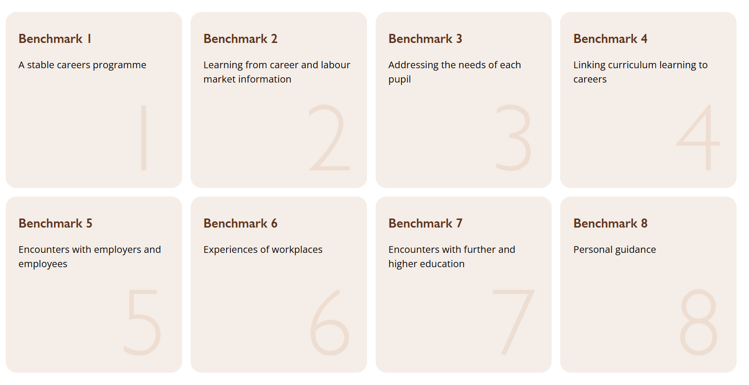

Slide 2
A meaningful encounter will…
have a clear purpose, which is shared with the employer and the young person
be underpinned by learning outcomes that are appropriate to the needs of the young person
have opportunities for two-way interactions between the young person and the employer
be followed by time for the young person to reflect on the insights, knowledge or skills gained through the encounter
The Benchmark 6 checklist also includes:
involve extensive two-way interactions between the young person and employees
include opportunities for young people to meet a range of different people from the workplace
include opportunities for young people to perform a task set by the employer or to produce a piece of work relevant to that workplace
include the employer providing feedback to the young person about their work
The Benchmark 7 checklist also includes:
include information about the provider, such as their recruitment and selection processes, the qualifications that provider offers and the careers these could lead to
describe what learning or training with the provider is like
be followed by opportunities for the young person to reflect on the insights, knowledge or skills gained through the encounter

Slide 3
Theme 1

Slide 4
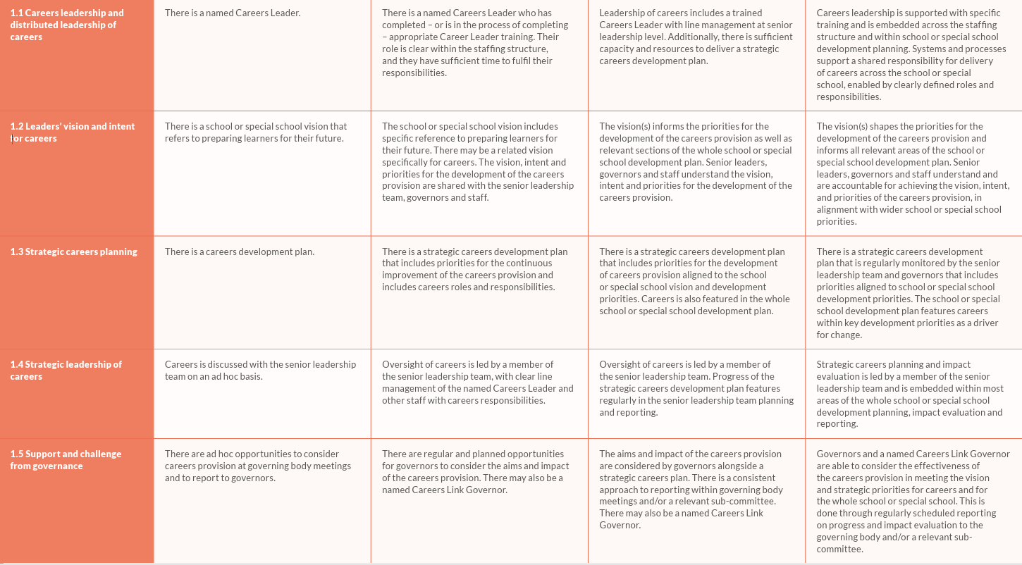

Slide 5
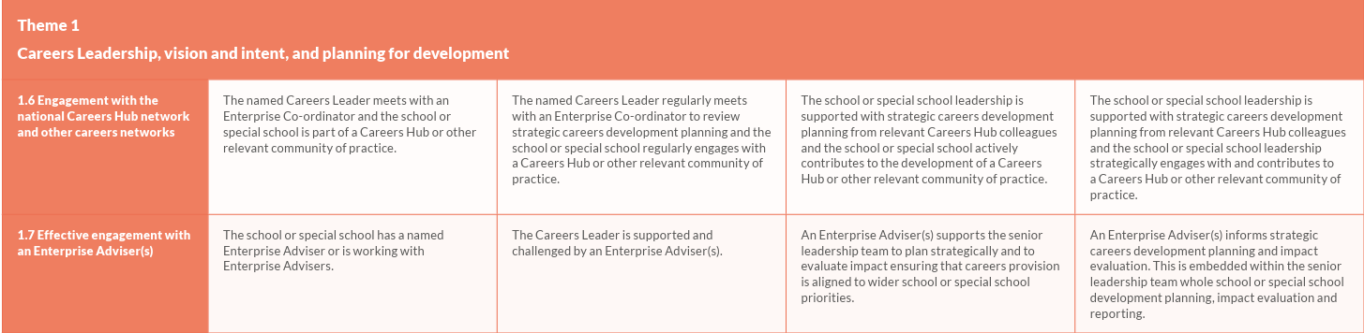

Slide 6
Theme 2

Slide 7
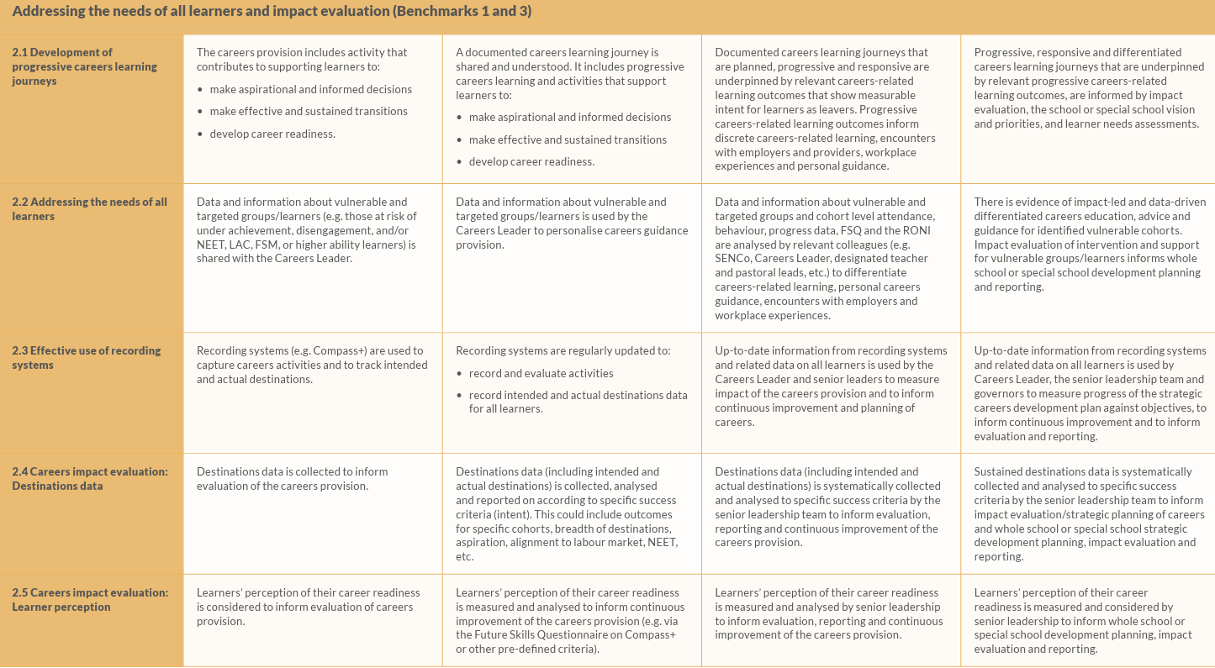

Slide 8
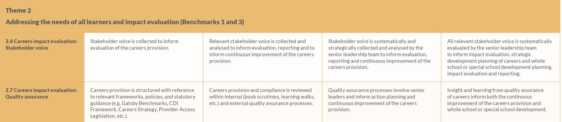

Slide 9
Theme 3

Slide 10
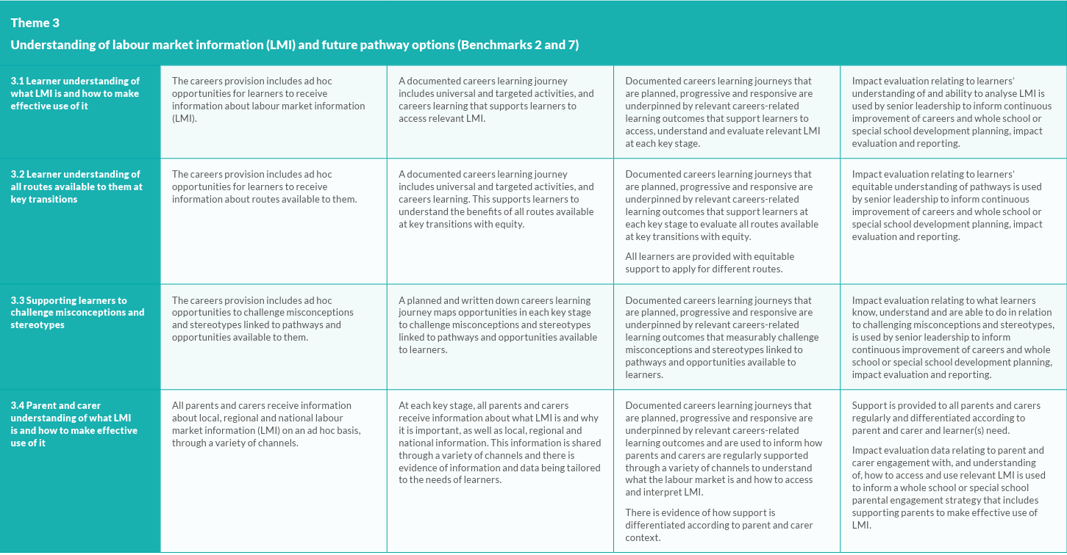

Slide 11
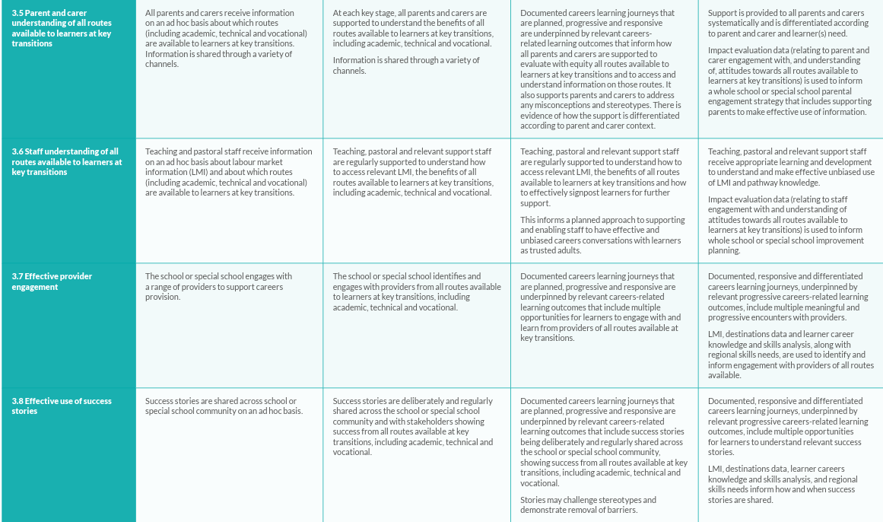

Slide 12
Theme 4

Slide 13
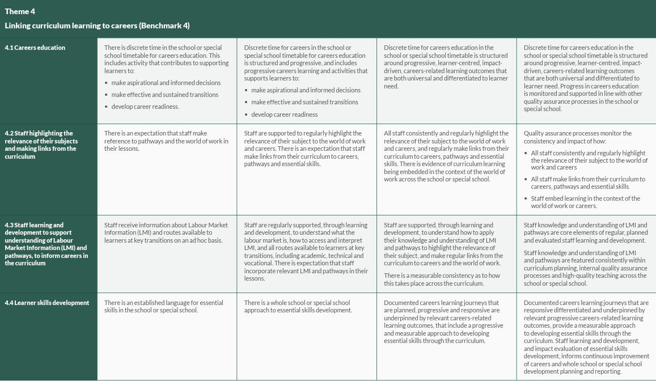

Slide 14
Theme 5

Slide 15
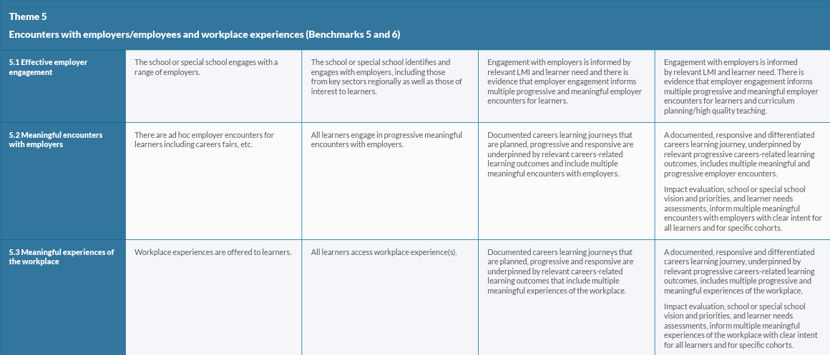

Slide 16
Theme 6

Slide 17
