Slide 1


Careers for Every Learner: Using OnTrack+ to Design a Responsive Careers Programme
Sarah Latimer
Careers Consultant, South Midlands Careers Hub
20th October 2026

Slide 2
Agenda
RONI, disengagement and the OnTrack+ feature
Demonstration
How to use the feature to target support
Practical task
Learning outcome
Understand how OnTrack+ can be used to identify, target and track careers activities for disadvantaged learners, particularly those at risk of becoming NEET

Slide 3
The challenge is growing - the number of young people aged 16–24 NEET is now at its highest since 2014
Careers education is one of the most powerful tools we have for prevention - the highest-quality provision reduces the likelihood of a young person being NEET by 8% post-16 and post-18
Key principles to boost NEET prevention through careers education include:
  Identify the need, act early
  Target barriers that are exacerbated by economic disadvantage
  Provide continued support
  Creating social capital for young people with more limited networks e.g. employer engagement and trusted and relatable role models/mentors
  Track progress and outcomes
Data-driven early prevention - With 94% of schools and colleges now using CEC’s digital tools, this rich data enables earlier identification and smarter interventions
Now is the time – Milburn review, LA RONI update and Statutory guidance (DfE Recommends that all schools and specialist settings us OnTrack+)

Slide 4
Early prevention the strategy
Identify
Respond
Track
FSQ, ILR, destinations
OnTrack+
Resources
Notes:
CEC’s approach to NEET and disengagement has three strands.
We are providing support resources at each strand – though we would only say that we have fully developed the first Identify strand. This being OnTrack +
In the second respond strand we provide a toolkit through our resources directory. This was written by Bath University using their Connected Belonging approach which seeks to build over time a connection and stronger reason for young people to engage with their education. Response activities in the toolkit are mapped from risk factors across to domains of the connected belonging theory.
The third Track strand is currently best informed by FSQ and the feedback a young person can give on their programme and intended destinations. We are commencing work with local authorities to develop stronger data sharing around intended and final destinations.
The strategy is still in its infancy but the logic is in place and leads out activity.

Slide 5
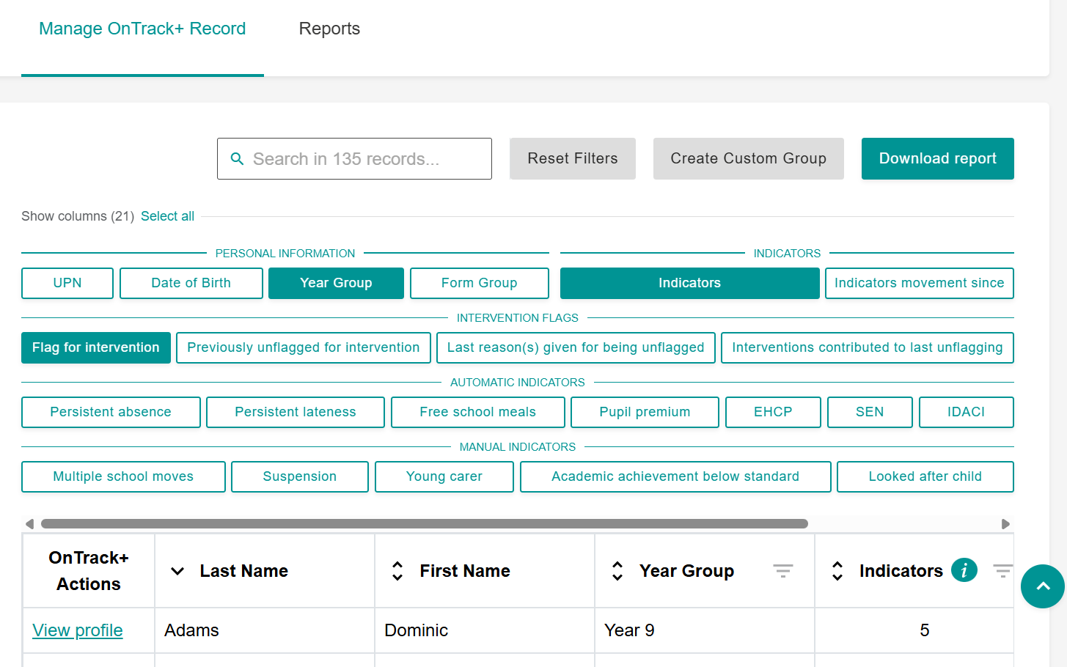
OnTrack+
OnTrack+ will allow schools to identify, prioritise and manage activities for learners who require enhanced intervention to help prevent them from becoming NEET.
The objective of the tool is to provide the basis for early intervention from KS3 against disengagements and ultimately NEET outcomes.
The identification process works by using:
  Automatic indicators - Generated from the learner data shared with Compass+ from your MIS (e.g., FSM, pupil premium). These produce a statistically valid prediction.
  Manual indicators - Optional and must be entered and managed by the school (e.g., multiple school moves, young carer).
Users can illustrate the group through reporting and export functions, manage interventions at the group or individual level, and track the effectiveness of interventions with young people by reassessing their OnTrack+ outputs and FSQ use.
Notes:
Refresh attendees on the availability of the system: How it is accessed via Compass + - school has the potential to enlarge the user list to draw pastoral and SEND teams into contributing to OnTrack+.
and
Principles of use – data is automatically transferred into the Compass + product for auto indicators - no effort is required by CLs at all, data processing and sharing is covering in the preexisting terms and conditions for Compass + use. Schools are encouraged to reflect on their current practice in some of the support documents we have provided with OnTrack+ but no additional processing or sharing requirements exist (unless student level OnTrack+ data is eventually being shared onto post 16 providers).
Refresh on the launch – the product launched in February. Since then over 1000 schools have explored it and 200 have started to use it. Oxon figures for both are . 10 schools have explored and two school have used the feature.
Quick demo – to cover:
Accessing the feature
Explain it is simply a list of all students that a user can then sort, filter and process
Can sort and filter on basic items but also on the indicators of risk. The automatic indicators will all be presented by ticks on the student where they are activated, manual indicators do require effort from the school – to move through the list and manually tick them as required. Key point the statistical analysis from the pilots which allowed us to choose the indicators showed that a valid prediction of NEET risk is produced even if only the automatic indicators are used.
Also cover the way in which a pupil can be marked for intervention – highlighting that this is where professional opinion and non data circumstance comes into play – examples a student with high level of risk and multiple indicators active may not be selected for further intervention because opinion is that there is no further support required at this stage. Equally a pupil with low or no risk showing through data but still be highlighted for intervention because the school knows something that hasn’t yet filtered through into data – e.g. a bereavement.
Next move into student profile and the areas for additional comments on OnTrack+ record – highlighting the opportunity for this to be used to overview and summarise additional information that could then be (with pupil permission) shared with next learning provider (currently would have to be via printing or PDF).
Lastly quickly show the reporting (noting it is dummy data) but highlighting how the system can be used to illustrate a schools risk situation and provide reports that could be added to SLT or Governor reporting.

Slide 6

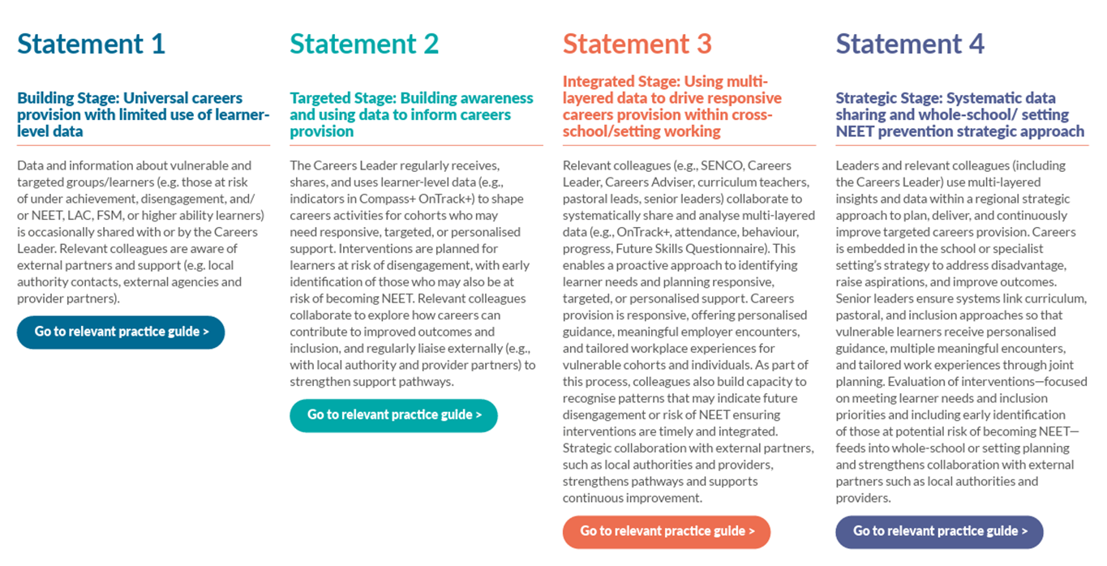
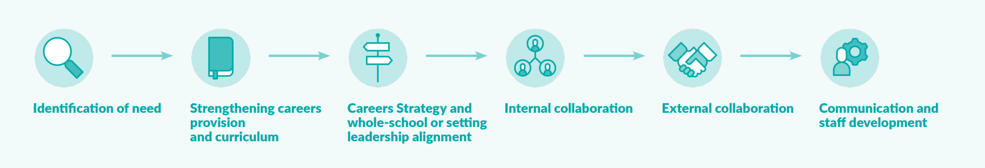
Careers Impact System: Maturity Model
Notes:
5.2 – Meaningful encounters with employers
Planning activity draws on learner needs assessment and evaluation information to support equitable access and to determine the focus, timing and format of encounters, including for under-served groups.
5.3 – Meaningful experiences of the workplace
Arrangements for meaningful workplace experiences are formalized within whole-setting systems, with agreed approaches for planning, sequencing and access that draw on learner participation information, needs assessment and evaluation activity. These arrangements support consistency and equity of access over time, including for learners from under-served groups.
6.2 – Meaningful approach to personal guidance
Personal guidance is systematically embedded within whole-setting arrangements for careers, inclusion, engagement and transition planning, including NEET prevention.

Slide 7
Demo
Notes:
Refresh attendees on the availability of the system: How it is accessed via Compass + - school has the potential to enlarge the user list to draw pastoral and SEND teams into contributing to OnTrack+.
and
Principles of use – data is automatically transferred into the Compass + product for auto indicators - no effort is required by CLs at all, data processing and sharing is covering in the preexisting terms and conditions for Compass + use. Schools are encouraged to reflect on their current practice in some of the support documents we have provided with OnTrack+ but no additional processing or sharing requirements exist (unless student level OnTrack+ data is eventually being shared onto post 16 providers).
Refresh on the launch – the product launched in February. Since then over 1000 schools have explored it and 200 have started to use it. Oxon figures for both are . 10 schools have explored and two school have used the feature.
Quick demo – to cover:
Accessing the feature
Explain it is simply a list of all students that a user can then sort, filter and process
Can sort and filter on basic items but also on the indicators of risk. The automatic indicators will all be presented by ticks on the student where they are activated, manual indicators do require effort from the school – to move through the list and manually tick them as required. Key point the statistical analysis from the pilots which allowed us to choose the indicators showed that a valid prediction of NEET risk is produced even if only the automatic indicators are used.
Also cover the way in which a pupil can be marked for intervention – highlighting that this is where professional opinion and non data circumstance comes into play – examples a student with high level of risk and multiple indicators active may not be selected for further intervention because opinion is that there is no further support required at this stage. Equally a pupil with low or no risk showing through data but still be highlighted for intervention because the school knows something that hasn’t yet filtered through into data – e.g. a bereavement.
Next move into student profile and the areas for additional comments on OnTrack+ record – highlighting the opportunity for this to be used to overview and summarise additional information that could then be (with pupil permission) shared with next learning provider (currently would have to be via printing or PDF).
Lastly quickly show the reporting (noting it is dummy data) but highlighting how the system can be used to illustrate a schools risk situation and provide reports that could be added to SLT or Governor reporting.

Slide 8
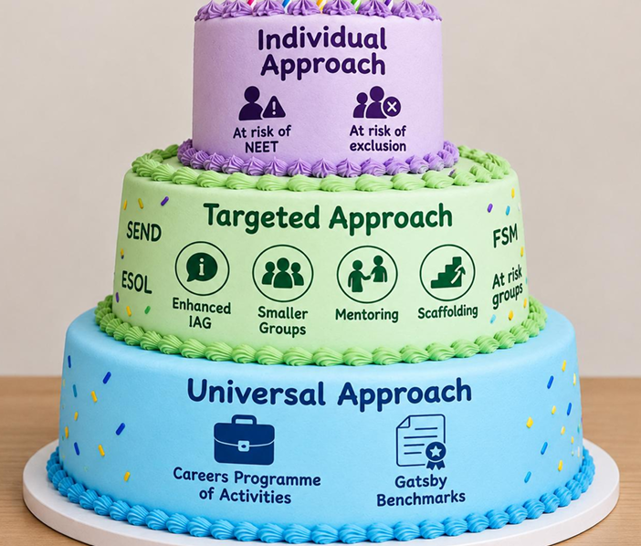
Activity
Look at your example activity that is part of a school’s ‘Universal offer’
Review students flagged on OnTrack+ as at risk
Discuss:
How could a school use this data to amend their current offer?
What adaptations could they make to target support for this group?

Slide 9
Universal Careers Offer: Annual Whole-School
Careers Fair
St Mary’s School holds an annual ‘Careers Fair’ for all students in Years 7 – 13. Year groups visit the stallholders for roughly 30 - 40 minutes each throughout the day, to meet local employers, training providers and FE Colleges.
Offer a ‘Careers Carousel’ of taster activities instead (fewer providers, better engagement)
Staff support with scaffolding conversations with providers
Targeted preparation session prior to event
Complete FSQ with target students to identify interests and support them with speaking to employers matched
Additional ‘breakout’ interactive workshop or speed networking for targeted students
Follow up visit to a College course of interest

Slide 10
Universal Careers Offer: Apprenticeship Assembly
for KS3
Hillfield School is holding an assembly for KS3 students, introducing apprenticeships. A local apprenticeship provider has been asked to come and deliver a 15-minute presentation to share: an introduction to apprenticeships; the apprenticeships they offer; where an apprenticeship can lead.
Provider stays to speak with students in a small group post-assembly
Apprentice or alumni mentoring offer for target students - relatable
Follow-up personal guidance interview with target students

Slide 11
Universal Careers Offer: Year 10 Work Experience
Week
Richardson School holds its Work Experience Week as a block for all students in Year 10, during the last week of June. The placement runs across 5 full days. Students are typically responsible for sourcing their placement, but will receive additional support from school staff if required.
Priority placements of these students first
Confidence and/or employability workshops prior to placement
Preparation sessions prior to placement
Complete FSQ with target students to identify interests and match employers
Flexibility with ‘block’ approach – could this be one day a week over multiple weeks?
Pre-placement visit / meet the employer (incl. virtual)

Slide 12
Follow up reading
CEC Case Studies
Milburn Review (due Autumn 2026)

Slide 13

Next Steps Pledge
Log into Compass+ and spend time exploring OnTrack+
Read OnTrack+ guidance materials
Talk to your SLT about OnTrack+
Identify under-served groups on OnTrack+ and consider how to target support
Consider how OnTrack+ could support whole-school development priorities
Partner with a contact from today’s session and use it as an opportunity to share learning
Speak to your Careers Consultant about using OnTrack+

Slide 14
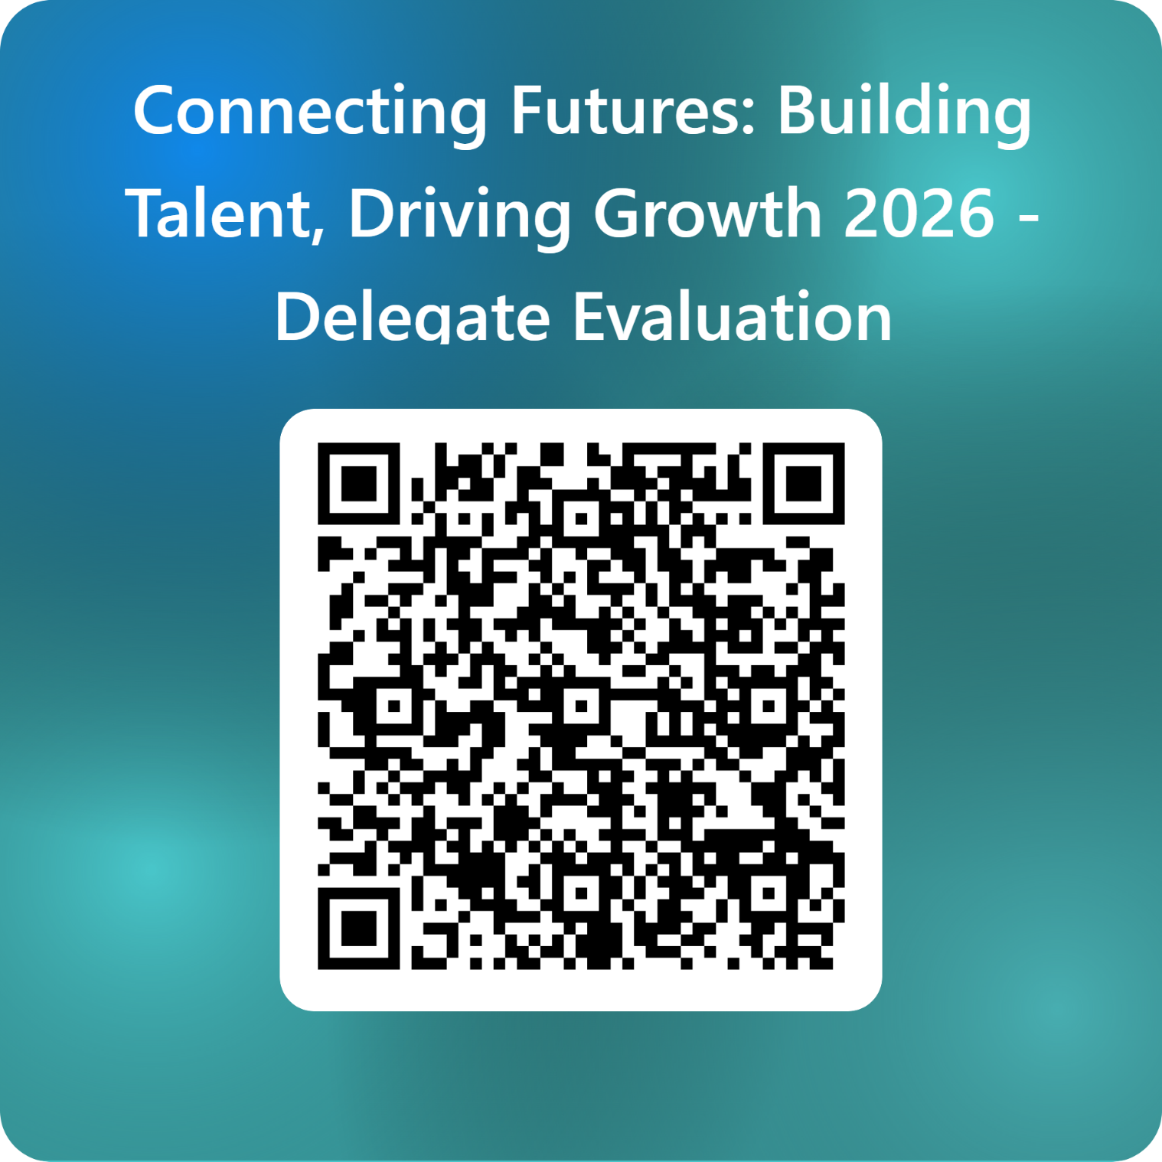
SMCH Conference Evaluation
Thank you for attending our Conference
Connecting Futures: Building Talent, Driving Growth 2026 - Delegate Evaluation – Fill in form

