Slide 1
Gatsby Benchmark 4:
Embedding Careers in the Curriculum

Slide 2
Careers Impact Maturity Model
Theme 4
Linking curriculum learning to careers
4.2 Staff highlighting the relevance of their subjects and making links from the curriculum
4.4 Learner skills development

Slide 3


GATSBY BENCHMARK 4
How we made careers
part of subject teaching
The Duston School approach to 4.2 and 4.4
IN THE NEXT 10 MINUTES I WILL SHOW YOU
1 The problem we had
2 The four actions I took
3 What changed and what we still need to improve
Diane Fisher | Careers Leader, The Duston School
Notes:
0:00–0:55
Good afternoon. I am going to make this very practical. I will explain the problem we had at The Duston School, the four actions I took, and what changed.
My section focuses on two parts of Benchmark 4: 4.2, helping teachers show why their subject matters beyond school, and 4.4, helping pupils recognise the skills they develop through subjects. At the end, you will use the same process to plan one next step for your setting.

Slide 4

What 4.2 and 4.4 mean in practice
4.2 Subject relevance
4.4 Learner skills
Teachers make clear:
• where subject knowledge is used
• the routes their subject can lead to
• why the learning matters in work and life
At Duston, pupils already know our character language:
• Respect • Resilience • Aspiration
4.4 connects that familiar language to subject skills and future pathways.
Example: a maths teacher links data analysis to engineering, finance and healthcare.
Example: a pupil identifies problem solving, shows where they used it and reflects on improvement.
The key question: can pupils explain the link, or are adults only recording that it happened?
Notes:
0:55–2:10
First, this is what the two areas mean in plain language.
For 4.2, subject teachers help pupils understand where their knowledge is used, which routes the subject can lead to and why the learning matters beyond the classroom.
For 4.4, we are not inventing another vocabulary. As a School of Character, pupils already understand Respect, Resilience and Aspiration. We use that familiar language, name the specific skill being practised and connect it to future learning and work.
The difference is important. A scheme might mention a career, but stronger practice means the pupil understands the connection.

Slide 5
Our starting problem
Careers activity existed, but I could not show that every pupil experienced it consistently in every subject.
100%
15%
83%
98%
Sept 2025
previous framework
Dec 2025
honest new assessment
March 2026
first action cycle
July 2026
latest evaluation
The missing evidence mattered
NO AUDIT = NO EVIDENCE
Initially missing: Sociology, Psychology, Health & Social Care, Music and Media
Even where good work was happening, I could not count what had not been evidenced. The gap lowered the whole-school judgement and made coverage impossible to assure.
Notes:
1:40–2:45
Our reported score had been 100% under the previous framework. When I applied the updated criteria honestly, it fell to 15%. It then rose to 83% in March and 98% in July.
A major issue was missing evidence. Sociology, Psychology, Health and Social Care, Music and Media had not submitted audits at the point of the March report. That did not necessarily mean careers was absent, but under an evidence-only approach I could not count it. No audit meant no evidence, and that affected the whole-school Benchmark score.
That changed the conversation. I was not asking for paperwork for its own sake. I needed every subject to show what pupils experienced, where the gaps were and what needed to improve.

Slide 6
What I actually did
1
Set an evidence-only
baseline
Audits mapped schemes, year groups, careers links, routes and skills
2
Made gaps visible
without blame
Missing audits, 50% explicit rows and uneven coverage became a shared problem
3
Gave tailored feedback
and practical actions
Every subject saw its strengths, gaps, examples and precise next steps
4
Created shared ownership
and follow-up
Leaders compared practice, exchanged ideas and reviewed changes together
AI helped me analyse patterns and structure feedback at scale. I checked every finding against the evidence and applied professional judgement.
Notes:
2:45–4:00
I used four linked actions. First, I created an evidence-only baseline. Second, I made the gaps visible without blaming subjects for work that had not yet been captured. Third, I gave tailored feedback: what was strong, what was missing, examples they could use and precise next steps.
The fourth action was crucial. I moved this from a Careers Leader task into shared curriculum ownership. Subject leaders began comparing practice, giving one another guidance and sharing practical tips. Follow-up happened through curriculum discussions, CPD, schemes and review rather than through a one-off audit.
I did not ask staff to create separate careers lessons. I helped them recognise and strengthen what belonged naturally in their subject.

Slide 7
What subject leaders actually received
Example: Modern Foreign Languages
INDIVIDUAL FEEDBACK
BEFORE
AFTER CURRICULUM REVIEW
WHY DEVELOPING
• links regular but repetitive
• limited breadth of careers explored
• progression pathways not clear
• transferable skills not explicit
WHAT NEEDED TO IMPROVE
1 Broaden careers beyond obvious routes
2 Embed skills language explicitly
3 Show GCSE → A Level → careers
4 Add real employer and workplace contexts
60%
95%
Changes evidenced
• industry and labour-market information added
• wider range of careers linked to languages
• progression routes made explicit
• Languages Week and employer encounters used
• international opportunities and work experience highlighted
By July, the same feedback structure was used consistently: judgement → strengths → development → recommendations → review.
Notes:
4:20–5:50
This is evidence from the feedback I actually gave subject leaders. I did not send a percentage on its own. I explained why the subject had received its judgement and what needed to change.
For Modern Foreign Languages, the March report said that links were regular but repetitive, the breadth of careers was limited, progression pathways were unclear and transferable skills were not explicit. The actions were equally specific: broaden careers beyond the obvious routes, embed skills language, show the pathway from GCSE to A Level and careers, and introduce real employer or workplace contexts.
After curriculum review, the subject score rose from 60% to 95%. The evidence included industry information, a wider range of careers, explicit progression routes, employer encounters, Languages Week and international opportunities.
By July, I was using the same repeatable structure in individual reports: an overall judgement, summary, strengths, areas for development, recommendations and an overall evaluation. That made the feedback actionable and made follow-up possible.

Slide 8
From no audit to Strong: Sociology & Psychology
MARCH 2026
JULY 2026
No submitted audit
No evidence available
Excluded from analysis
STRONG
→
Evidence now showed
• careers planned across Years 10–13
• links embedded in knowledge organisers, homework and discussion
• broad professional pathways
• transferable skills linked explicitly to employment and HE
• clear GCSE → A Level → future progression
The work may already exist—but the audit, feedback and professional dialogue make it visible, coherent and improvable.
Notes:
5:15–6:25
Sociology and Psychology show why this process mattered. In March, they had not submitted an audit. That meant I had no evidence to include, so they were excluded from the analysis and the whole-school picture remained incomplete.
By July, their completed audit was judged Strong. It showed careers deliberately planned across Years 10 to 13, embedded in knowledge organisers, homework, curriculum content and discussion. It identified a broad range of pathways, made transferable skills explicit and showed progression from GCSE through A Level into higher education and employment.
This is not a story about creating activity from nothing. It is a story about making practice visible, coherent and capable of being reviewed and improved.

Slide 9
The turning point: subject leaders owned the work
“Careers is already happening. We need to make it consistent, visible and understood by pupils.”
EVIDENCE
Leaders saw their own strengths, omissions and pupil gaps—not a generic whole-school message.
DIALOGUE
Subject leaders compared audits, shared examples and gave one another practical guidance and tips.
ACTION
Changes were built into schemes, knowledge organisers, homework, curriculum discussions and employer links.
FOLLOW-UP
The same structure—judgement, strengths, development and recommendations—made review possible.
My role shifted from chasing evidence to enabling curriculum leaders to solve the problem together.
Notes:
6:25–7:25
The turning point was when this stopped being work that belonged only to me. I used subject evidence rather than a generic message. Leaders could see their own strengths and gaps. They then began working together, comparing audits, sharing examples and giving one another guidance and practical tips.
The message was constructive: careers is already happening; we need to make it consistent, visible and understood. Changes were built into normal curriculum work—schemes, knowledge organisers, homework, classroom discussion and employer links.
My role shifted from chasing evidence to creating the framework, feedback and follow-up that enabled curriculum leaders to solve the problem together.

Slide 10

What pupils told us—and what happens next
Measurable progress
4.4 builds on language pupils already know
• Benchmark 4: 15% → 83% → 98%
• MFL: 60% → 95%
• Sociology/Psychology: no evidence → Strong
• subject leaders sharing practice and solutions
SCHOOL OF CHARACTER
Respect
Resilience
Aspiration
PUPIL EVIDENCE — JULY FSQ
OFSTED 2026
“At each stage, pupils gain the knowledge and skills they need to be ready for future learning.”
Know at least a little about skills employers need
Y7 77% (n=172) • Y9 82% (n=204) • Y10 85% (n=126)
However, 23–33% of valid skill-item responses in Y7–10 showed uncertainty. This confirms the need to name, practise and reflect on skills.
Familiar value → subject skill → practise it → career or pathway → pupil reflection
FSQ-informed next steps: explicit skill teaching • targeted PP/SEND support • reflection after authentic tasks • repeat FSQ and pupil voice
Notes:
7:25–8:30
The results are measurable: Benchmark 4 moved from 15% to 83% and then 98%; MFL moved from 60% to 95%; and Sociology and Psychology moved from no submitted evidence to a Strong judgement.
The July Future Skills Questionnaire adds pupil evidence. Of valid responses, 77% of Year 7, 82% of Year 9 and 85% of Year 10 pupils said they knew at least a little about the skills employers need. However, across the eight skill self-assessment items, 23 to 33% of valid Year 7 to 10 responses still showed uncertainty. The bases vary because some questionnaires were blank or incomplete.
Ofsted independently reported that pupils gain the knowledge and skills needed for future learning. The FSQ now informs four actions: explicit skill teaching through our character language; targeted support for PP and SEND pupils; reflection after authentic curriculum and employer tasks; and repeat FSQ and pupil voice to test whether understanding improves.

Slide 11
Your 10-minute task
Apply the same improvement process to one barrier in your setting. Leave with a clear starting plan.
0–2 min
Diagnose
Choose a 4.2 or 4.4 barrier and record the evidence.
WORKED EXAMPLE
Barrier
Pupils know our character values but do not connect them to subject learning or pathways.
Message
“Use the language pupils already know—and make the careers link explicit.”
First action
Name Resilience and persuasive communication in a Year 9 English speech task.
Impact evidence
Can pupils explain where they used them and why they matter?
2–4 min
Influence
Identify who needs to support the change and the message they need to hear.
4–7 min
Start small
Choose one subject, year group or team and set the first action.
7–9 min
Measure
Write what will be different for pupils and how you will know.
9–10 min
Commit
Share your first action and when you will begin.
Leave with: one evidence-based priority, the right message, a starting point and a measure of pupil impact.
Notes:
8:30–10:00
You are not being asked to copy the Duston approach. You are going to apply the same improvement process to one barrier in your own setting.
The worked example shows the expected level of detail. It identifies the barrier and evidence, the message colleagues need to hear, a small starting point in Year 9 English and the pupil evidence that would show whether it worked.
By the end, you should have one evidence-based priority, the right message for the people you need to influence, one subject or team in which to start, a first action and a measure of pupil impact. The final question is: what will be different for pupils as a result?
TIMEKEEPING DURING ACTIVITY: call 2, 4, 7 and 9 minutes. Stop at 10 minutes.

Slide 12
Creating A Culture of Careers: Quick Curriculum Wins!
Lewis Davis
Curriculum Leader for Personal Development & Careers
Sandy Secondary School

Slide 13
A Culture of Careers:
Why we do what we do!
PRS Teacher:
I got into teaching because school was my safe place when I was a teenager and I loved further education, which I did as an adult. I want to help young people have a passion for learning and asking big questions. I believe that to be taught how to think critically and know how to debate with tolerance is important in today’s world.
Geography Teacher:
I got into teaching as I was at a bit of a crossroads. I am organised and have a drive for getting thing done. I love the sense of accomplishment when I see students progressing and enjoying their learning.

Slide 14
A Culture of Careers:
Why we do what we do!
Art Teacher:
I teach to help make a difference; I like to have made a difference to at least one student’s day every day. I got into teaching more for pastoral reasons than subject related reasons but have begun to fall in love with my subject more as time goes on. Art helps us express; I love giving students that platform.
Sociology Teacher:
I believe that children are the future and no matter what, they deserve the very best chance of success at life. Education is the key to breaking the deprivation cycle and giving young people the chance to flourish and be the very best version of themselves.

Slide 15
A Culture of Careers:
Why we do what we do!
English Teacher:
I teach because I want to make a difference to young people’s lives, not just teach English. I want people to believe in themselves and have adults around them who care and can make a difference. I believe education can open doors and with the qualifications and soft skills they can pick up through school, pupils have the chance to succeed.
Social Sciences Teacher
I remember always having a love of learning. My subjects enable me to understand the world, and I want to help the next generation of young people to understand their world.

Slide 16
A Culture of Careers:
Why we do what we do!
Executive Principal / Business Teacher
I came into teaching because I have always had a genuine passion for working with young people and wanted to make a difference to their lives. What makes teaching so special is knowing that we can help to shape a young person’s future, open doors for them and improve their life chances. No two days are ever the same, and it is the motivation, energy and enthusiasm of young people that continues to inspire me. Ultimately, I want every student I teach to leave my classroom believing that they can achieve more than they thought possible, with the knowledge, confidence and ambition to take their next steps in life.
AI said:
Most people get into teaching because they want to make a positive difference in young people's lives by helping them learn, grow, and achieve their potential.

Slide 17

A Culture of Careers:
The Sandy Graduate
Equipping our young people with the skills, knowledge and attributes to be happy, healthy, safe and successful citizens of the future.

Slide 18
A Culture of Careers:
Policies & Frameworks
All teachers should link curriculum learning with careers. Subject teachers should highlight the progression routes for their subject and the relevance of the knowledge and skills developed in their subject for a wide range of career pathways.
Every year, in every subject, every pupil should have opportunities to learn how the knowledge and skills developed in that subject helps gain entry to, and be more effective workers within, a wide range of careers.
Careers should form part of the school’s ongoing staff development programme for teachers and all staff who support pupils.
Every year, from the age of 11, pupils should participate in at least one meaningful encounter with an employer.
By the age of 16, every pupil should have had at least one meaningful experience of a workplace.
By the age of 16, every pupil should have had meaningful encounters with providers of the full range of learning opportunities, including sixth forms, colleges, universities and training providers.

Slide 19
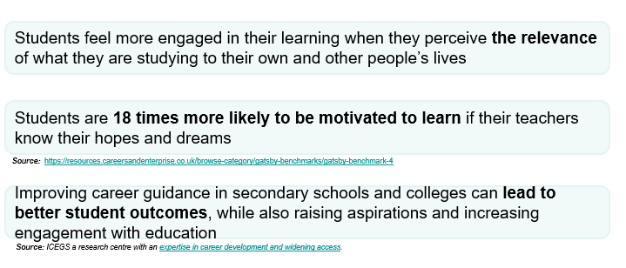
A Culture of Careers:
Careers in the Curriculum

Slide 20
A Culture of Careers:
Careers in the Curriculum
Subject teachers are highly influential – they are the second biggest influences after parents.
Students feel more engaged in their learning when they perceive the relevance of what they are studying to their own lives.
Strong essential skills such as speaking, listening and staying positive can positively influence young people’s employment prospects .
Teachers highlighting the relevance of their subject to future careers and opportunities creates social capital for young people.
Students become more aspirational, understanding that perceived barriers can be overcome and that there are various pathways to success.

Slide 21
A Culture of Careers:
Curriculum Planning
Every Department will:
  ✓ Identify careers links within each year group's curriculum.
  ✓ Map curriculum content to relevant sectors and occupations.
  ✓ Signpost progression routes related to the subject.
  ✓ Include at least one planned careers-focused “meaningful encounter” for each Key Stage across the academic year.
Every Teacher will:
  ✓ Explain why learning matters beyond examinations.
  ✓ Reference at least one example of a progression route when introducing new topics where appropriate.
  ✓ Highlight transferable skills being developed during lessons.
  ✓ Using LMI to link knowledge, skills and attributes to the needs of the workforce.

Slide 22
A Culture of Careers:
Curriculum Planning
What is a meaningful encounter?
A clear shared purpose,
Extensive two-way interaction,
Time for reflection following the encounter.
What this could look like:
All teachers should aim to have at least one speaker each year to deliver an aspect of curriculum (students find different speakers more interesting than all being delivered by one teacher).
Ask employers to run an after school or lunchtime club for a term, in their area of expertise.
Invite a former student to talk to the class about studying or working in your subject.
Put up a slide before lessons explaining types of workplace where you would use what is being taught in that lesson.
Have a school careers icon. Add to lesson slides to mention the careers aspect, the topic being covered relates to.
Link a project to careers, eg: Y10 students can write about their work experience week during an English or MFL lesson.
Play videos about people doing related jobs. Get Career Confident, Culture Shift & BBC Bitesize Careers.
Integrate stories of successful or famous people who studied that subject area.

Slide 23
A Culture of Careers:
A Focus on Skills
What is the most commonly held degree amongst all the staff working for the fraud department at HMRC?
History!

Slide 24
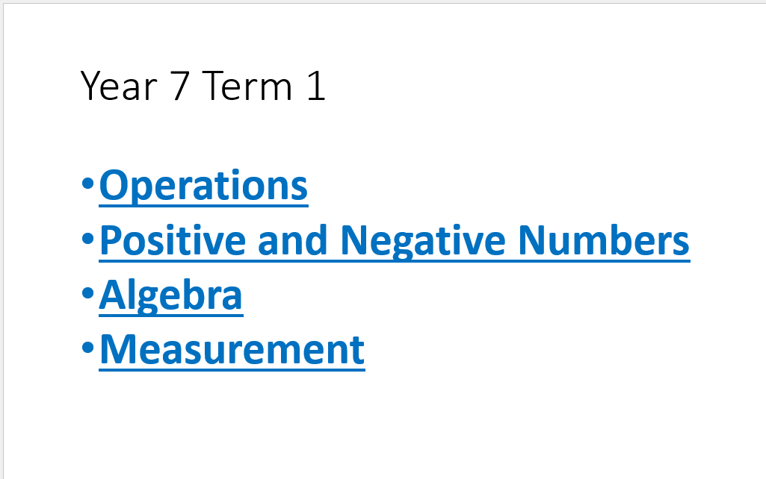
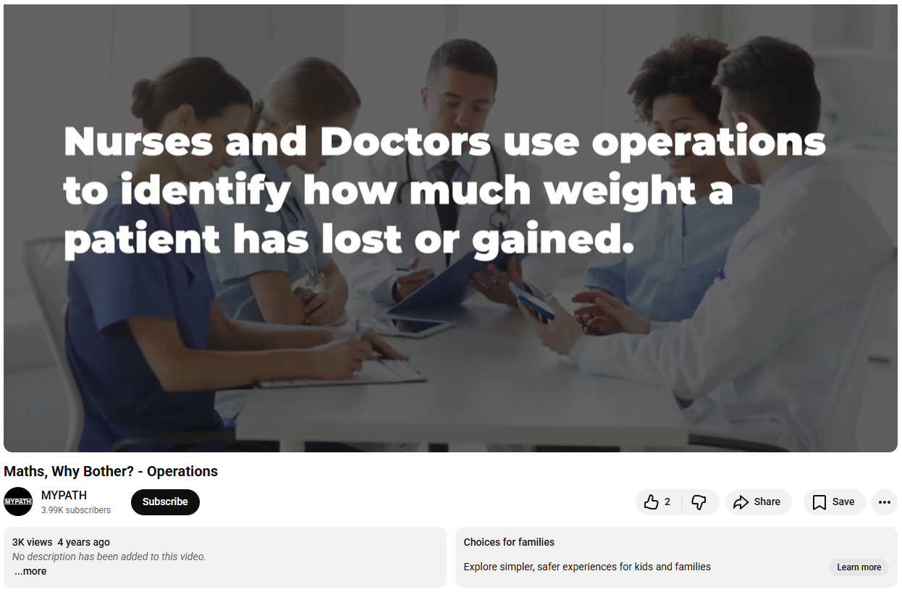
A Culture of Careers:
In Practice: Maths
“We show them to the class at the start of [a new topic], have a brief discussion immediately after about if there were any surprises in there, and then at the end of the lesson or following lessons I like to ask my classes to tell me as many of the careers that were in the video as they can collectively remember.”

Slide 25
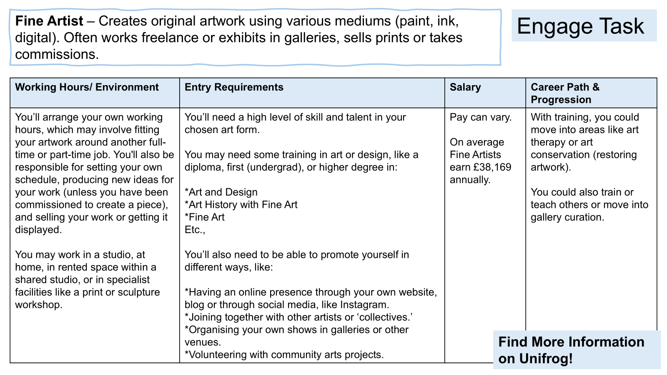
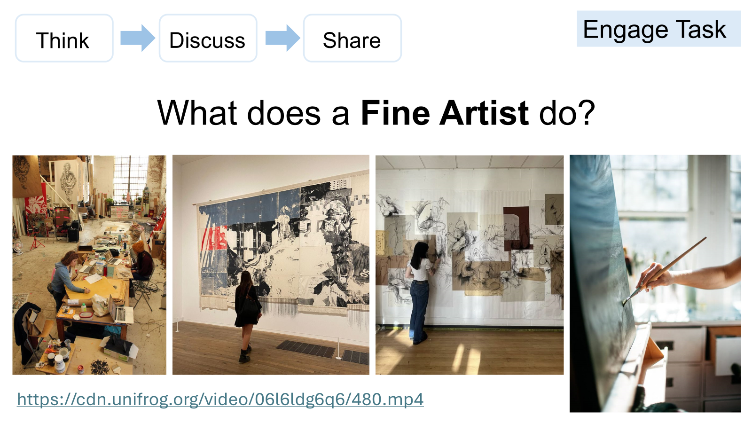
A Culture of Careers:
In Practice: Art
“I’ve embedded links to Unifrog, Labour Market Info and an understanding of roles/responsibilities into starter tasks and homework in KS3 Art.
As part of Artist Research, I get students to research key information about linked careers using the Unifrog system and feed this back into the Artist Research page for their portfolios.”

Slide 26
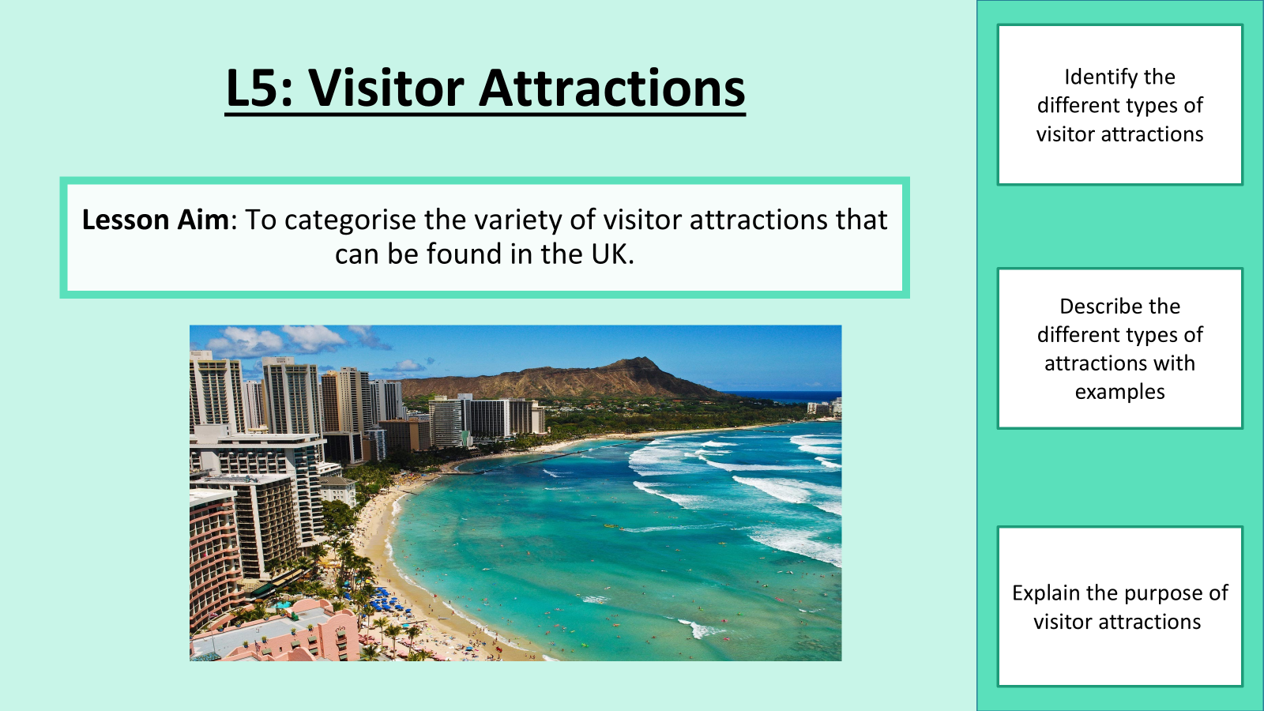

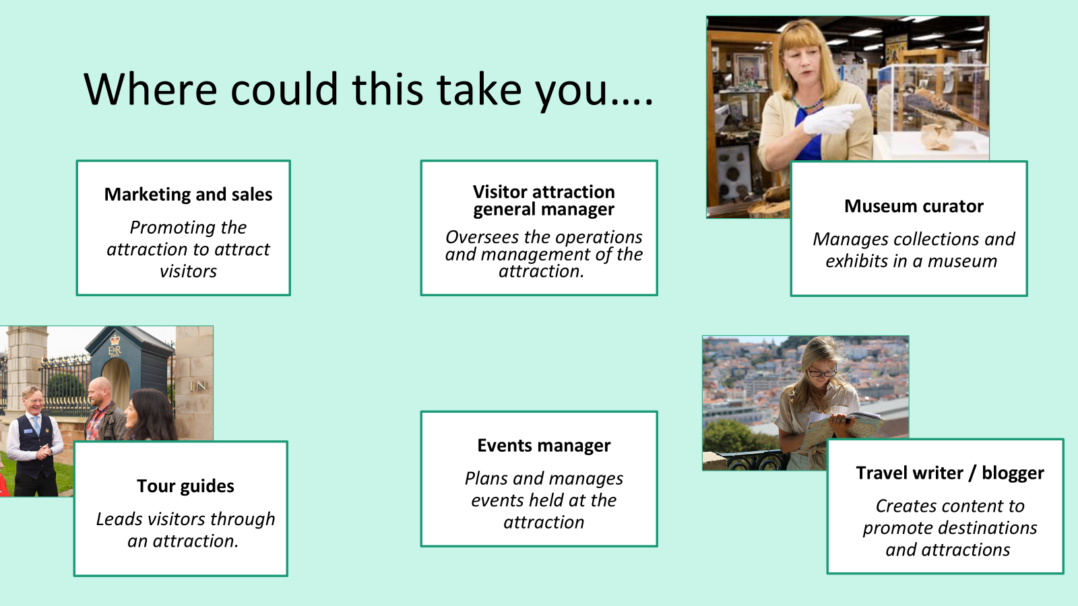
A Culture of Careers:
In Practice: Travel
“In Travel, we focus on both the actual jobs that could come from studying the topic, and the transferable skills that help students in all areas in the future. I like to be really explicit in mentioning “CAREERS” in my lessons as this also helps them in their coursework. Since doing this, students have started to recognise that Travel & Tourism is more than ‘booking holidays’.”

Slide 27
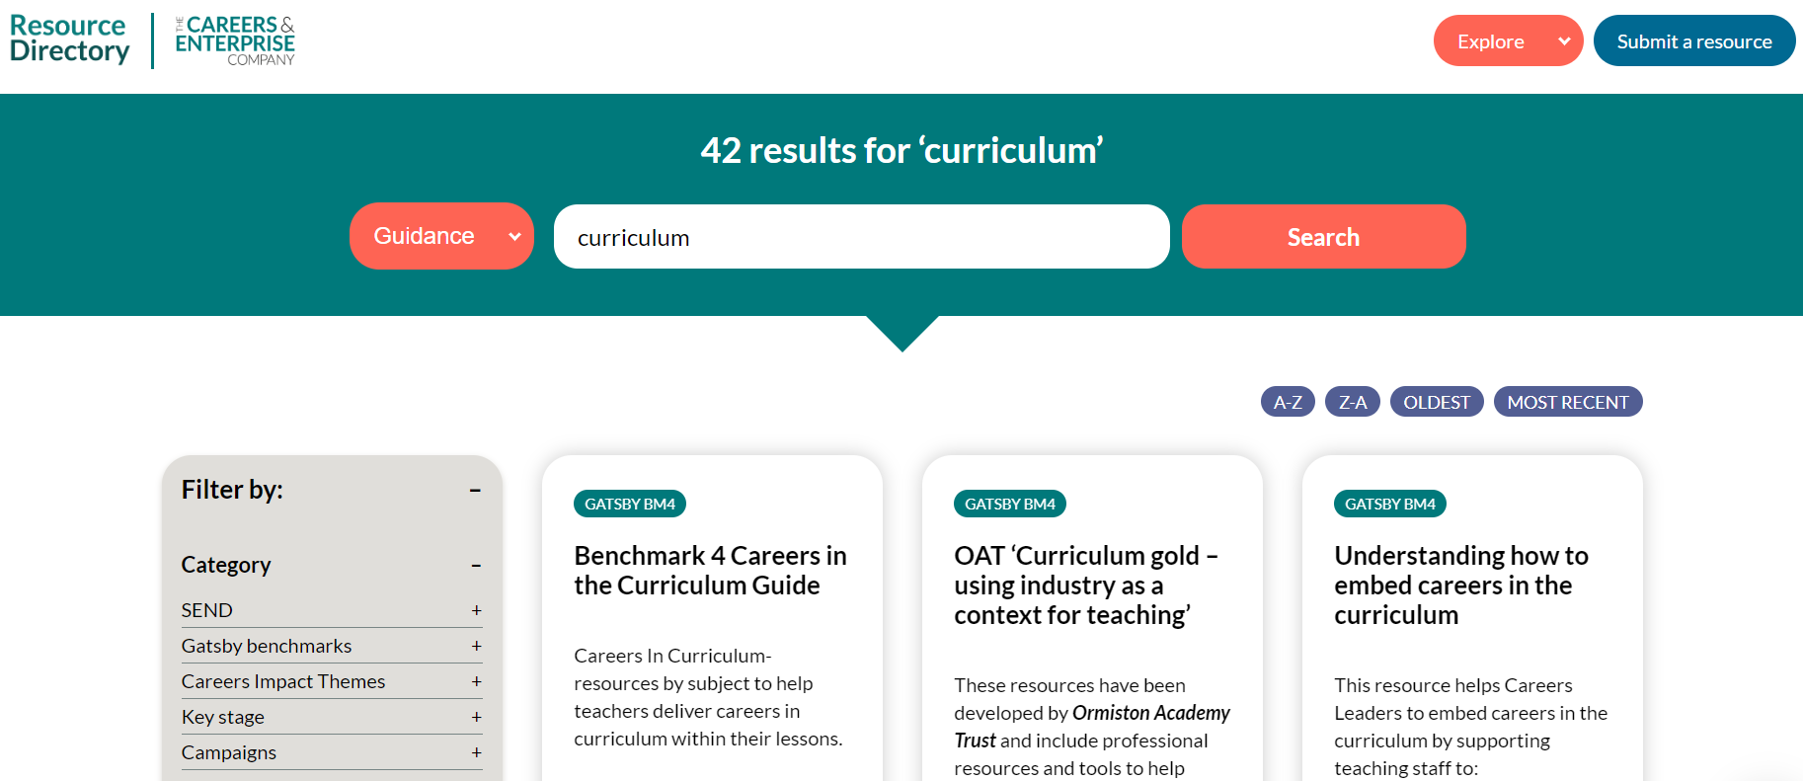
A Culture of Careers:
Practical Resources & Quick Wins
There are 42 results for “Curriculum” on the CEC Resource Directory.
This includes help guides, tools and subject specific resources.

Slide 28
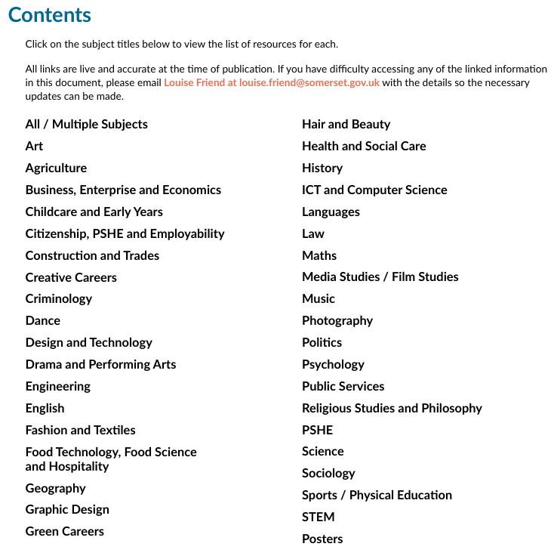
A Culture of Careers:
Practical Resources & Quick Wins
Benchmark 4: Careers in the Curriculum Guide
28 Page Resource Booklet with hints, tips, guides, sample resources, links to websites, videos, etc.
Contents Page – clickable links to every subject featuring subject specific info.

Slide 29
A Culture of Careers:
Application to your Setting
Task One:
In your groups, discuss how you could embed a culture of careers in your setting?
What do you need to do to increase buy-in?
How can you shape make careers everyone’s business?
Task Two:
What are the Quick Wins you can take away from today? Write yourself a Quick Wins check list – what are three things you can do immediately when returning to your setting tomorrow?

Slide 30
Gatsby Benchmark 4 resources
South Midlands Careers Hub Benchmark 4 - South Midlands Careers Hub

Slide 31


SMCH Conference Evaluation
Thank you for attending our Conference
Connecting Futures: Building Talent, Driving Growth 2026 - Delegate Evaluation – Fill in form

