Slide 1

Engaging Parents & Carers as Influencers
Using parent voice and practical approaches to strengthen careers engagement.
South Midlands Careers Hub Annual Conference 2026
Mike Britland:
Careers & Enterprise Company

Slide 2
Parents and carers are one of the biggest influences on young people’s career decisions.
They help shape:
Aspirations
Perceptions of different pathways
Career conversations at home
Confidence in decision-making
Why does parent/carer engagement matter?
Notes:
Speaker note: briefly introduce why parent/carer engagement matters and CIS theme 3.5 – Parent and carer understanding of all routes available to learners at key transitions.

Slide 3
Involvement vs Engagement
Parental Engagement
Discussing careers at home
Understanding different pathways
Challenging misconceptions
Supporting informed decision-making
Acting as positive careers influencers
Parental Involvement
Attending events
Opening emails
Receiving information
Following school social media

Slide 4
Which best describes your current approach?
We inform parents
We involve parents
We engage parents
Discussion question
2 minutes

Slide 5


Listening to Parent & Carer Voice
  The value of Your Child’s Future
Robust evidence for strategic planning
Strengthens impact evaluation
Core approach for capturing stakeholder voice
Actionable insight to target gaps
Embeds parental engagement as a strategic driver of improvement
Notes:
Before we jump into the demo, it’s important to note the value of Your Child’s Future and how it can enhance your practice.
<JUST READ OUT THE EXPLANATION FOR EACH ONE – DON’T READ THE TITLES IN BOLD!!>
1. Provides robust evidence to shape your careers strategy
YCF gives you reliable parent/carer insight to inform your strategic plan, this strengthens alignment with Gatsby Benchmark 1, enabling you to clearly evidence a data-led approach to SLT and governors.
2. Strengthens evaluation and ensures you meet statutory expectations
Your Child’s Future enables you to systematically capture parent/carer voice as part of your evaluation cycle —alongside learner insight via the Future Skills Questionnaire, destinations data via the learner profile and from completing your Compass evaluation. Evaluating your provision thoroughly supports meeting statutory requirements to gather and act on stakeholder feedback.
3. Acts as a core vehicle for stakeholder voice (complementing learner insight)
YCF positions parent/carer feedback as the equivalent of FSQ for learners—the questionnaire gives you a structured, repeatable way to capture this critical perspective and use it to inform, adapt and continuously improve your careers provision.
4. Delivers actionable insight to target gaps and improve outcomes
YCF highlights where parents/carers lack confidence (e.g. pathways, LMI, transitions), allowing you to design targeted interventions that improve equity, strengthen decision-making, and better support young people.
5. Embeds parental engagement as a strategic driver of improvement
Your Child’s Future moves parent engagement beyond one-off activities—embedding their voice into planning, quality assurance and improvement planning, and supporting progression against all eight Gatsby Benchmarks and movement through the Careers Impact Maturity Model.

Slide 6

Statutory guidance Careers guidance and access for education and training providers. June 2026
“The Your Child’s Future (YCF) is a feature in Compass+ that has been designed to help institutions understand parents’ and carers’ knowledge, confidence and awareness of careers. It enables institutions to strengthen parental engagement and use this insight to develop more informed, responsive and effective careers programmes that better support young people.”
Notes:
I’m not going to go into great detail with this one, but here’s a short quote from the DfE stat guidance that endorses and encourages the use of YCF in all educational settings.

Slide 7

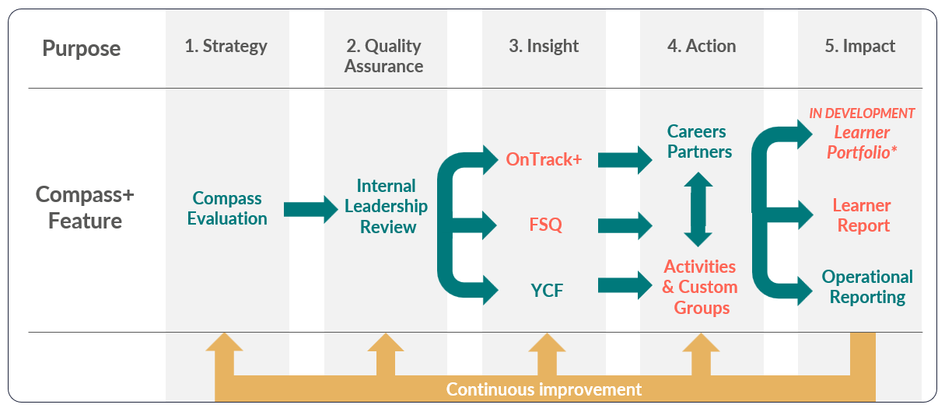
Connected and not-connected settings
Compass+ 5 steps to success
There are two versions of the framework based on a setting’s MIS connection.
Additional features for settings that have connected their MIS are displayed in orange.
*Learner Portfolio will enable learners to record their reflections of modern work experience (name subject to change)
Notes:
The Compass+ 5 Steps to Success model is a recommended framework designed to help education settings make the most effective use of Compass+ and continuously improve outcomes for young people.
It is not a prescriptive process or delivered to a fixed timeline.
Every setting has different priorities and varying levels of time, capacity and resources they can dedicate to careers.
We recommend users engage with each Compass+ feature in a way that aligns with their existing practice, careers programme and strategic priorities.
The 5 steps to success framework supports users to understand how Compass+ features work together as part of a connected approach to evaluating, managing and reporting on their careers provision.
There are two versions of the model to reflect whether a setting's Management Information System (MIS) is connected to Compass+.
Features in green are described as core features, available to all users regardless of their setting’s MIS connection.
Features highlighted in orange are only available to setting’s that have connected their MIS to Compass+.
If you’re unsure if you can connect your MIS or not, further guidance can be found in the Help Centre.
The Compass+ 5 steps to success framework underpins all CXT training going forward. The framework is embedded across Compass+ Help Centre content and will be referenced in Compass+ webinars this academic year.

Slide 8
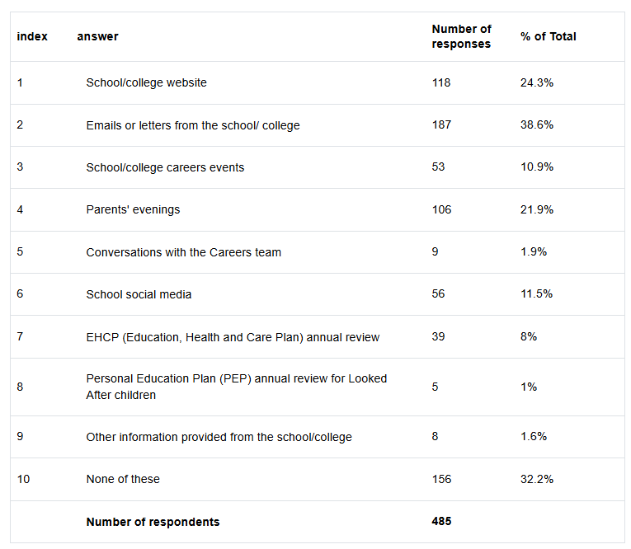
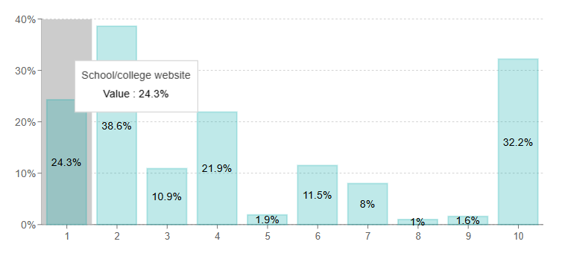
Using YCF Insights
Turning data into action
Reflection: How could parent/carer voice influence your careers planning?
Notes:
Reflection prompt: How could parent voice influence your careers planning?

Slide 9
‘Solution Stations’
Over the next 30 minutes, you will rotate around 4 discussion stations.
At each station:
Consider barriers and solutions
Review previous ideas
Add your own suggestions
Share examples that have worked
Notes:
Use flipchart paper and post-it notes

Slide 10
‘Solution Stations’
Station 1
Station 2
Improving attendance at careers events
Helping parents understand pathways
Station 3
Station 4
Engaging hard-to-reach parents
Digital communication & social media
Questions to consider:
What is the biggest barrier?
What causes it?
What works well?
What could schools try differently?

Slide 11
Consider:
Highly-engaged parents
Hard-to-reach families
SEND families
Carers/Legal Guardians
EAL families
Parents unfamiliar with the UK education system
Would the same approach work for all these groups?
Different Parent/Carer Groups
Are we reaching everyone?

Slide 12
Sharing our Ideas
1 Quick Win
Something operational schools could implement this term
1 Bigger Idea
Something strategic that could create longer-term change.

Slide 13
Commitments to take away:
1 thing I will do within the next half term…
Taking Action
1 thing I want to explore further…
The resource or support that I need is…

Slide 14
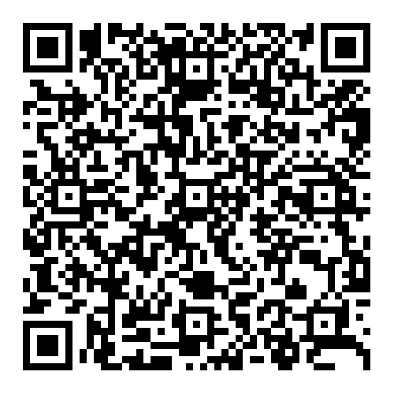



Your Child’s Future resources
CEC Parental Engagement CPD
SMCH Parent/Carer tools
Talking Futures

Slide 15
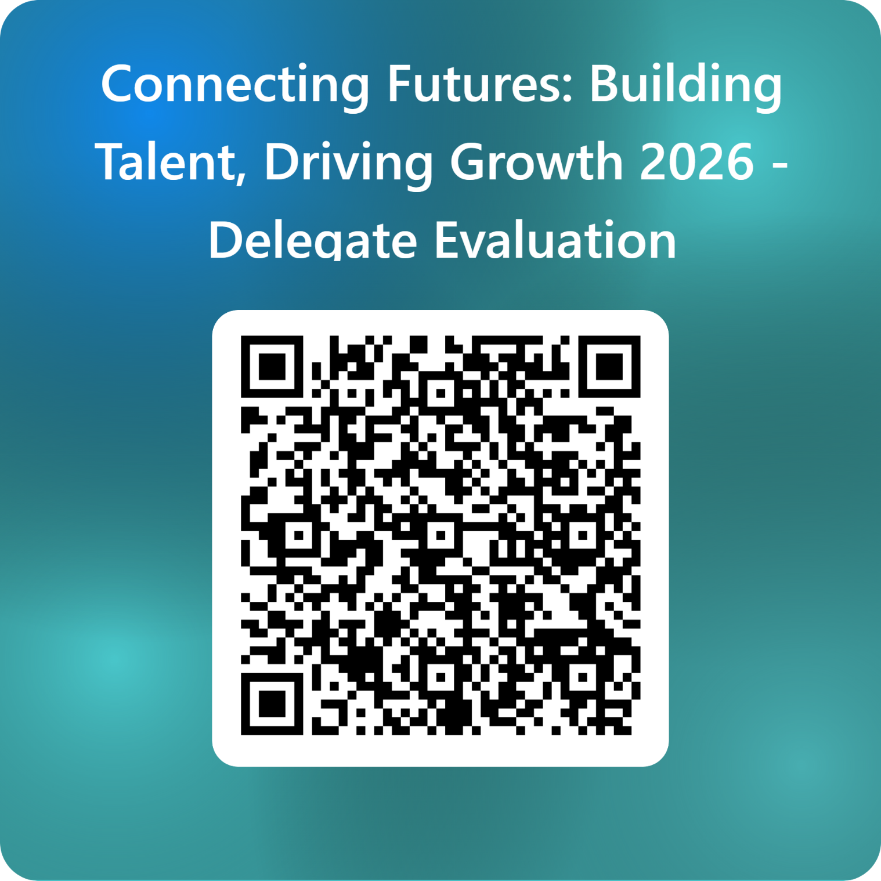
SMCH Conference Evaluation
Thank you for attending our Conference
Connecting Futures: Building Talent, Driving Growth 2026 - Delegate Evaluation – Fill in form

