Slide 1

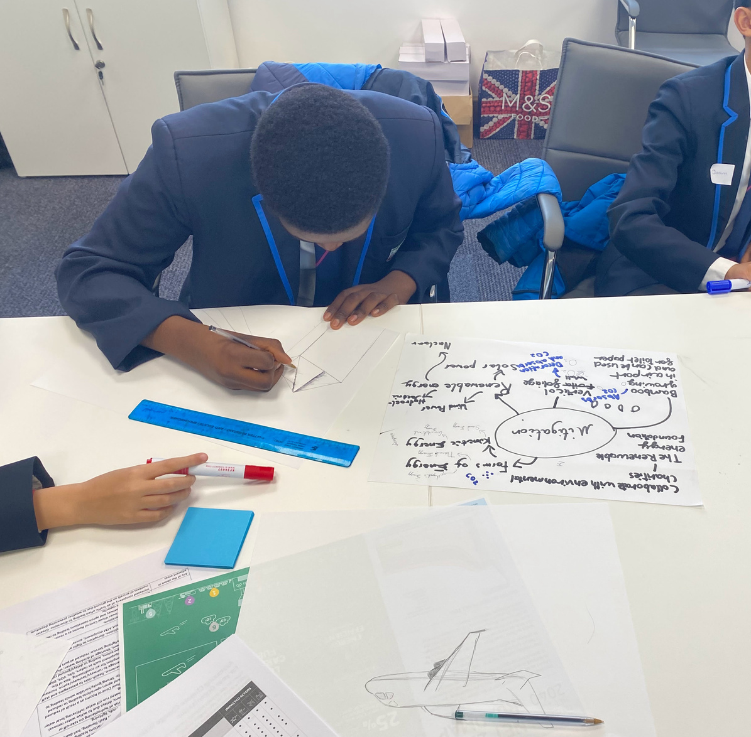

From Activities to Impact
Creating Progressive Careers Learning Journeys
South Midlands Careers Hub Conference
20 October 2026

Slide 2
Initial Thoughts?
Complete the sentence
“If learners experienced our careers programme exactly as intended, they would leave our institution able to...”

Slide 3
WHY THIS MATTERS
Beyond the Events Calendar.
Effective careers provision is not simply a calendar of activities. It is a progressive, purposeful learning journey - one that builds knowledge, confidence, and career-readiness over time. When provision is truly progressive, learners don't just attend events; they develop the skills and understanding to make informed decisions about their futures.
The question is not: What activities are we delivering?
Should be thinking: What are students learning and how does that learning progress?

Slide 4
ACTIVITY 1
Programme Health Check
Rate each statement: Red / Amber / Green
Statement
R
A
G
We have clear learning outcomes for each key stage
Activities build on previous learning
Careers in the curriculum is mapped
Employer encounters are progressive rather than one-off
Work experience forms part of a wider journey
Learners understand why they are completing activities
We use learner voice to shape provision
We use destination and FSQ data effectively
We can demonstrate progression from KS3 to KS5
Careers provision supports whole-school priorities
My strongest area: _______________________________ Greatest opportunity for development: _______________________________

Slide 5
What does progression look like?
True progression in careers learning means learners are building on what they already know, understand, and can do. It is about deepening knowledge, developing skills, and growing career readiness over time - not simply adding more events to a calendar.
Which areas in your current provision is an area of strength and where are the gaps?

Slide 6
ACTIVITY 2
Define Your Learner Outcomes.
What should learners know, understand, and be able to do? Use the sections below to map your intended learner outcomes. Think about the knowledge, understanding, and skills you want learners to have developed by the end of each stage of their careers learning journey. Does this reflect FSQ results? Evidence of Impact: What will you measure and how?
End of Year 8
Know and Understand
Skills Developed
Be Able To
End of Year 11
Know and Understand
Skills Developed
Be Able To
End of Year 13
Know and Understand
Skills Developed
Be Able To

Slide 7
EMPLOYER ENCOUNTERS
Employer Encounters Reflection.
Reflective question: What is currently missing from our progression? Consider which phases are well developed and which need strengthening. Are employer encounters sequenced deliberately, or delivered as one-off events?
Use this model to identify gaps and plan a more coherent, progressive employer engagement offer.
→
→
→
A 4-phase model for meaningful, progressive employer engagement
01
02
03
04
Introduce & Inspire
Investigate & Explore
Apply & Demonstrate
Transition & Prepare
Assemblies, career talks, and role models that spark curiosity and broaden learner awareness of the world of work.
Speed networking, workshops, and projects that deepen understanding of sectors, roles, and workplace expectations.
Mock interviews, enterprise challenges, and work simulations that build practical skills and real-world confidence.
Recruitment workshops, mentoring, and technical pathway events that support informed decisions and successful transitions.

Slide 8
WORK EXPERIENCE REFLECTION
Which of these outcomes are we actually measuring?
How do we know work experience is making a difference?
Why provide work experience? (tick all that apply)
✓
Broaden aspirations — expose learners to a wider range of careers, industries, and possibilities.
✓
Increase confidence — build self-belief and ability to navigate professional environments.
✓
Challenge stereotypes — help learners question assumptions and open doors to non-traditional pathways.
✓
Develop essential skills — strengthen communication, teamwork, problem-solving, and professional behaviours.
✓
Reduce risk of NEET — build skills, confidence, and experience that support sustained progression.
✓
Improve engagement — connect learning to real-world contexts and future opportunities.
✓
Support transition decisions — help learners make informed choices about their next steps.
✓
Other: _______________________________________________

Slide 9
EVIDENCE-BASED PROVISION.
Using Data to Drive Provision.
Source
Currently Used?
How Could It Be Used Better?
Compass+ (OnTrack+)
FSQ
Learner voice
Destination data
Attendance data
Behaviour data
SEND data
Pupil Premium data
Local labour market information
Consider: Are we collecting data to prove compliance, or using it to genuinely improve provision and outcomes for learners? Are you using On Track+, completed an ILR, FSQ?

Slide 10
PERSONAL REFLECTION
One Change, One Commitment.
You have explored what progressive careers learning journeys look like, reflected on your current provision, and considered how to use data, employer encounters, and work experience more effectively. This is the foundation of an universal offer - now think how to use tools such as OnTrack+ to meet individual learner need and differentiate your offer.
Use the prompts on this page to identify one meaningful commitment you will take back to your institution.
The one thing I will STOP doing:
The one thing I will START doing:
The one thing I will IMPROVE:

Slide 11
30-DAY ACTION PLAN
Turn your workshop insights into committed actions.
ACTION
WHY?
WHO?
BY WHEN?
Planning Guidance
01
ACTION
Be specific — name the task, not the aspiration.
02
WHY?
Link to learner outcomes or programme goals.
03
WHO? / BY WHEN?
Name a person and a realistic deadline.
04
Link this with completion of an Internal Leadership Review to ensure a whole school approach

Slide 12
Reflection
Complete the sentence
“If learners experienced our careers programme exactly as intended, they would leave our institution able to...”

Slide 13
RESOURCES:
Careers Leader Roadmap
https://resources.careersandenterprise.co.uk/resources/careers-leader-roadmap
Understanding How to Embed Progressive Employer Encounters and Work Experiences
Understanding How to Develop Progressive and Responsive Careers Provision and Careers Learning
https://resources.careersandenterprise.co.uk/understanding-how-embed-progressive-employer-encounters-and-work-experiences
https://resources.careersandenterprise.co.uk/resources/understanding-how-develop-progressive-and-responsive-careers-provision-careers-learning
Understanding How to Effectively Evaluate Your Careers Provision
Understanding How to Embed Progressive Encounters with Further and Higher Education
https://resources.careersandenterprise.co.uk/resources/understanding-how-effectively-evaluate-your-careers-provision
https://resources.careersandenterprise.co.uk/understanding-how-embed-progressive-encounters-further-and-higher-education

Slide 14

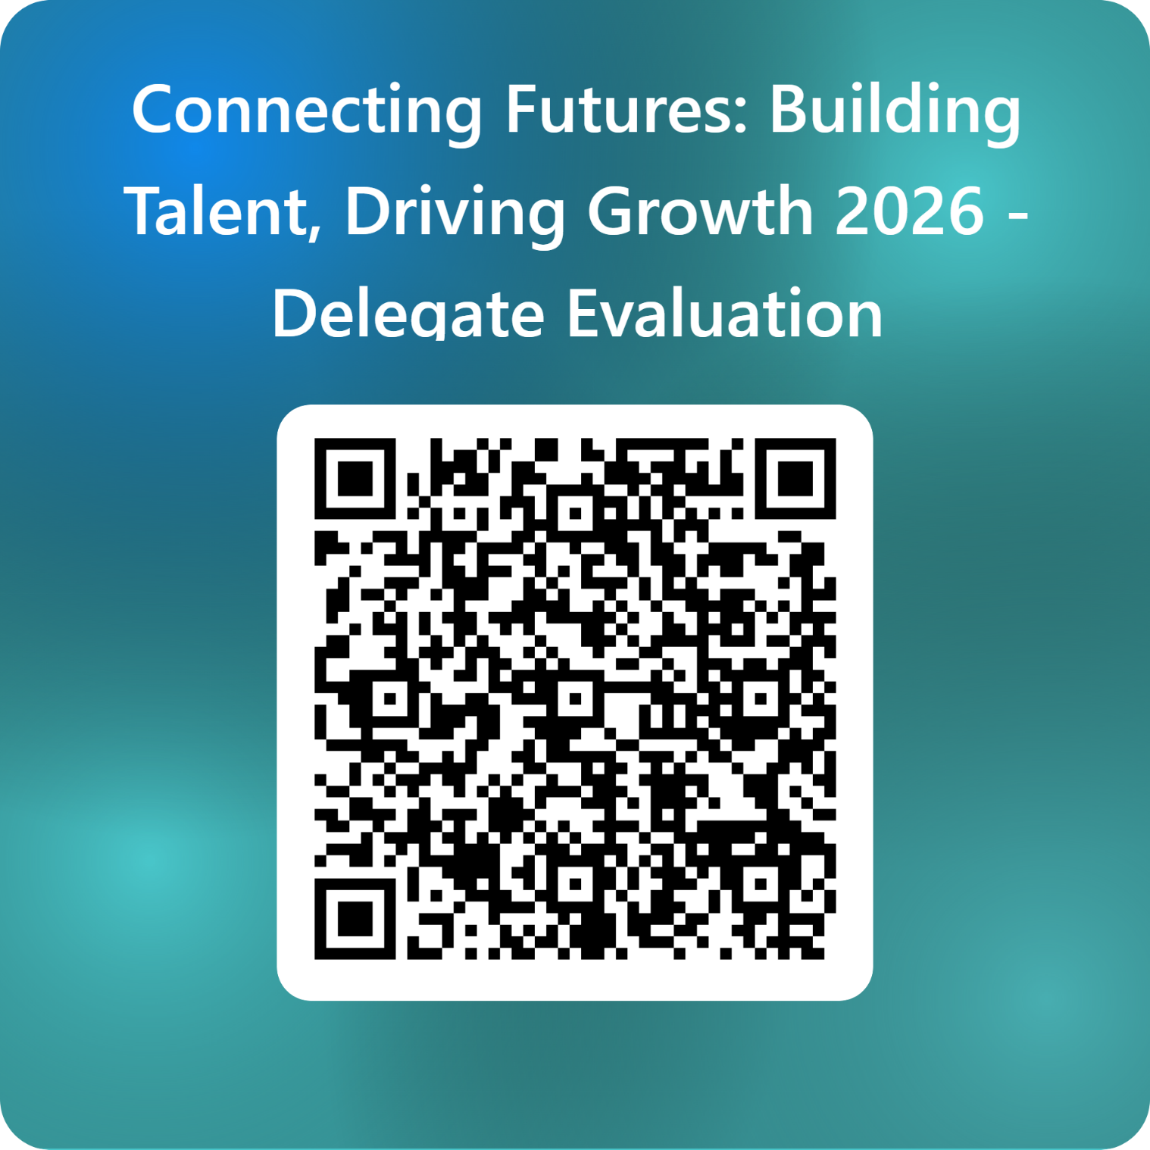
SMCH Conference Evaluation
Thank you for attending our Conference
Connecting Futures: Building Talent, Driving Growth 2026 - Delegate Evaluation – Fill in form

