Slide 1

Jargon Busting For Employers
An insight into CEC & School Language
South Midlands Careers Hub Annual Conference 2026

Slide 2
Who is this session for?
This session is designed for employers who are new to working with schools and colleges, or who are looking to strengthen their engagement with education.
What You'll Gain
We want this session to be the start of your employer engagement journey.
By the end of the session, you'll:
✅ Understand the language and structure of schools and colleges
✅ Feel more confident engaging with education professionals
✅ Gain insight into the opportunities and challenges facing education today
✅ Discover practical ways to support and inspire young people
✅ Leave with ideas, resources and next steps to help you get involved
Why It Matters
By working together, employers and educators can help young people make informed choices, develop essential skills, and prepare for successful futures.

Slide 3
🎲Lingo Bingo
Education has its own language... and sometimes it can feel like a game of bingo!
Before we dive in, let's see how many of these school and college terms you already know.
🎤 Game Rules
You may only tick a box if you can:
✅ Say what it stands for
✅ Explain what it means
Work together..... and if you are unsure, Leave it blank until later
🏆 Winning Structure
🥉 First Row = Small Prize
🥈 Two Rows = slightly bigger prize
🥇 First Full Card = Lingo Bingo Legend
Notes:
Speaker note: briefly introduce why parent/carer engagement matters and CIS theme 3.5 – Parent and carer understanding of all routes available to learners at key transitions.

Slide 4
Meaningful
What Makes Employer Engagement Meaningful?
Employer engagement is most effective when it helps young people make informed decisions about their future and connects learning to the world of work.
A Meaningful Activity:
✅ Gives students direct interaction with employers and employees
✅ Provides real insight into careers, workplaces and skills
✅ Helps young people understand pathways into different industries
✅ Challenges stereotypes and broadens aspirations
✅ Supports informed choices about education, training and careers
✅ Has a clear purpose and positive impact on students
Why It Matters
The Careers Statutory Guidance and Gatsby Benchmarks encourage schools to provide meaningful employer encounters (Benchmark 5) and experiences of workplaces (Benchmark 6), ensuring every young person benefits from engaging with employers throughout their education.

Slide 5
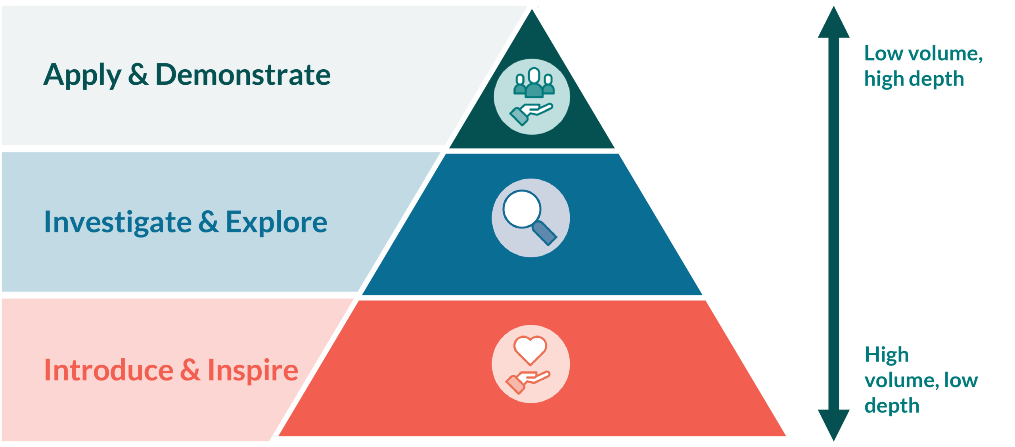
Meaningful
Modern work experience should guarantee every young person access to high-quality, multiple workplace experiences, totaling 10 days’ worth throughout secondary education.
The guarantee will help young people to make informed choices and improve career readiness and employability by offering multiple, variable and targeted experiences throughout their education journey.
Students may experience more frequent, shorter workplace experiences in years 7 – 9 before exploring their chosen career pathways in more depth in years 10 and 11.

Slide 6
Discussion Questions
⭐ You don't need to offer work experience to have a lasting impact.
A conversation, challenge, workplace tour, mentoring session, social media insight, or skills workshop could be the moment that inspires a young person's future.
💡So How Could You Make a Difference?
🚀 Think Outside the Box

Slide 7
Round Table Discussions
  What could your organisation or you offer ?
  🎤 Career Talks
  🤝 Mentoring
  🏢 Workplace Visits
  💼 Mock Interviews
  📱 Virtual Experiences
  🛠️ Skills Challenges
  🌐 Networking Events
  📅 Work Experience
  🤔 Discuss
  What are you already doing?
  What could make it even better?
  What haven't you tried yet?
  What unique skills, experiences or opportunities could your staff share with young people?
    ⭐ Challenge Question
    If every young person left your activity feeling inspired, informed, and more confident about their future, what would that look like?
    📝 Share one new idea with the group.
Notes:
Use flipchart paper and post-it notes

Slide 8
Round Table Discussions
⏱️ 15 minutes
🎓 What CPD or training would help you feel more confident engaging with schools and colleges?
📍 How would you like it delivered?
Workshops
Webinars
Networking events
Employer forums
Toolkits & guides
💡 Any other ideas? Add your suggestions and share with the group.
Notes:
Use flipchart paper and post-it notes

Slide 9


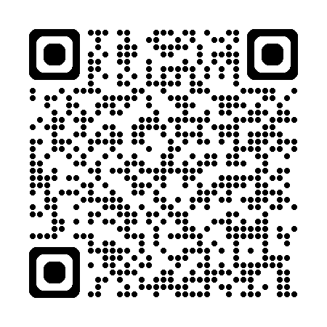
Next steps
The South Midlands Careers Hub Employer Network is a community of employers committed to helping young people prepare for the world of work. Through meaningful partnerships with schools and colleges across Bedfordshire, Milton Keynes and Northamptonshire, members share their expertise, showcase career opportunities and inspire future talent. Together, we are connecting education and industry to create brighter futures for young people and a stronger workforce for the South Midlands.

