Slide 1

Labour Market Intelligence & Pathways:
Supporting Young People Make Sense of Their Future

Slide 2

What is Labour Market Information?

Slide 3
Labour Market Information
refers to either quantitative or qualitative data found in tables, spreadsheets, maps, graphs, charts, reports, or newspaper articles that describes the state, past trends, current conditions and future projections of the world of work.
What is Labour Market Information?

Slide 4
What is Labour Market Intelligence?

Slide 5
Labour Market Intelligence
refers to subsets of information that have been subjected to further analysis. It is an interpretation of labour market information to understand workforce trends, skills demand and future economic shifts.
It can aid understanding and can also be used to make a point.
What is Labour Market Intelligence?

Slide 6
What are the Growth Sectors in our region?

Slide 7

Growth Sectors in our region:
  Advanced Manufacturing
  Aerospace and Defence
  Construction
  Creative Industries
  Digital & Technologies
  Financial and Services
  Health & Social Care
  Life Sciences
  Logistics and Distribution
  Professional and Business
  Tourism & Visitor Economy
Do young people know what these are?
Could they name careers or job roles that exist within these sectors?

Slide 8
What Pathways are available Post 16?

Slide 9
Apprenticeships
Technical e.g. T Levels
Academic e.g. A Levels
Vocational e.g BTECs
How confident are education staff, employers,
parents and careers in their understanding of these options?
GCSE’s

Slide 10
Today we’ll explore:
  The difference between Labour Market Information & Labour Market Intelligence
  Barriers and Misconceptions
  Why information alone isn’t enough
  How education and employers can bring LMI to life

Slide 11
What is the difference between Labour Market Information
and Labour Market Intelligence?

Slide 12
Information
Intelligence
How many businesses are there across the South Midlands Region?
What subjects could lead into a career within construction?
What is one of the key sectors in our area?
With new jobs being created all the time, what transferable skills do you have?
Which industry are there growing opportunites in?
What pathway(s) have you looked into if you are interested in digital?
How many people are in employment in our town?
Have you researched which local companies offer the apprenticeship you are interested in?
What is the average salary of an engineer?
What qualifications do you need to do the level 3 course at college?

Slide 13
With so much career information available...
...why may some young people struggle to use it?

Slide 14

  Information overload ≠ informed choice
Lots of sources, but may struggle to know what is relevant or reliable of how to interpret it
  Social media shapes perceptions (“can’t be what they can’t see”)
Platforms can make certain careers look glamourous, lucrative or easily obtainable, while other careers aren’t represented. Algorithms can reinforce what you already believe
  They rely on what they know (“they don’t know what they don’t know”)
Parents remain the single most influential factor in how young people shape their future careers, education, and life choices
  Difficulty connecting learning to future opportunities
Do not always see the relevance of what they are learning (in/out of the classroom) or how it translates to their future
  Misconceptions can be emotionally powerful
Even when the evidence says otherwise “University is the only route to a good career” “You’ll need a degree for that job” “Apprenticeships are cheap labour”

Slide 15
Future Skills Questionnaire:
Student’s Career Readiness

Slide 16
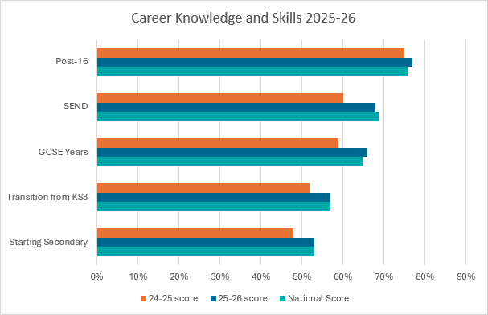
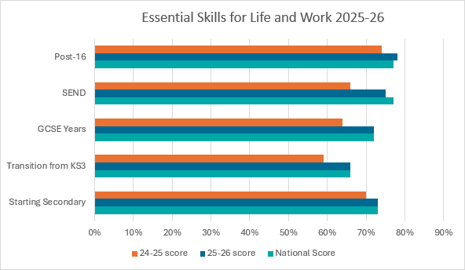
FSQ: So, What Do Young People Think ?

Slide 17
FSQ: So, What Do Young People Think ?
Top job interests at each transition point:
Transition point | 1st place | 2nd place | 3rd place
Starting Secondary | Sport and Leisure (23%) | Design (18%) | Creative roles (14%)
Transition from KS3 | Creative roles (15%) | Sport and Leisure (15%) | Design (14%)
GCSE | Creative roles (14%) | None of the above (13%) | Engineer (12%)
Post 16 | Engineer (15%) | Creative roles (15%) | Finance (14%)
Top 3 sectors/industries at each transition point:
Transition point | 1st place | 2nd place | 3rd place
Starting Secondary | Sport and Leisure (25%) | Creative (17%) | Beauty and Hair (13%)
Transition from KS3 | Sport and Leisure (17%) | Creative (14%) | Health (12%)
GCSE | Health (13%) | Sport and Leisure (13%) | Creative (13%)
Post 16 | Finance/Banking (16%) | Health (14%) | Creative (12%)

Slide 18
How can education and employers work together to improve young people’s understanding of pathways and LMI?

Slide 19
Flip Chart Activity
1) What’s working well currently?
2) What’s missing?
3) Where do young people get stuck?
4) How can employers and education staff work better together?

Slide 20

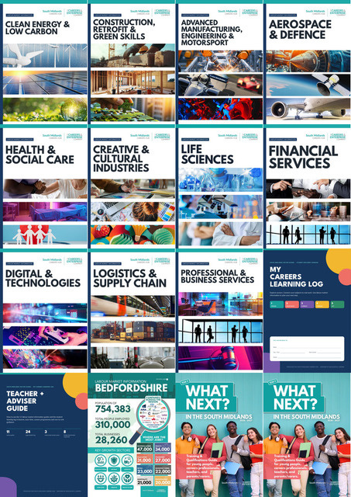





Resources
Careers & Enterprise Company -
LMI Resources
South Midlands Careers Hub - LMI Resources
Careers & Enterprise Company -
Future Skills Questionnaire
South Midlands Careers Hub - What Next Guide

