Slide 1


South Midlands Career Challenges
Co-design Workshop

Slide 2

Average BMs by Institution Type
South Midlands Career Challenges Resources
Aim: provide schools and employers with a library of ready-made, employer-informed challenges linked to priority sectors across the region.
Each challenge will:
Be based on a realistic sector/workplace problem or scenario
Help students understand careers within a specific sector
Develop employability skills and workplace behaviours
Include a summary of all resources needed to deliver the activity
Be enhanced by employer volunteers who can share industry insights and provide feedback
Our ambition is to create challenges that any school or employer can deliver, whilst ensuring they remain authentic, engaging and relevant to industry.
Notes:
Why This Matters for Employers
Whilst these challenges are designed to support young people in developing career awareness, employability skills and sector knowledge, they should also create value for employers.
Young people bring fresh perspectives, creativity and different ways of thinking. Through these challenges, employers have the opportunity to gain insights that may help shape future products, services, customer experiences and workforce strategies.
We would encourage participants to think about challenge themes that could generate genuine ideas, feedback or new perspectives for their organisation or sector.
Purpose of Today's Session
The objective of the co-design workshop is not to create a complete classroom resource at this stage.
Instead, we want to draw upon your expertise to help us answer three key questions:
1. What does great work in your sector look like?
We want students to experience authentic industry thinking and understand what employers value.
2. What challenges does your sector currently face?
The most engaging student challenges are based on genuine business problems and opportunities.
3. What skills and behaviours do young people need?
We want every challenge to develop the knowledge, skills and attributes that employers are seeking.

Slide 3

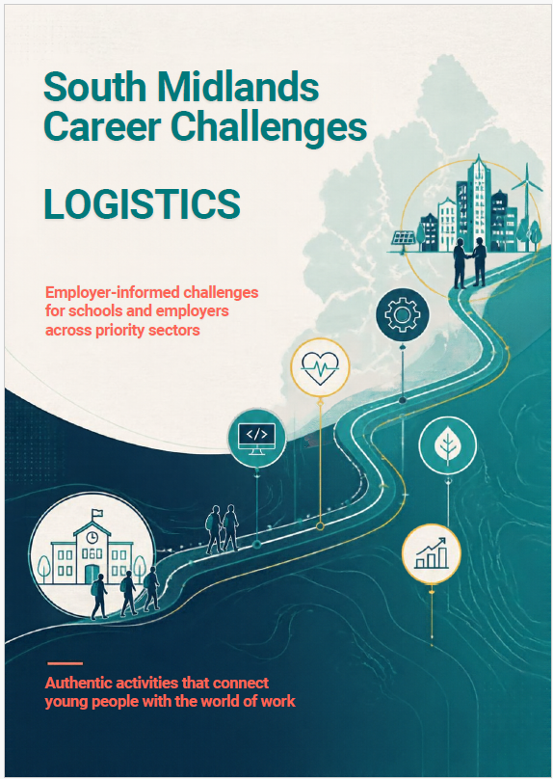
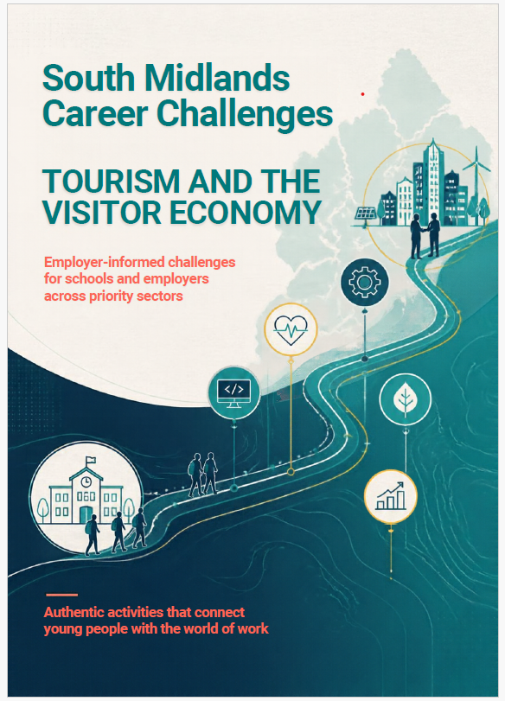
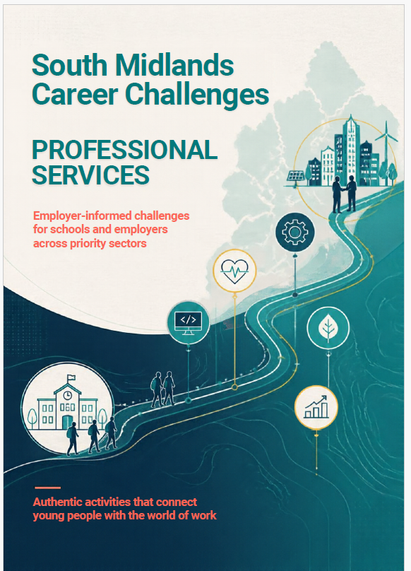
Average BMs by Institution Type

Slide 4
Average BMs by Institution Type
Gatsby Benchmark 6 – Experiences of the workplace
A meaningful experience will:
have a clear purpose, which is shared with the employer and the young person
be underpinned by learning outcomes that are appropriate to the needs of the young person
involve extensive two-way interactions between the young person and employees
include opportunities for young people to meet a range of different people from the workplace
include opportunities for young people to perform a task set by the employer or to produce a piece of work relevant to that workplace
include the employer providing feedback to the young person about their work
be followed by opportunities for the young person to reflect on the insights, knowledge or skills gained through their experience
Notes:
We are focussing on the highlighted section in this session today. An employer facing and teacher facing supporting resource will be produced to ensure all aspects of the meaningful checklist are considered and support understanding on how to use the South Midlands Career Challenges.

Slide 5
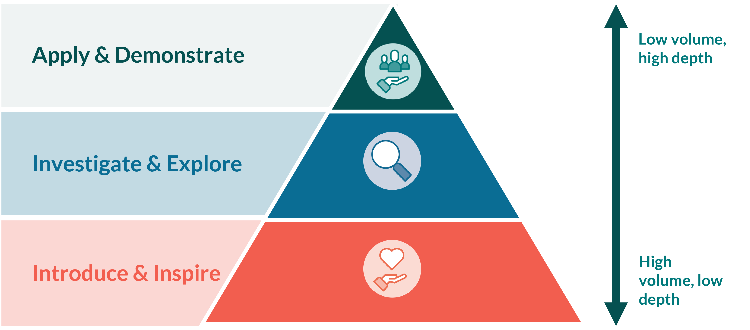
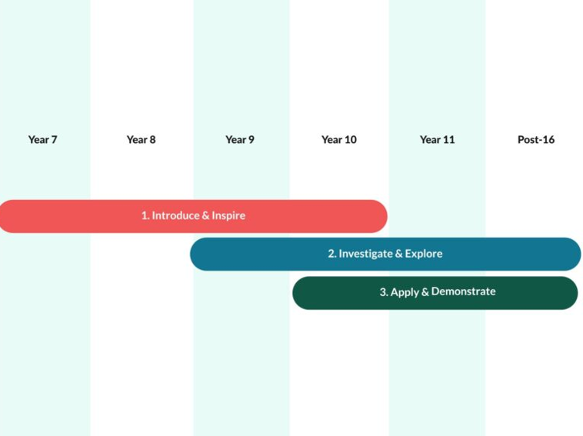
Average BMs by Institution Type
Notes:
There are two frameworks we will also be using, the first is the equalex framework

Slide 6
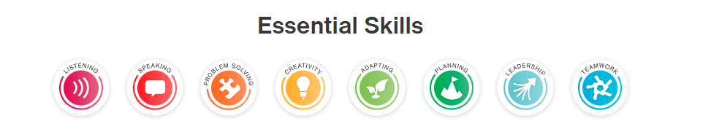
Average BMs by Institution Type
Notes:
The second is the Skillsbuilder framework

Slide 7
Average BMs by Institution Type
10 minutes
In your groups consider:
What does great work in your sector look like?
We want students to experience authentic industry thinking and understand what employers value.
2. What challenges does your sector currently face?
The most engaging student challenges are based on genuine business problems and opportunities.
3. What skills and behaviours do young people need?
We want every challenge to develop the knowledge, skills and attributes that employers are seeking.
Notes:
Feedback – is there one area of discussion that jumped out most that would be good to use as your challenge statement – which will then be developed into a task/challenge for young people to work on?

Slide 8
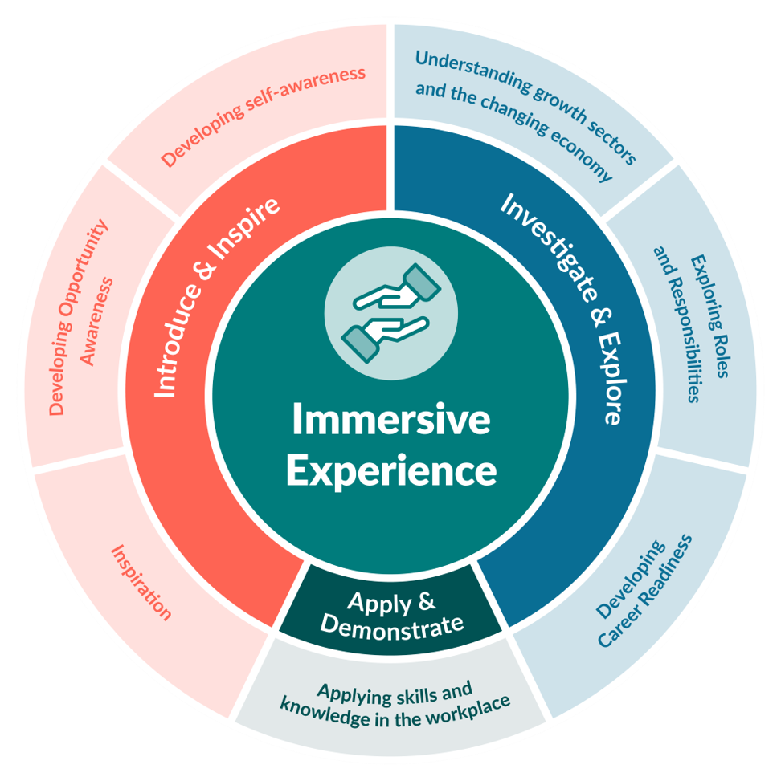
Average BMs by Institution Type
20 minutes
In your groups begin to pull together a challenge/task idea that could be delivered with young people. Using your worksheet consider:
The Scenario - A realistic problem or opportunity.
The Task – What do you want students to do? What is their role?
The Output - A presentation, proposal, campaign, design or recommendation that they can receive feedback on
Notes:
Feedback – is there one area of discussion that jumped out most that would be good to use as your challenge statement – which will then be developed into a task/challenge for young people to work on?

Slide 9
Average BMs by Institution Type
What next?
Review all workshop outputs
Develop challenge concepts
Create teacher, student and employer resources
Pilot challenges with schools and employers
Refine resources based on feedback
Launch the South Midlands Career Challenge resources
Employers and business volunteers will have opportunities to continue supporting the programme through on-going challenge development, launches, school engagement activities and feedback events through our employer network.

